Slide 1
21things4students.net
Recommended link
Updates news flash….. Dec 1, 2017

Slide 2
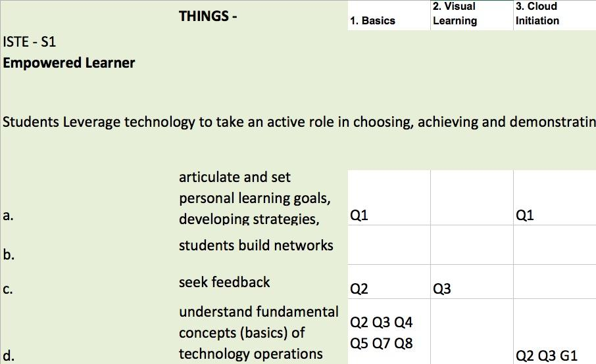
ISTE STANDARDS FOR STUDENTS Alignment
Updated Cross-walk between 21t4s Things & Quests and the 7 ISTE Standards
Location: Teacher Resources>Standards
MDE alignment coming

Slide 3
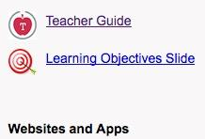
Each Main Thing Page:
Learning Objectives
[ISTE alignment]
*No longer a “Complete Student checklist” - only located on individual Quests

Slide 4
Each Quest Page:
I Can Statements
Quest Student Checklist
Quizlet for vocabulary

Slide 5
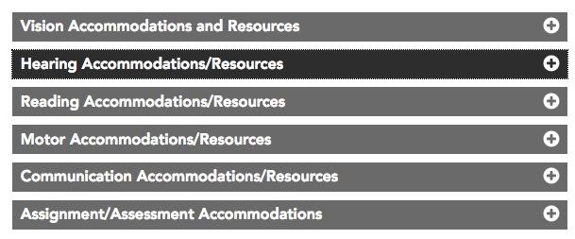
21t4s Teacher Resources: Accommodations
System | Accessibility Guide | Keyboard Shortcuts
Windows | https://goo.gl/bGeA1V | https://goo.gl/z97MKy
Mac/Apple | https://goo.gl/zjVGpp | https://goo.gl/nmBMHq
Chromebook | https://goo.gl/2xUvOC | https://goo.gl/ZglSif
iPad/iOS | https://goo.gl/8hrZX1 | NA
Android | https://goo.gl/XhNVS5 | NA
UDL Framework
*Thanks to Robin Pegg, Eaton ISD

Slide 6
Notes:
False article; 2. True news; 3. Current science thinking

Slide 7
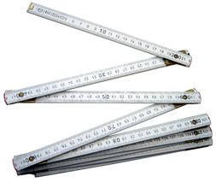
How do you know? What do you do?
Challenge: With a partner,
NAME the first thing you do to check
Name two other things you do

Slide 8
Excerpt from Melissa White 2017 MAME presentation
Notes:
Melissa White presentation slide #9 to MAME 11/2017

Slide 9
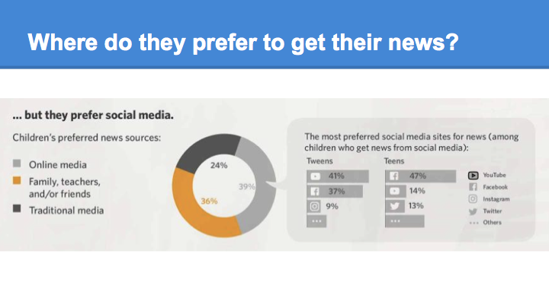
Excerpt from Melissa White 2017 MAME presentation
Notes:
Melissa White presentation slide #8 to MAME 11/2017

Slide 10
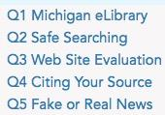
21t4s 9. Search Strategies
I can:
Tell the difference between real and fake news
Factcheck an article

Slide 11
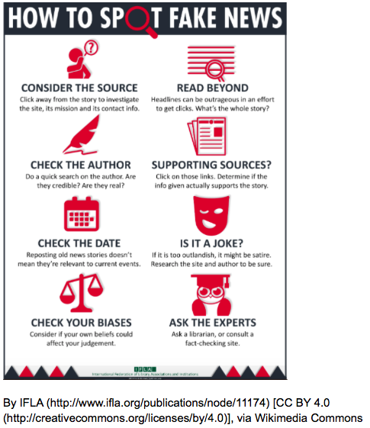
Snopes.com is a popular fact checker for rumors and stories you might hear or read on the Internet. (Be aware that Snopes may not always be accurate - the site does continuously fact check)
Sourcewatch is published by The Center for Media and Democracy (CMD) a nonprofit watchdog and advocacy organization and checks for media bias

Slide 12
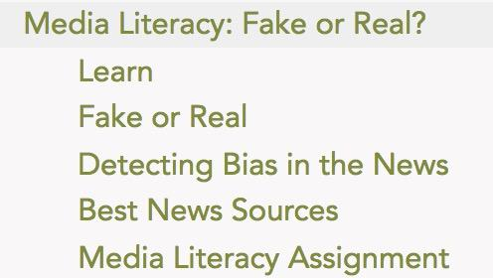
21things4teachers.net Media Literacy PD Module

Slide 13
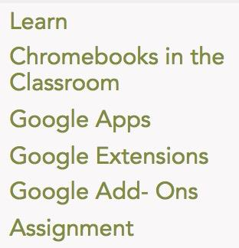
21things4teachers: New Quest in Draft - Jan 1, 2018

Slide 14
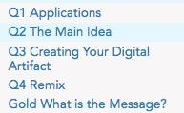
17. Creative Communications (Revised)
ISTE emphasis on:
Design Process
Choose appropriate platforms and tools
Create original works
Responsibly repurpose or remix

Slide 15
Q1: Analysis of a Digital Artifact Chart
Q2: Make a Plan and Gather Information
Assign parts
Creation Options Vocabulary
Infographic : Remix : Screencast: Split Screen : Embed :
Sequence : Podcast/Vodcast
Q3: Advantages and Disadvantages of Different Media Table
Project Proposal
Q4: Remix

Slide 16
Animation
Audio
Cartoon
Infographic
Interactive
Screencast
Slideshow
Video
Creative Communicators

Slide 17
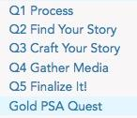
18. Digital Storytelling Redone
Personal Narrative Stories
Content Area Stories
Human Interest Stories
GOLD: PSA - Public Service Announcement

Slide 18
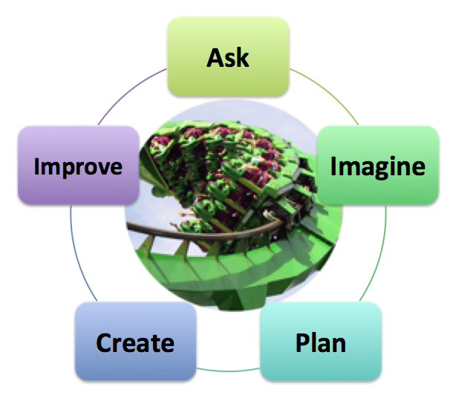
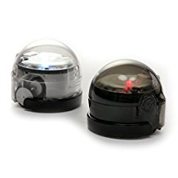
STEAM/STEM
2. VISUAL LEARNING: Q4 STEAM Roller Coaster
5-step Engineering Process
21. CODING & GAME DESIGN: Q4 Sphero, Q5 Ozobots

Slide 19
Coming soon...
LAUNCH At 2018 March MACUL Conference

Slide 20
Notes:
POSSIBLE ADDITION OF BASICS ACROSS ALL GRADES

Slide 21
K-5 Task Cards ~ Resources for integration of tech tools/resources for teachers
Overview
Teacher Prep
Steps
Vocabulary
Assessment Options
ISTE Standards
Device, Browser, App
Content area resources: ELA, Integrated Arts, Math, Science, Social Studies
Credits: Teacher creator

Slide 22
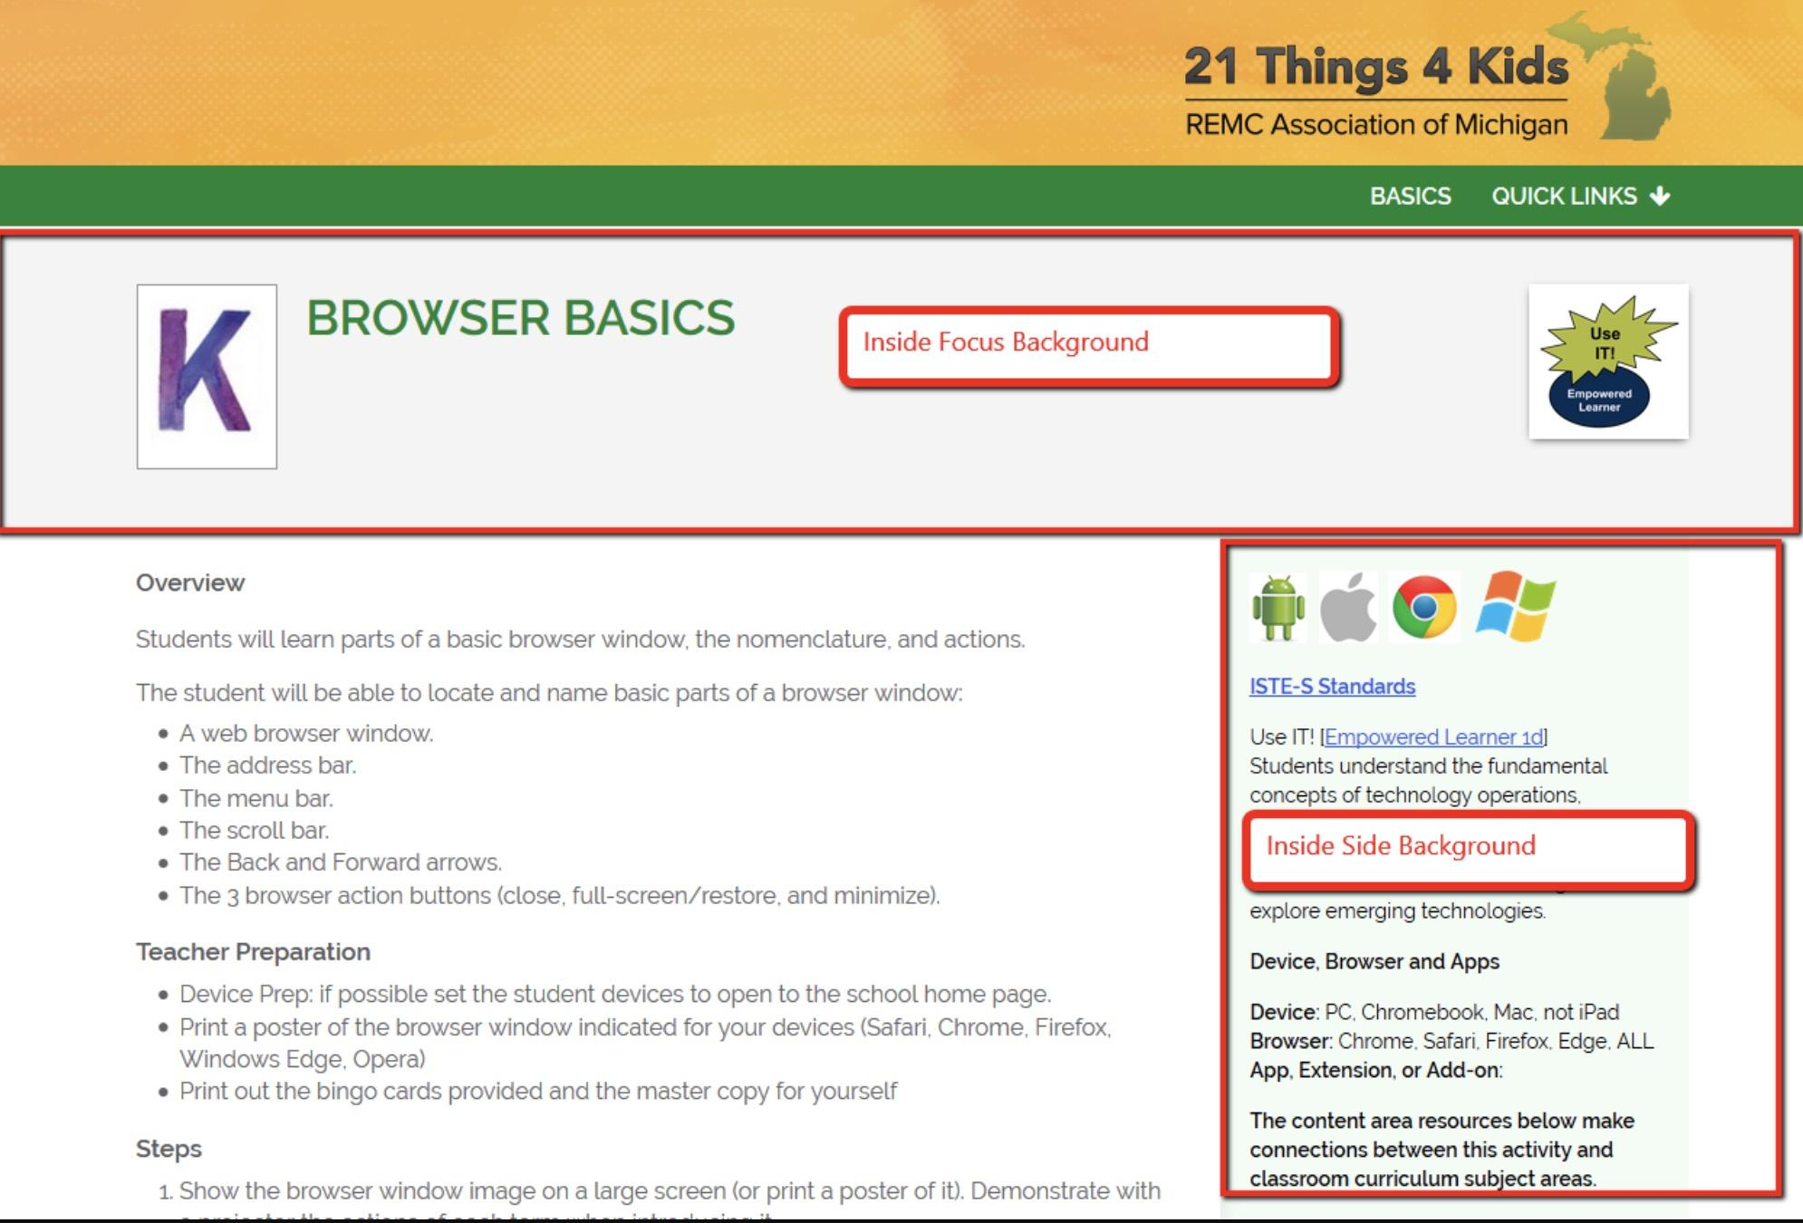
DRAFT
Sample

Slide 23
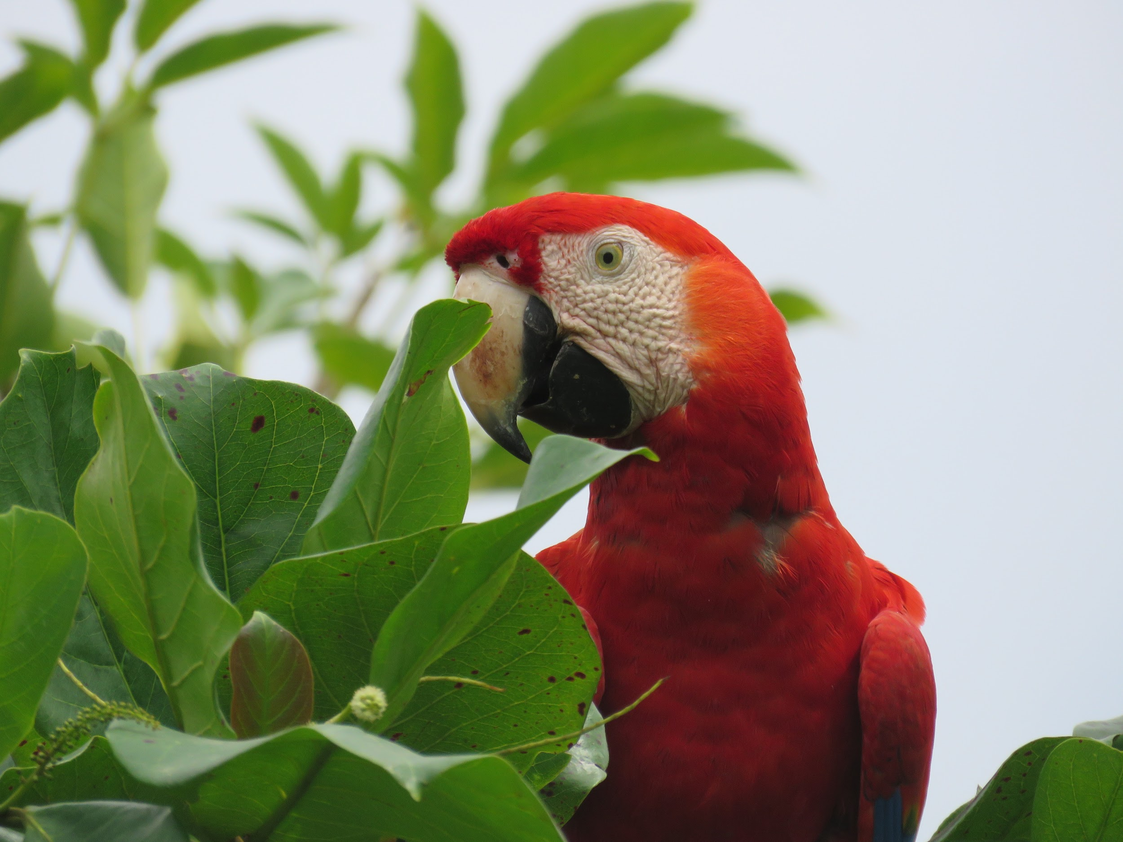
Have a Question? FEEDBACK...

