Slide 1
SIR Observation Preparation and Report Examples
Clare-Gladwin RESD
2014

Slide 2
The Instructional Core
Student
"You don't change performance without changing the instructional core…the relationship of the teacher and the student in the presence of content must be at the center of efforts to improve performance.“
Elmore et al., (2009)
The instructional task is at the center of the instructional core, i.e. the actual work students are asked to do, not what the teacher thinks they are asking students to do, or what the official curriculum says students will do. What students actually engage in defines the instructional core.
Instructional
Core
Teacher
Content
Notes:
According to Elmore, there are basically only three ways you can increase learning and performance:
1. increase the knowledge and skill of teachers
2. Increase the rigor and relevance of the content
3. alter the relationship of the student to the teacher and the content

Slide 3
Problem of Practice: First Good Instruction
Critical Component | Observation-based Focus Areas
Planning and Preparation Addresses the need to facilitate successful student learning in a focused and purposeful manner. | Determined based on patterns of observations
High Quality Instruction Addresses the need: To ensure innovative, rigorous and equitable learning opportunities for all students to reach their maximum potential. | Determined based on patterns of observations
Student Engagement Addresses a need for students to master both skills and content; to develop deeper understanding of a topic; and to personalize learning so it is relevant to one’s own life. | Determined based on patterns of observations
Formative Assessment & Feedback Addresses a need for teachers to monitor student learning and adjust instructional practice. | Determined based on patterns of observations

Slide 4
Support for Originality: Multiple Avenues of Learning
Instructional
Core
Observed Strengths
Opportunities to be Considered
Evidence of kinesthetic learning opportunities were observed beyond the P.E. class.
Significant use of small groups, partner activities, and center based learning was observed.
How well do the types of partner activities deeply align with academic learning goals for content, performance, and DOK?
How could time spent on academically aligned center tasks be maximized and transition time reduced?

Slide 5
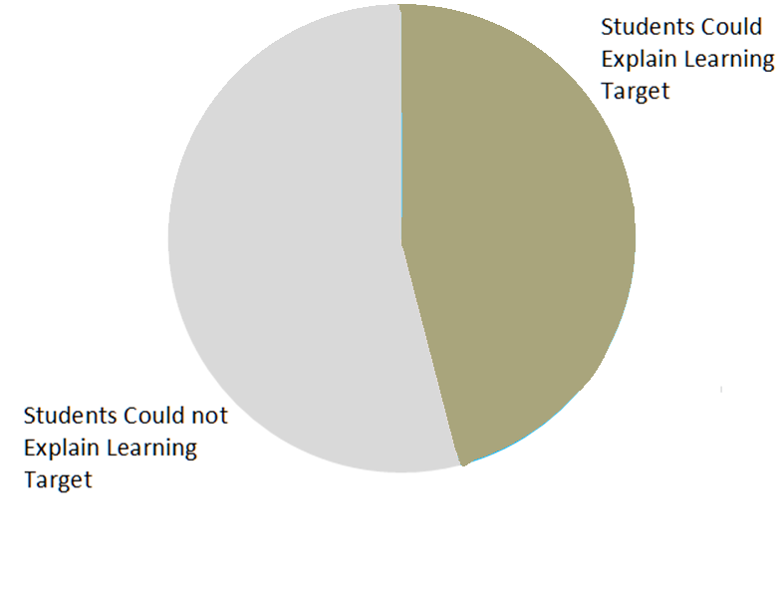
Sample Data Display: 37 students were asked to explain what they were doing and why.
Notes:
Students were only questioned if it did not interfere with the lesson. If the student was able to repeat the “I Can” statement, but could not explain or re-phrase it, they are included in the category of “could not explain”. Note the similarity between the % of students who could explain the targets and the % of classrooms where the targets were referenced in the previous slide. What is this saying to us?

Slide 6
Evidence of Explicit Instruction
The SIR team reflected on and acknowledged that explicit instruction around Foundations of Reading is essential.
The majority of observations noted a significant amount of teacher directed, explicit instruction.
Evidence of gradual release of responsibility was noted across grade levels. Implementation of gradual release was inconsistent across the building, with few observations of independent practice.
It was observed and discussed by the SIR team that staff appears to hold high expectations for student learning.
Instructional
Core

