Slide 1
Educational Talent Search
After Two Years

Slide 2
Quick Review of ETS
Works with 500 students in Grades 6-12
In 6 Local School Districts
Primary goal is to get students interested in college, make a plan for college, and explore careers.
The majority of our students are low income and first generation college students.
Some of our popular services are: campus visits, cultural experiences, college prep assistance, and fee waivers

Slide 3
2012-2013 Year in Review
530 total students
Beaverton: 102
Clare: 93
Coleman: 26
Farwell: 88
Gladwin: 129
Harrison: 92
Including 121 seniors
Hosted or participated in 20 events/workshops

Slide 4
Campus Visits

Slide 5
Cultural Experiences

Slide 6
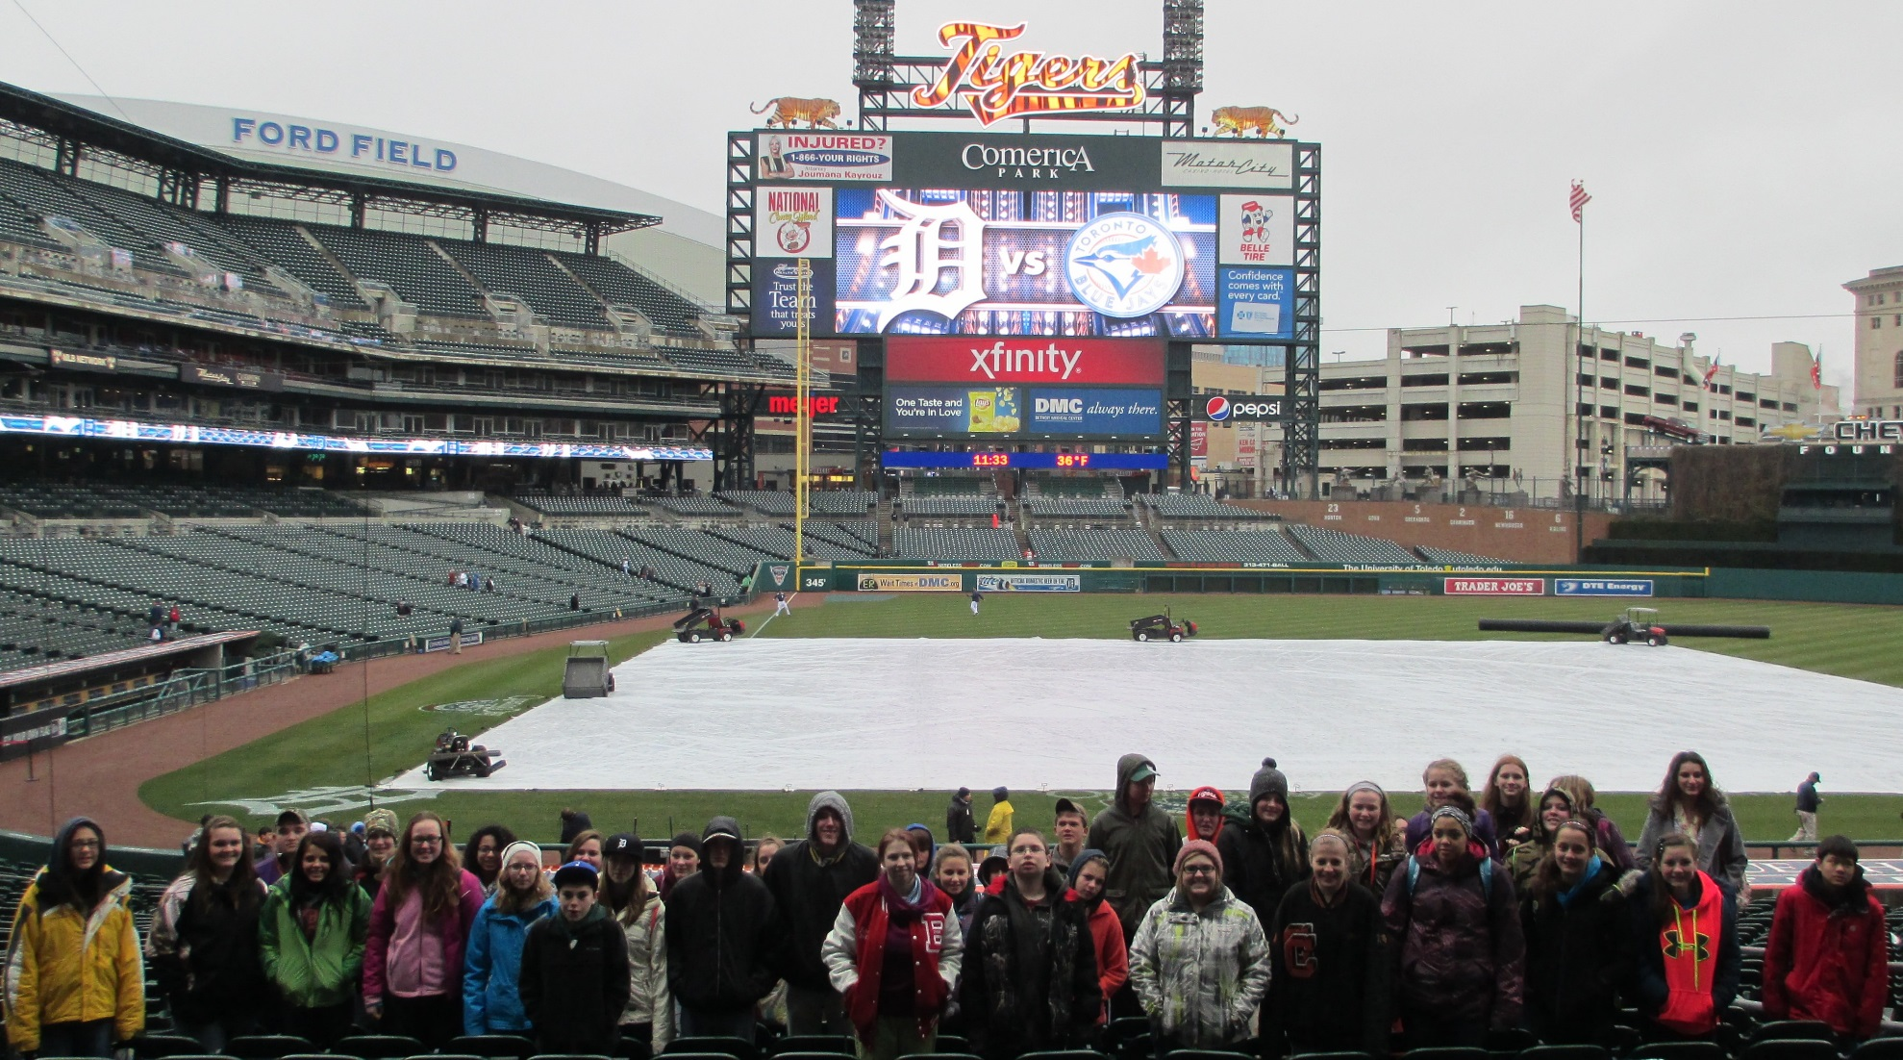
Cultural Experiences

Slide 7
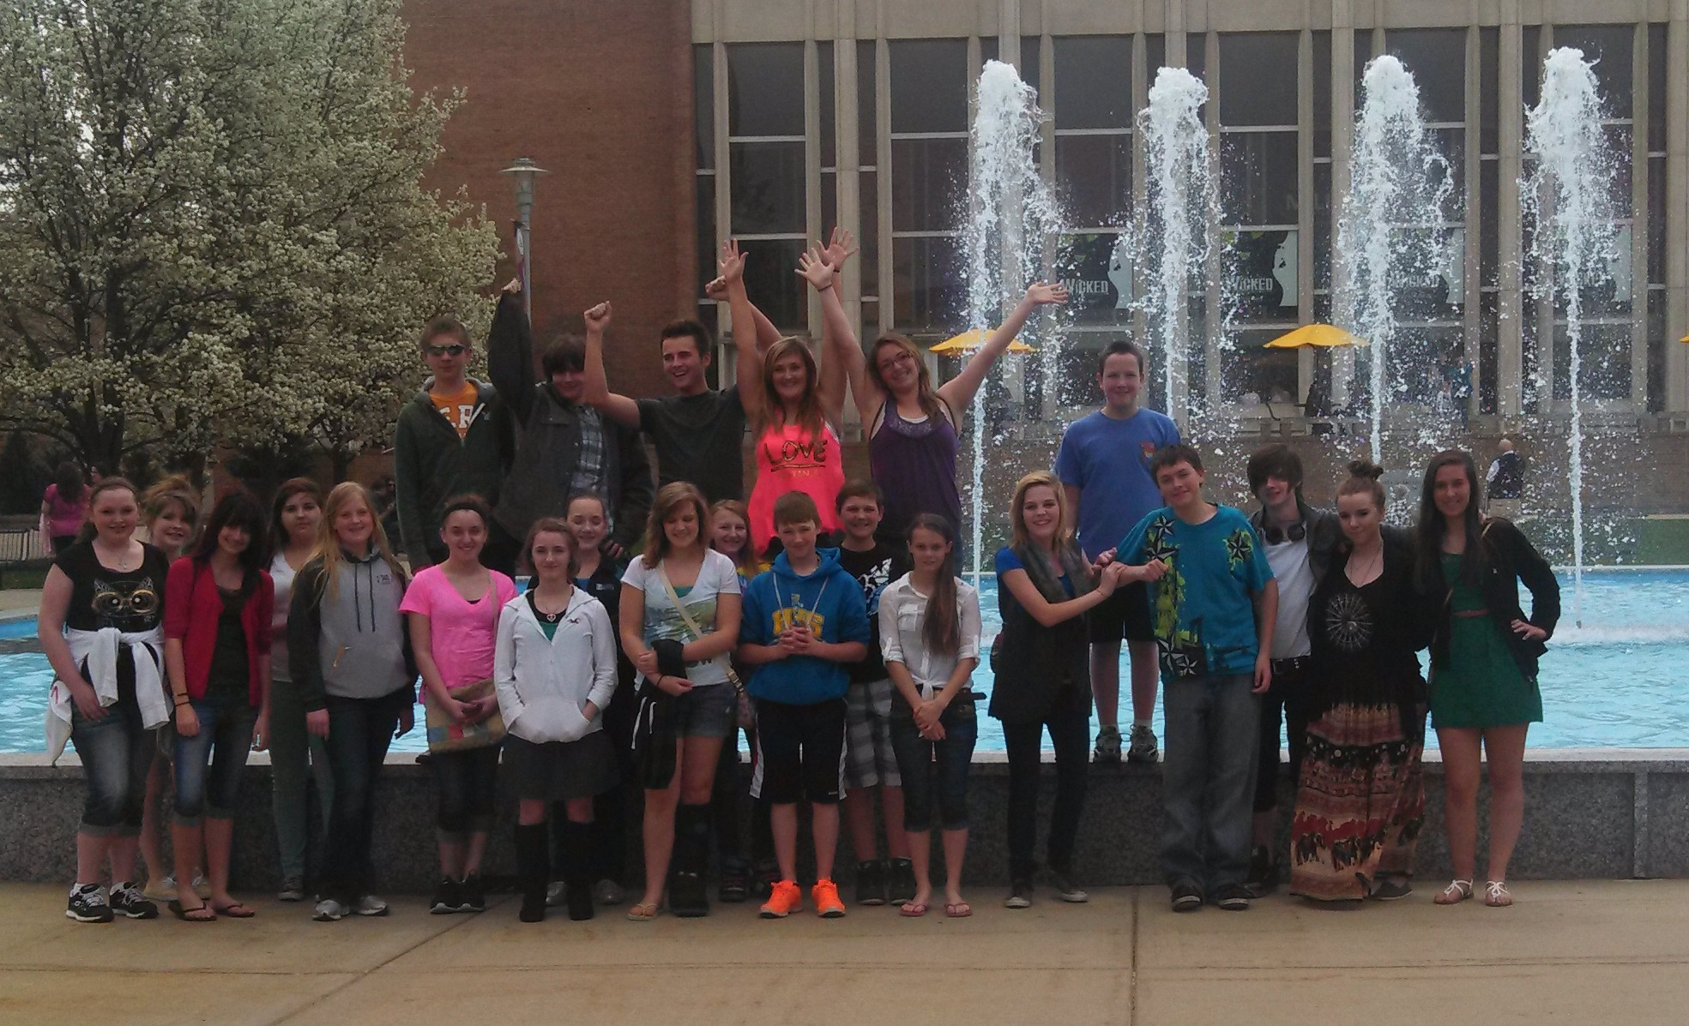
Cultural Experiences

Slide 8
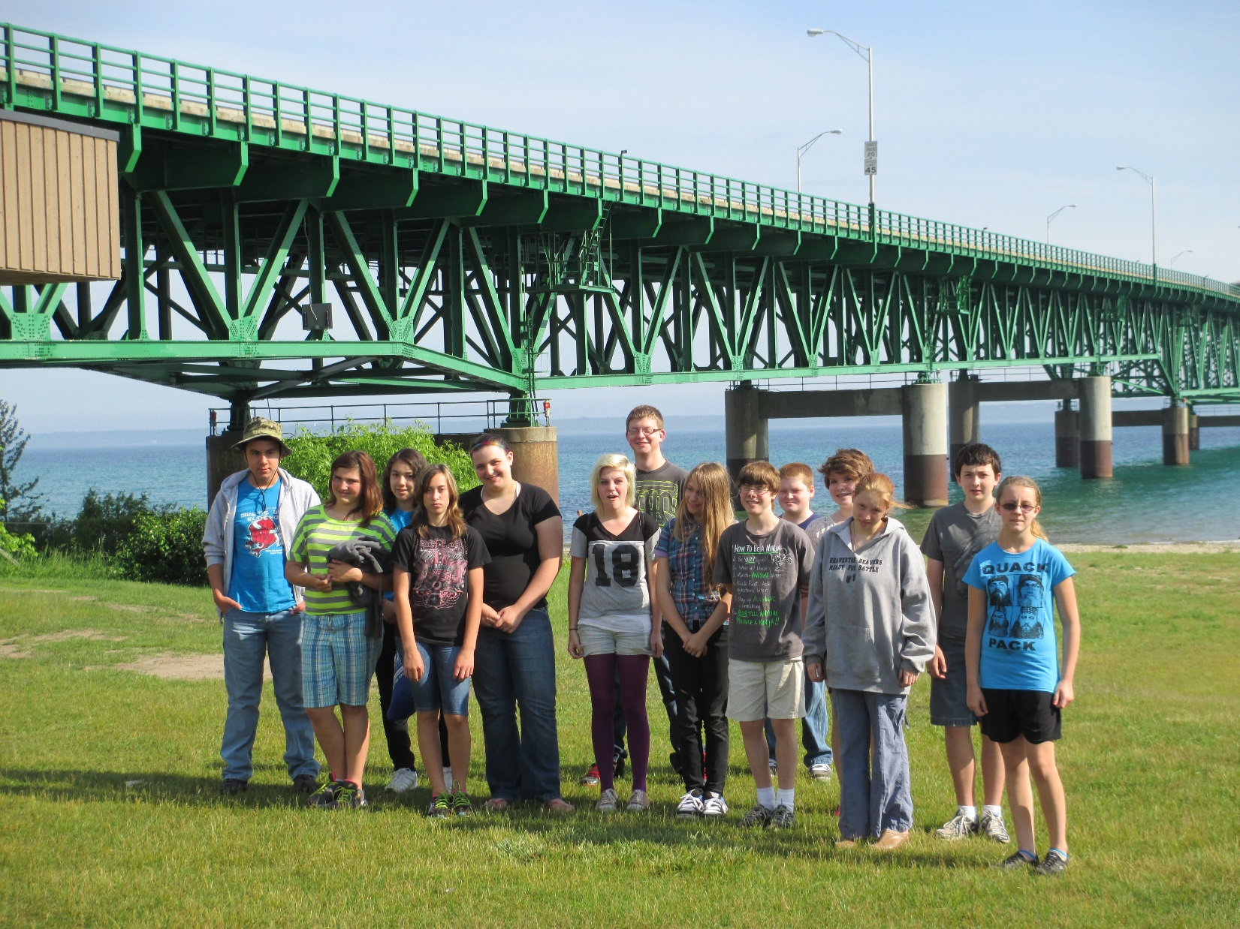
Cultural Experiences

Slide 9
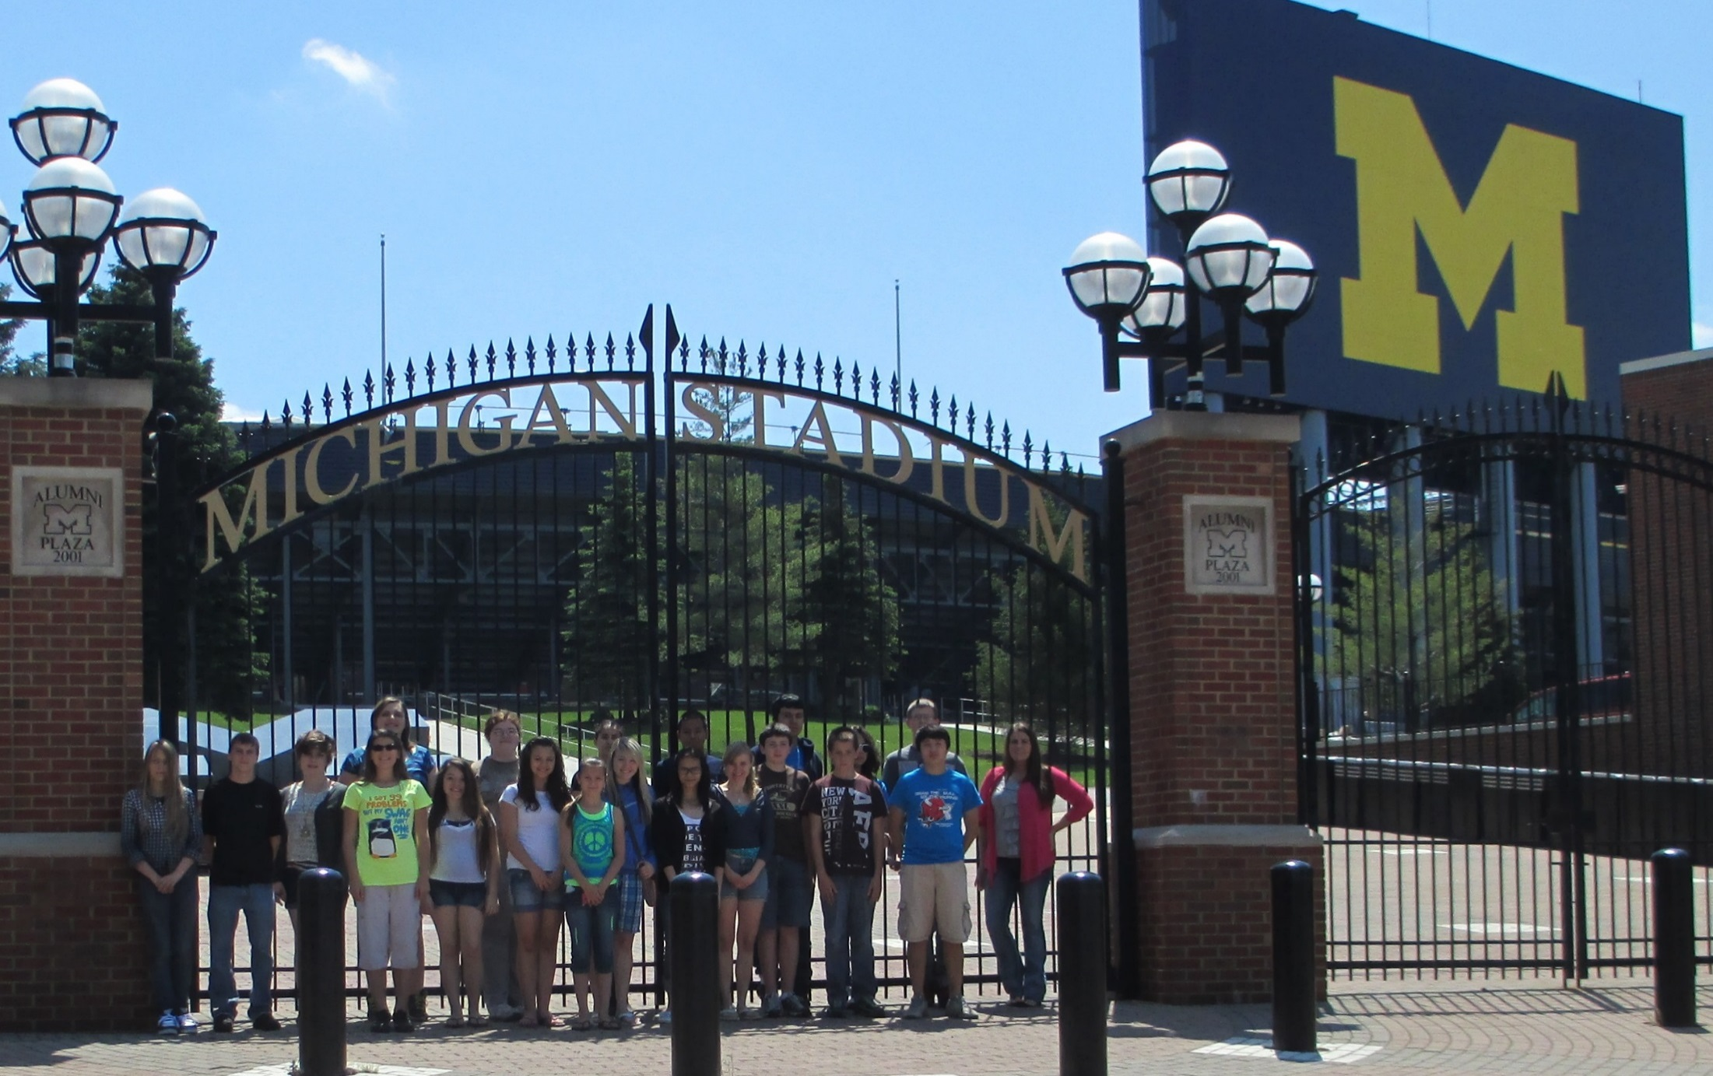
Campus Visits

Slide 10
Career Workshops

Slide 11
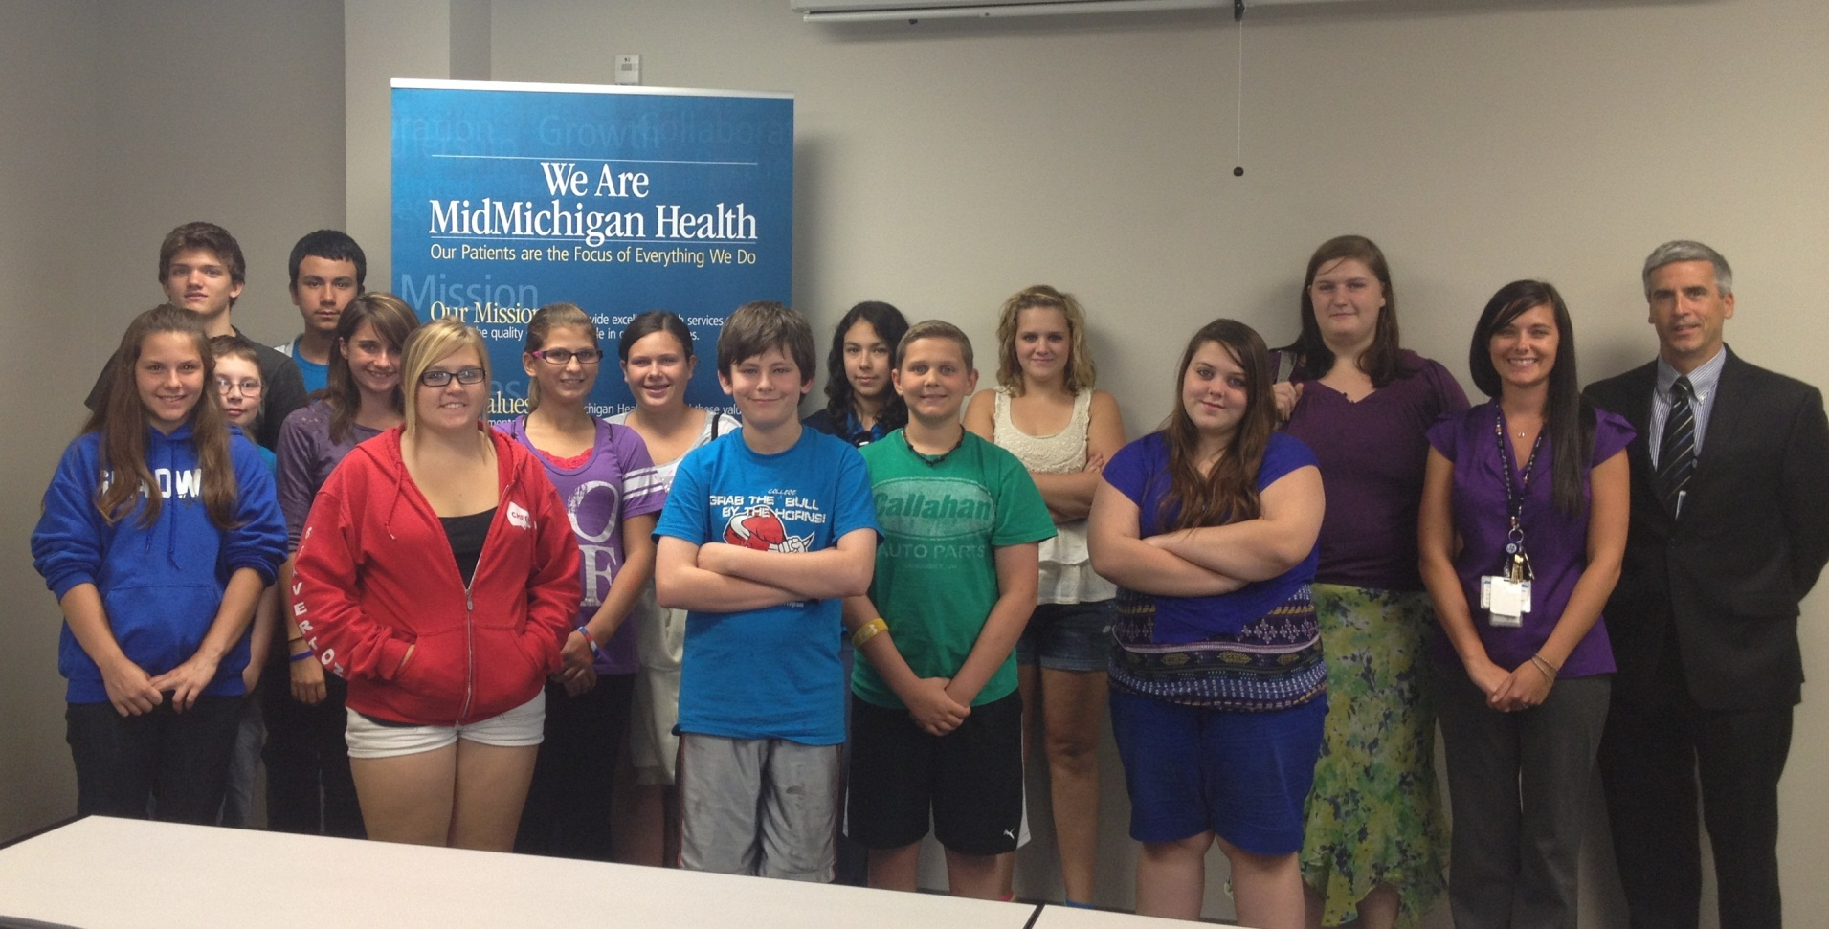
Career Workshops

Slide 12
Scholarships
The Michigan Experience Scholarship is awarded to ETS students who are accepted to the University of Michigan. Valued at $40,000
Rachel Blaisdell- Beaverton High School
Cody Keetch- Gladwin High School
Brianna McCann- Gladwin High School
Jordan Hales- Clare High School
Keagan Owens- Clare High School
Nicholas Merritt- Coleman High School

Slide 13
Financial Aid

Slide 14
Federal Objective Results
Percent of Non-Seniors who go on to the next grade level at the next year
Federal Objective
89%
MMCC ETS Results
98%

Slide 15
Federal Objective Results
Percent of seniors who will graduate high school on time
Federal Objective
83%
MMCC ETS Results
97%

Slide 16
Federal Objective Results
Percent of seniors who will enroll in an institution of higher learning immediately after graduation
Federal Objective
75%
MMCC ETS Results
85%

Slide 17
2013-2014 Year Year 3
Current Enrollment of 515 students
Out of those students, we have 84 seniors
Have processed 100 college application fee waivers
Has an approximate value of $3,000.
Have processed 27ACT fee waivers
Has an approximate value of $1,200.
Will be transitioning to a new ETS staff

