Slide 1
Technology Readiness In Michigan

Slide 2
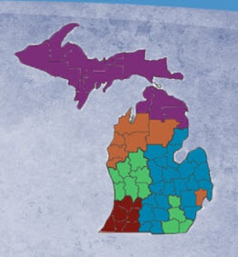
Activity Three: Classroom Readiness
Greater Michigan Education Consortium (GMEC)
Classroom Readiness
Teacher Technology Training Course (T3 Course)

Slide 3
Kay’s Pilot Schools
Alma High School
Ashley High School
Bay City Auburn Elementary
Beaverton High School
Breckenridge High School
Farwell High School
Harrison Hillside Elementary
Ithaca North Elementary
Ithaca Jr/Sr High School
Mt. Pleasant Fancher Elementary
St. Louis TSN Middle School
Shepherd Winn Elementary
Whittemore-Prescott Elementary/Middle Schools
13 Pilot Schools
42 Coaches

Slide 4
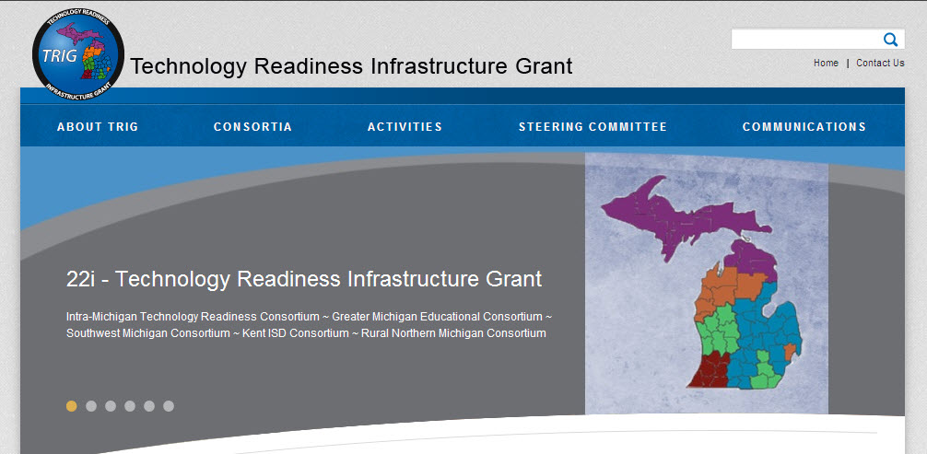
22i TRIG Website
http://www.22itrig.org

Slide 5
What are the Benefits?
Coaching model to assist teachers in the pilot buildings
T3 (Teacher Technology Training) to help teachers become tech ready (that is projected to take 25 hours) is now available to all districts
A regional coordinator will work with pilot buildings and coaches in each of the buildings to assist teachers while they go through the T3 course
Data will be gathered in the pilot buildings to measure teacher and student growth in tech readiness
T3 Course available statewide, at no cost, for any school to use

