Slide 1
Classroom Readiness In Michigan

Slide 2
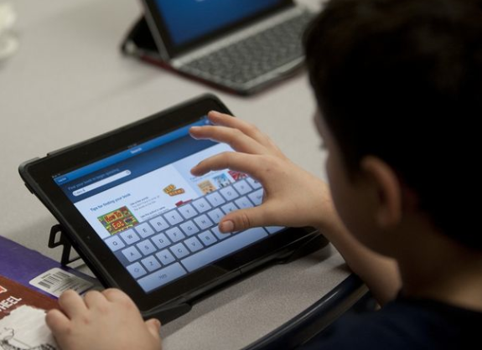
Classroom Readiness Goal
The goal for Classroom Readiness is:
to build the capacity of Michigan educators to effectively plan and implement online assessments and "Any Time, Any Place, Any Way, Any Pace" learning through increasing technology proficiency.
Notes:
Image from http://www.mlive.com/news/jackson/index.ssf/2013/03/addison_elementary_school_thir.html

Slide 3
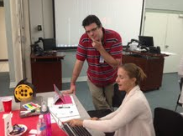
Train the Trainer Model
Using a train-the-trainer model, this pilot project will provide collaboration opportunities for a statewide professional development network of K-12 educators with a training ground and resource base to improve technology proficiency and local district readiness for online assessments.

Slide 4
What are the benefits?
T3 (Teacher Technology Training) course to help teachers become tech ready (that is projected to take 25 hours) is available to all districts
A Regional Coordinator will work with 10-12 pilot buildings and work with 2-5 coaches in each of the buildings to assist teachers while they go through the T3
Coaching model to assist teachers in the pilot buildings via teacher coaches
Data is being gathered in the pilot buildings to measure teacher and student growth in tech readiness

Slide 5
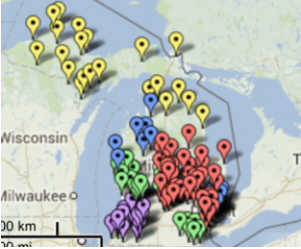
Who is participating?
140 pilot buildings are participating statewide

Slide 6
Who is leading the project?
Advisory Committee: Anthony Buza, Blake Prewitt, Cassie Thelen, Melissa White, Laura Cummings, Jan Harding, Jennifer Parker-Moore, Rhonda Provoast, Kay Hauck, Andrew Steinman, Michelle Ribant (not pictured)

Slide 7
Who is moving the project forward?
Regional Coordinators: Gaby Eyzaguirre, Elizabeth Fairbanks, Luke Brown, Valerie Coffey, Steve Kass, Melissa White (Project Manager, Anthony Buza, James Spruill, Kay Hauck, Andy Mann, Andrew Steinman, Amber Kowatch, Dave Johnson, Anne Thorp, Jennifer Johnson, Rhonda Rasmussen, Jim Wenzloff, Tina, Sue Summerford (not pictured)

Slide 8
What is the role of a Regional Coordinator?
Conduct a train the trainer model with 500+ coaches statewide
Assist the coaches and teachers in the pilot buildings with the T3 course
Help ensure that data is being collected through surveys- help select the focus groups in the spring

Slide 9
What is the role of a coach?
Attend 3 days of training by Regional Coordinator
Attend MACUL Conference in March
Coach teachers through the T3 course
Provide training in classroom readiness on PD days, lunch and learns, after school workshops

Slide 10
Coach receives the following for their work:
Device or $250 in lieu of device
$1100 stipend (minus FICA, retirement etc.)
3 days of training (district reimbursed for sub costs)
Two day attendance at MACUL- registration and hotel paid for

Slide 11
T3 Course (Teacher Technology Training)
7 module course in Moodle that is self paced, but will be monitored by the Coaches and Regional Coordinators
The course is 25 hours long and is worth 25 SCECHs
All Pilot building are on the NGAP server at Kent ISD

Slide 12
How to get the course
All buildings and districts are able to access a .mbz file of the course on the TRIG sitehttp://22itrig.org/activities/activity-three/short-course/
The course must be downloaded and put on a Moodle server for access
A view only copy is available at: http://moodle.resa.net/resa/course/view.php?id=98

Slide 13
What is in the course?
Module 0 (1 hour)
The Goals and Learning Objectives of the T3 course
An orientation to Moodle and how to navigate the course
Assistive technology needs for students and how to accommodate students with disabilities

Slide 14
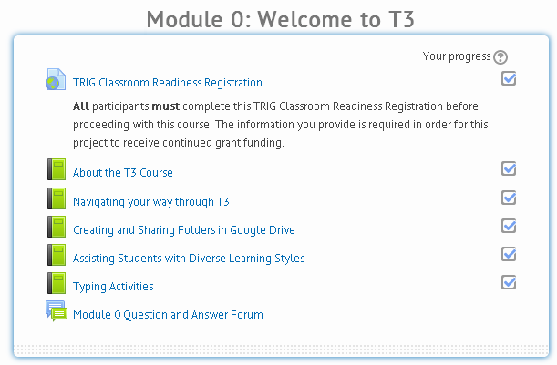
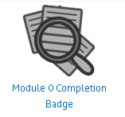
What is in the course?
A badge is earned when each module is completed.
Notes:
A badge is earned when each module is completed.

Slide 15
Module 1- Orientation to State Standards (2 hours)
Technology Standards
State Standards
Career and Technology Readiness Standards
Michigan eLibrary and M.O.R.E.

Slide 16
Module 1- Orientation to State Standards (2 hours)

Slide 17
Module 2 Best Practice in Technology (9 hours)
An Overview of the 9 Best Practices Categories
Setting Objectives and Providing Feedback
Reinforcing Efforts and Providing Recognition
Cooperative Learning
Cues, Questions and Advance Organizers
Nonlinguistic Representatives
Summarizing and Note Taking
Assigning Homework and Providing Practice
Identifying Similarities and Differences
Generating and Testing Hypotheses

Slide 18
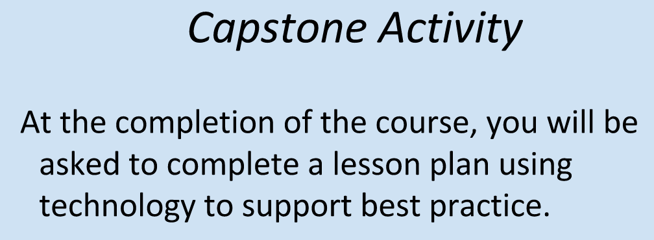
Module 2 Best Practice in Technology (9 hours)

Slide 19
Module 3- Introduction to Blended Learning (4 hours)
What is blended learning
Choosing web 2.0 tools for teaching and learning
Using apps in blended learning
Blended Learning Application
Taking Blended Learning further

Slide 20
Module 3- Introduction to Blended Learning (4 hours)

Slide 21
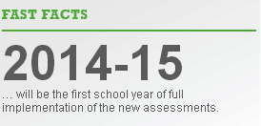
Module 4- All About Next Generation Assessments (2 hours)
Introduction to Next Generation Assessments
Connecting Next Generation Assessments to Standards
A look at Next Generation Assessment items

Slide 22
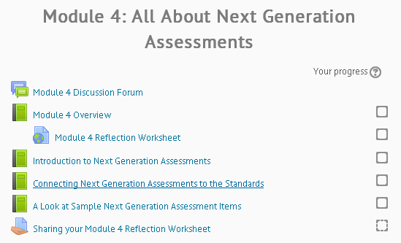
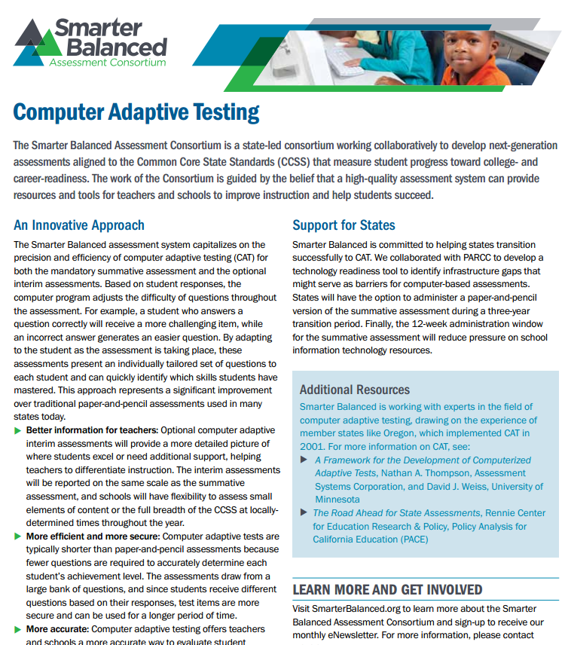
Module 4- All About Next Generation Assessments (2 hours)

Slide 23
Module 5-Preparing for Next Generation Assessments (4 hours)
Michigan Statewide Assessments
Example of Next Generation Assessments items
How to create high quality items
Item/task specification review
Item/task specification submission

Slide 24
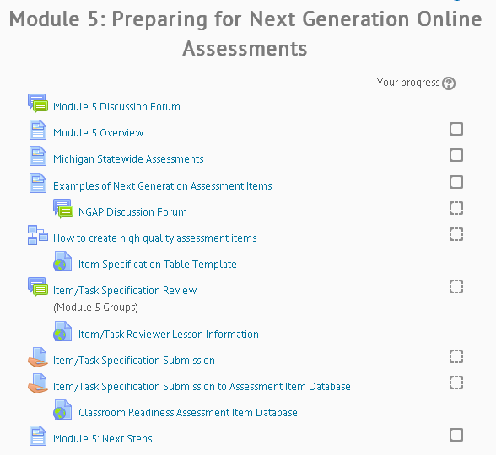
Module 5-Preparing for Next Generation Assessments (4 hours)

Slide 25
Module 6- Data Collection and Conferencing (2 hours)
Data Driven Dialogue- Integrating T3 Data in to the School Improvement Process
Technology Readiness Data: MTRAx Network/Infrastructure/Device Level
Data Collection: Types and Tools
Capstone Activity: Administering an Online Assessment
Data Review and Recommendations

Slide 26
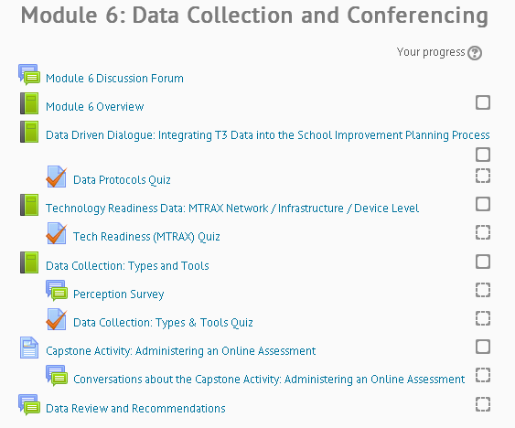
Module 6- Data Collection and Conferencing (2 hours)

Slide 27
Questions?
Melissa White- Classroom Readiness Project Manager
Kay Hauck- GMEC Regional Coordinator
Cassie Thelen- GMEC Coach (Alma)

