Slide 1
MCREL’s “Classroom Instruction that Works” Meets “The 21things4teachers”
21things for the 21st Century Educator
http://21things4teachers.net
Carolyn McCarthy, Dr. Jennifer Parker-Moore, Melissa White, Jan Harding
Revised 7/24/12
Notes:
Welcome and Introductions

Slide 2
Making Connections
The purpose of this presentation is to review best practice instructional strategies, and help you make connections to some of the technology tools that support these strategies.
Please note, the following include only some of the examples. Each lesson is unique, tools vary, and technology changes.
As you move through each of the 21things, consider how technology can help you improve your instruction.
Integrate Technology – Inspire Learning
Notes:
Emphasis on the fact that we are not covering ALL of the tools and their connections to the strategies. These are EXAMPLES only.
Cite the book, and the references to each strategy taken from the 2nd edition.

Slide 3
What is Classroom Instruction that Works?
Notes:
Describe the MCREL purpose, separation from Marzano, new book, and the overview of the 9 strategies
Products, purpose, website mcrel.org

Slide 4
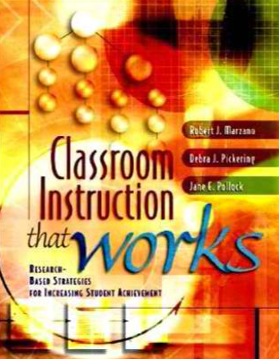
The 1st ed.: Marzano, Pickering, and Pollock (2001)
Marzano, R. J., Pickering, D. J., & Pollock, J. E. (2001). Classroom instruction that works: Research-based strategies for increasing student achievement. Alexandria, VA: Association for Supervision and Curriculum Development.
In some circles, the 9 strategies are known as the “Marzano 9”.
Notes:
Remind participants that it is the “CITW 9” NOT “Marzano 9”. Marzano has separated from MCREL.

Slide 5
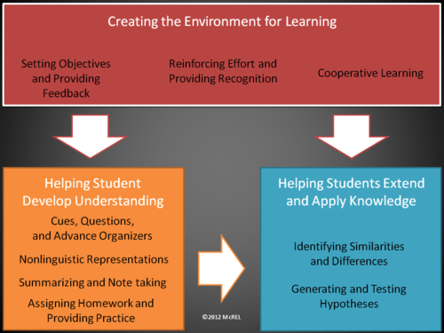
2nd ed. in 2012: New Edition!
Dean, C. B., Stone, B., Hubbell, E., & Pitler, H. (2012). Classroom instruction that works: Research-based strategies for increasing student achievement (2nd ed.). Alexandria, VA: ASCD.
New evidence-based research, framework, rationale, examples, and connections to the 21st century skills!
Source: Classroom Instruction that Works, 2nd ed.
Model used with permission, mcrel.org

Slide 6
Using Technology with Classroom Instruction that Works
Check out the new edition
Make connections to new tools
See sample lessons
Review research based approach to improving instruction
Pitler, H., Kuhn, M., & Hubbell, E.R. (2012). Using technology with classroom instruction that works, 2nd.ed. Alexandria, VA: Association for Supervision and Curriculum Development.
Notes:
Using Technology with Classroom Instruction That Works, 2nd Edition byMatt Kuhn, Elizabeth R. Hubbell, Howard Pitler

Slide 7
http://bcove.me/lksj6kew
View the video and explore the connections between technology and CITW with author Howard Pitler
Notes:
http://www.ascd.org/publications/books/classroom-instruction-that-works.aspx
http://bcove.me/lksj6kew
Embed Code:
<object id="flashObj" width="486" height="412" classid="clsid:D27CDB6E-AE6D-11cf-96B8-444553540000" codebase="http://download.macromedia.com/pub/shockwave/cabs/flash/swflash.cab#version=9,0,47,0"><param name="movie" value="http://c.brightcove.com/services/viewer/federated_f9?isVid=1" /><param name="bgcolor" value="#FFFFFF" /><param name="flashVars" value="videoId=1367742881001&playerID=11490813001&playerKey=AQ~~,AAAAAmGjiRE~,escbD3Me8-zfW2J4SI2ZSHPsqtup23tT&domain=embed&dynamicStreaming=true" /><param name="base" value="http://admin.brightcove.com" /><param name="seamlesstabbing" value="false" /><param name="allowFullScreen" value="true" /><param name="swLiveConnect" value="true" /><param name="allowScriptAccess" value="always" /><embed src="http://c.brightcove.com/services/viewer/federated_f9?isVid=1" bgcolor="#FFFFFF" flashVars="videoId=1367742881001&playerID=11490813001&playerKey=AQ~~,AAAAAmGjiRE~,escbD3Me8-zfW2J4SI2ZSHPsqtup23tT&domain=embed&dynamicStreaming=true" base="http://admin.brightcove.com" name="flashObj" width="486" height="412" seamlesstabbing="false" type="application/x-shockwave-flash" allowFullScreen="true" swLiveConnect="true" allowScriptAccess="always" pluginspage="http://www.macromedia.com/shockwave/download/index.cgi?P1_Prod_Version=ShockwaveFlash"></embed></object>

Slide 8
Refined CITW Framework
Setting Objectives and Providing Feedback
Reinforcing Effort and Providing Recognition
Cooperative Learning
Cues, Questions, and Advance Organizers
Non-linguistic representations
Summarizing and Note-taking
Assigning Homework and Practice
Identifying Similarities and Differences
Generating and Testing Hypothesis
Notes:
3 levels of the new framework
Creating the Environment for Learning (red)
Helping Student Develop Understanding (orange)
3) Helping Students Extend and Apply Knowledge (blue)

Slide 9
CITW Connections to
Notes:
Throughout the course, we will be making connections between the tools taught in each of the 21Things and the best practice instructional strategies of the CITW9

Slide 10
9 Strategies
21things
Setting Objectives and Providing Feedback
Reinforcing Effort and Providing Recognition
Cooperative Learning
Cues, Questions, and Advance Organizers
Non-linguistic representations
Summarizing and Note-taking
Assigning Homework and Practice
Identifying Similarities and Differences
Generating and Testing Hypothesis
About Basics
Face of the Classroom (Online Presence)
Collaboration Tools
Communication Tools
Content Area Tools
Differentiated Instruction & Diverse Learning
Digital Citizenship
Visual Learning
Copyright & Creative Commons
Digital Images
Presentation Tools
Evaluation/Assessment
Online Inter-actives
Productivity Tools
Staying Informed
Research & Reference Tools
Professional Learning Networks
Virtual Classroom
Digital Story Telling
Online Video and Audio Sources
Flipping Your Classroom (Screen-casting)
Notes:
Explore the 9 and the 21
Mcrel.org resource site
21things4teachers.net

Slide 11
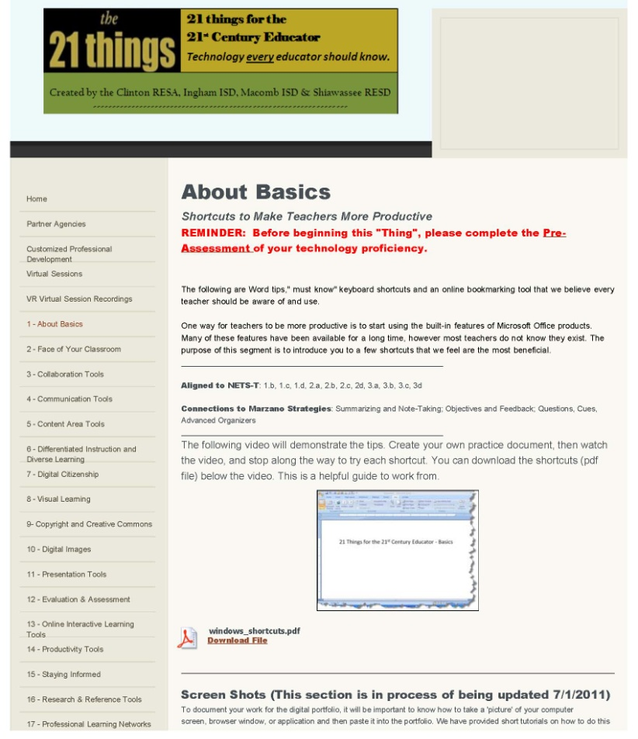
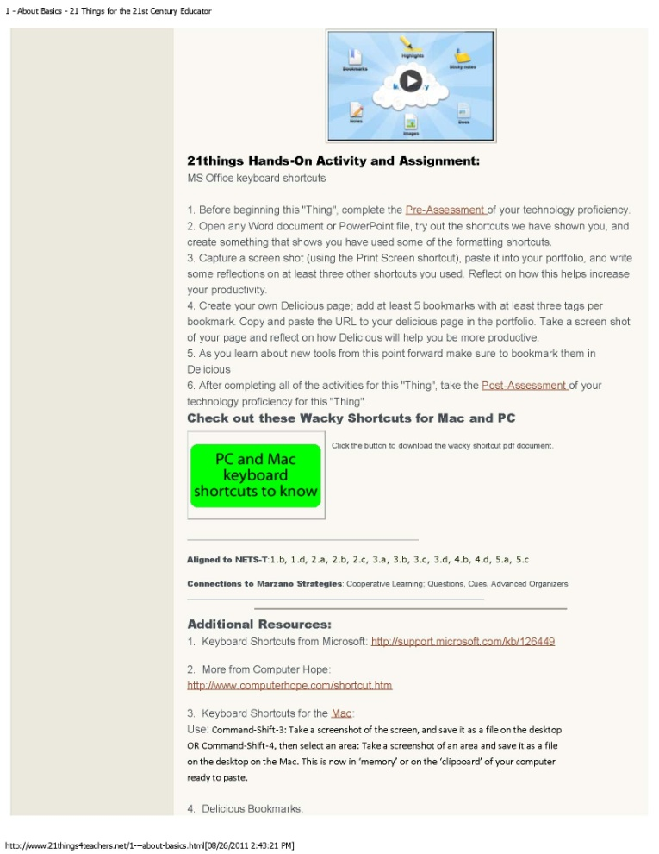
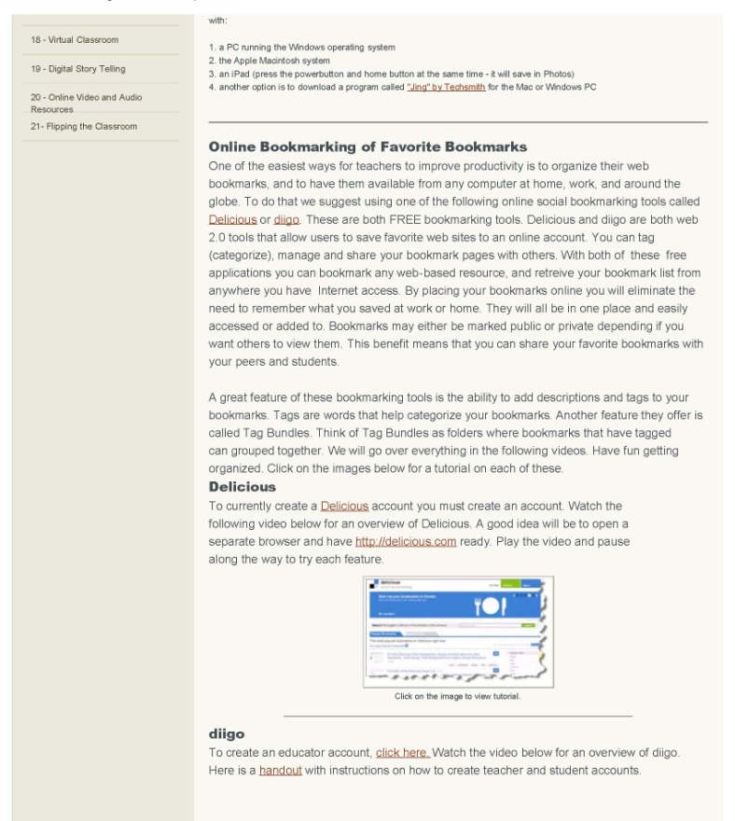
Each “Thing” has FREE tools, videos, hands on activities and resources to connect to best practice instruction. Note the strategies and standards are listed for each “Thing”
Notes:
Note that the CITW 9 strategies are highlighted on each “Thing”
Anatomy of a “Thing” --
What it is and how it can be used
The NETS-T and CITW9 connections
Free Tools
Video tutorials
Hands-on Activities
Additional Resources
Creative Commons

Slide 12
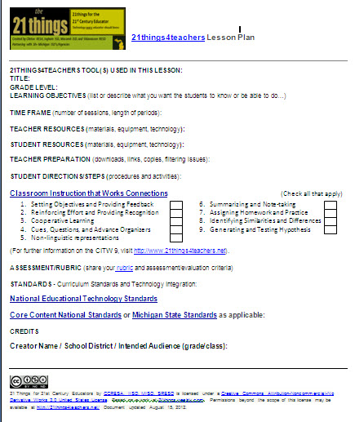
Connecting Technology to Best Practice Strategies
As educators create lessons within the 21things4teachers, they make connections to best practice instructional strategies using the CITW framework.
Notes:
During each “thing”, participants in the course will be asked to connect the technology tools to the strategy/strategies they support. In addition, each portfolio section (1-7, 8-14, 15-21) has a Capstone Activity that includes a lesson plan. Within the lesson, teachers will connect the lesson, tools, standards, and CITW strategies in their planning.

Slide 13
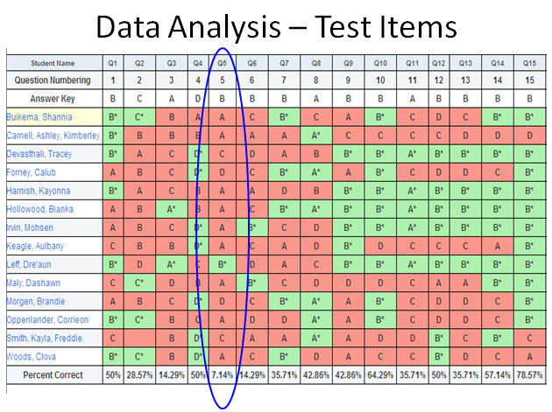
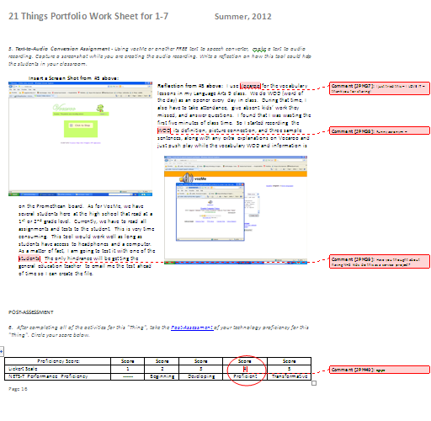
Setting Objectives and Providing Feedback
Setting, personalizing, communicating, negotiating objectives; preparing criterion-referenced feedback, providing feedback and engaging students in self-assessment
Ex: Rubrics, assessment and evaluation
Notes:
Participants will use a variety of tools to set objectives with students, including rubrics, found in “Evaluation & Assessment”
Setting Objectives is a critical piece of best practice instruction – students need a road map, not just an agenda.
Providing Feedback – thoughtful educators provide constructive feedback that allows the participant to reflect and make improvement
The “Collaboration Tools” Thing allows feedback to be provided in a variety of ways, including the Track Changes use of the “comment” feature in Word or Google Docs “comment” feature.
The “Online Interactive Learning Tools” provides an opportunity for students to self assess using Quizlet
The “Assessment/Evaluation” Thing includes a review of data analysis that provides feedback on standards, items, and individual student performance

Slide 14
Setting Objectives
Giving clear directions about what the objective of the learning is
Students make personal connections to lessons
Teachers should post, talk, allow students to personalize, and reference OBJECTIVES
Setting Objectives and listing the Agenda are not the same thing!
The student will…
Source: Classroom Instruction that Works, 2nd ed.

Slide 15
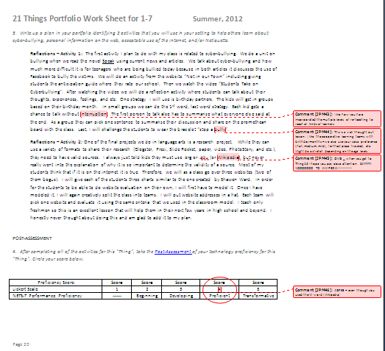
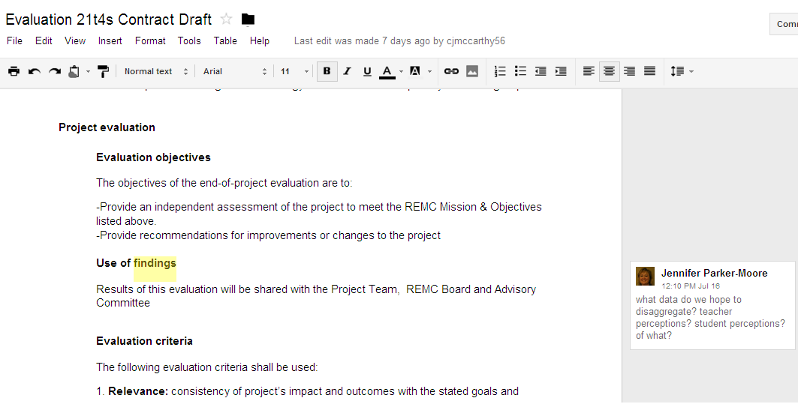
Providing Feedback
Should be specific about the student’s performance as it relates to the learning objective
Providing Feedback and Providing Recognition are NOT the same
Students are able to self-assess, peer assess, and react to feedback
Ex: Using the “Comment” feature in Word or Google Docs
Source: Classroom Instruction that Works, 2nd ed.
Notes:
Participants in 21things4teachers will receive constructive comments from your instructor(s) within the online environment. Examples include responses to the Discussion Boards/Forums in BlackBoard or Moodle, using the Track Changes feature in Word, responses to their blogs or web presence (Face of Your Classroom), or comments using Google Docs.

Slide 16
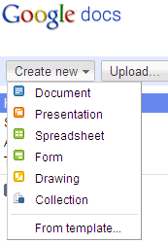
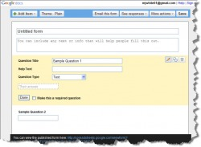
Reinforcing Effort and Providing Recognition
Establish rationale/rubrics, teach to improve achievement, chart, recognize, and use pause, prompts and praise
Ex: Rubrics, award generators, inter-actives that chart progress, surveys and evaluation tools
Notes:
Participants will utilize online interactives found in Thinkfinity or Illuminations
Participants will create online surveys/quizzes/tests using Google Forms or other online survey makers (Survey Monkey, Zoomerang)
Participants will learn about the power of portable mobile devices, such as cell phones, and the ability to use polling sites like Poll Everywhere.

Slide 17
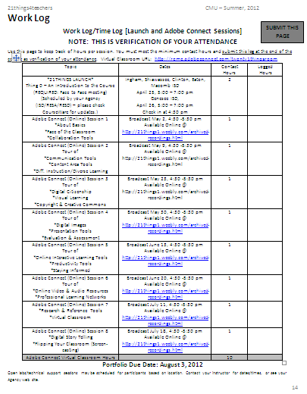
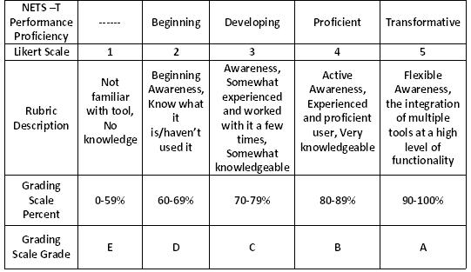
Reinforcing Effort
Understand the difference between effort vs. achievement
Expending effort
Tracking effort and achievement
Track your progress using your WorkLog, and multiple levels of self-assessment for each “Thing”
Source: Classroom Instruction that Works, 2nd ed.
Notes:
Participants will track their effort using a work log, and pre/post assess themselves at each “thing” to track their own progress
The NETS_T framework is utilized

Slide 18
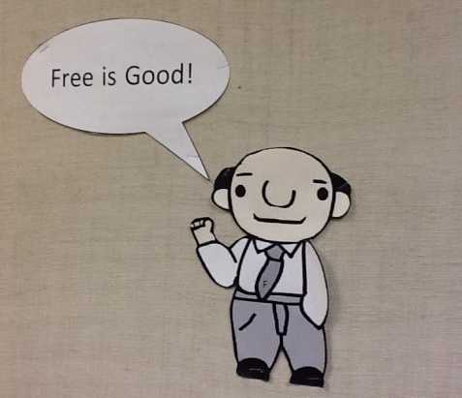
Providing Recognition
Personal mastery NOT competition!
Allow for multiple levels of learning, performance, and rewards
Praise leads to motivation
Recognize and appreciate different learning styles
Amazing!
Inspiring!
Awesome!
Source: Classroom Instruction that Works, 2nd ed.
Notes:
Each participant will strive to create a unique and complete portfolio that demonstrates their skills and abilities within the 21things4teachers course
Participants utilize rubrics to score their performance levels – aspiring to the “Transformative” level
Frank Miracola 21st Century Educational Excellent Award is designed to reward high achievers

Slide 19
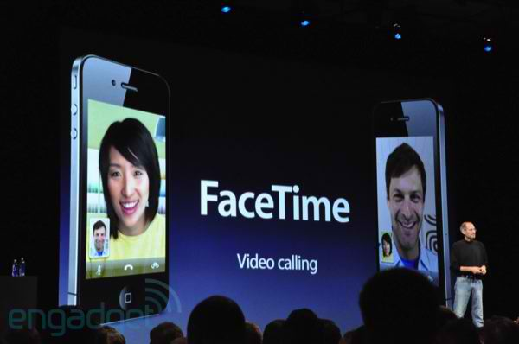
Cooperative Learning
Using elements of interdependence, interaction, accountability and group skills
Ex: Web Quests, collaboration tools, scavenger hunts, inter-actives
Notes:
Participants will utilize a variety of web tools that promote interactivity including BlackBoard – Discussion, Moodle – Forums, Google Docs, backchannel chats, and Skype
Both the “Collaboration Tools” and “Communication Tools” things promote cooperative learning, as do others.

Slide 20
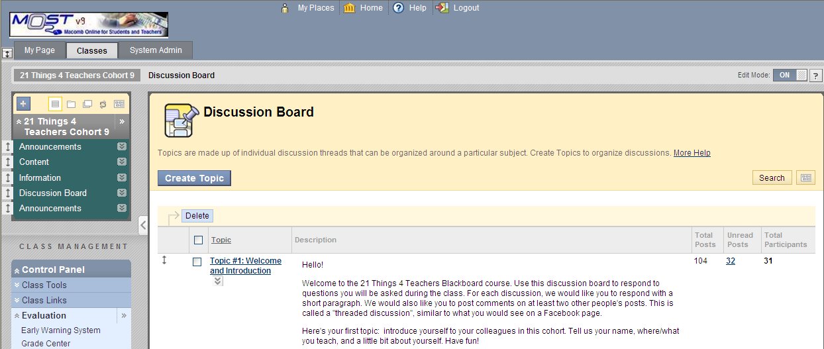
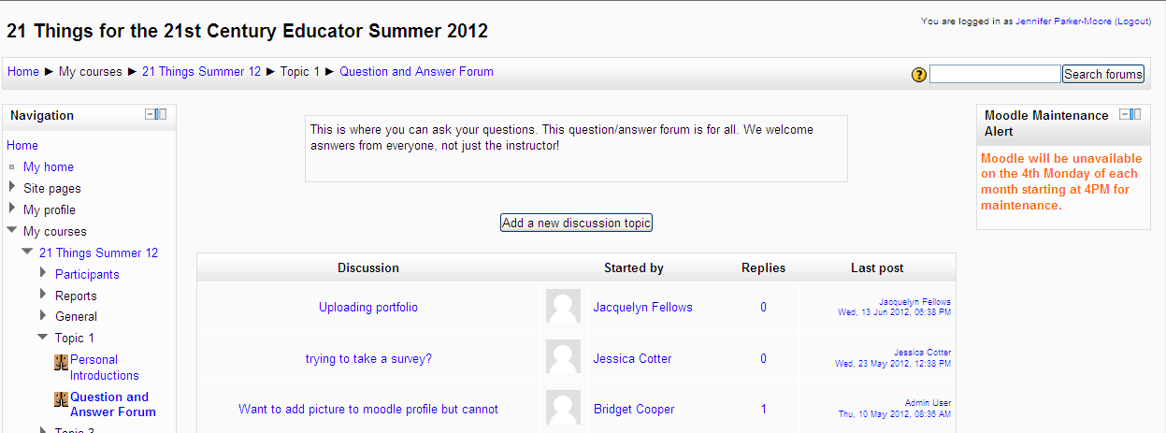
Cooperative Learning
Cooperative learning vs. Group Work
Positive interdependence and individual accountability
Source: Classroom Instruction that Works, 2nd ed.
Notes:
Cooperative learning is not GROUP WORK
Emphasis on INTERDEPENDENCE, and INDIVIDUAL ACCOUNTABILITY
Participants will be expected to actively participate in the Discussion Board or Forums within their Online Course Management Systems (BlackBoard or Moodle). Some instructors use Blogging, Edmodo, or other forms of cooperative communication.

Slide 21
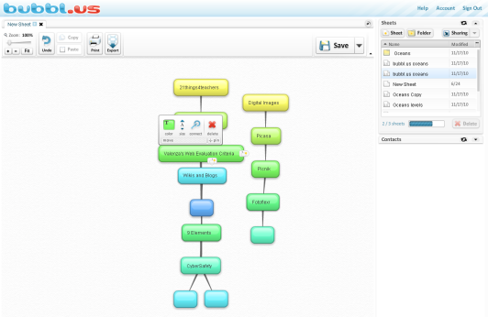
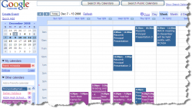
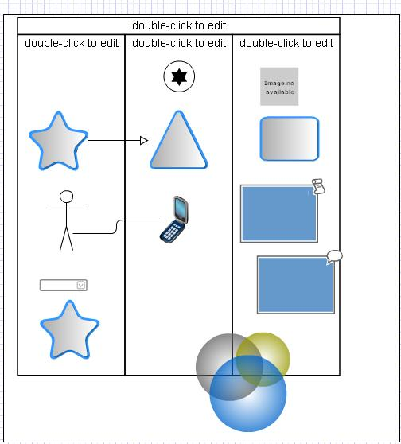
Cues, Questions, Advance Organizers
Focusing important information, cues, inference, and analysis, use of advance organizers and graphic organizers
Ex: Visual learning tools, digital images, formatting tools (highlighting), collaboration, peer editing, and classroom calendars
Notes:
“Collaboration tools” provide participants with an opportunity to peer edit documents
“Staying Organized” tools, such as Google Calendar, allow participants to plan ahead for due dates, assignments, and responsibilities
“Visual learning tools” such as Gliffy and Bubbl.us provide thinking maps for planning, organizing, and distributing work

Slide 22
Cues & Questions
Tools to build vocabulary, identify key concepts and make connections
Focus on what is important
Explicit cues, inferential and analytic questions
Connect to prior learning
Literal, inferential, and critical/evaluative/analytical thinking
Source: Classroom Instruction that Works, 2nd ed.

Slide 23
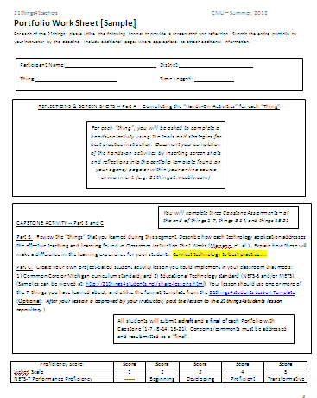
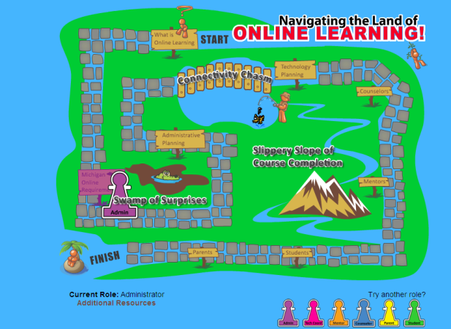
Advance Organizers
Expository
Narrative
Skimming
Graphic advance organizers
Source: Classroom Instruction that Works, 2nd ed.
Notes:
When utilizing this strategy, emphasize the use of expository writing, narrative writing, skimming for key ideas, and the use of graphic/advance organizers for content. The “Online Learning” and “Digital Storytelling” “things” are examples that support this strategy.
Participants are asked to storyboard in “Digital Storytelling” and their lessons in the “Flipped Classroom”
Mindmapping roles is done during “Navigating the Land of Online Learning”
Narrative and expository writing is emphasized in Portfolio reflections…Participants are asked to explain, describe, and reflect upon the tools in 150-300 words minimum. Capstones are 2-5 pages.
The use of Google Calendar for deadlines and responsibilities within the 21things environment.

Slide 24
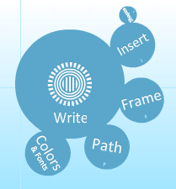
Non-linguistic Representations
Graphical representations, graphic organizers, physical models, mental pictures, drawings, pictures, pictographs, kinesthetic activities
Ex: Visual learning tools and pattern building, digital images, digital storytelling, movies, and online video that stimulate thinking
Notes:
Participants using “Presentation Tools” may select the Prezi tool, which allows users to mind map their presentation in a visual manner.
Gliffy and Bubbl.us are graphic organizer tools found in “Visual Learning”
Wordle and Tagxedo are also cloud tools found in “Visual Learning”

Slide 25
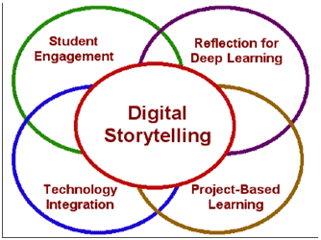
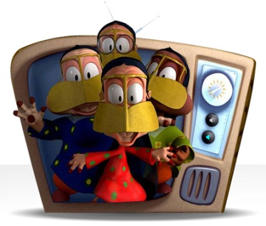
Non-Linguistic Representations
Graphic organizers
Physical models or manipulatives
Generate mental pictures
Pictures, illustrations, pictographs,
Engage kinesthetic activities
Source: Classroom Instruction that Works, 2nd ed.
Notes:
“Digital images”, “Visual Learning”, and “Presentation Tools” are sample “things” that teach tools that can be used to support the non-linguistic representations strategy.

Slide 26
Summarizing and Note-taking
Synthesize, prioritize, restate and organize concepts, topics and details
Ex: Word processing, presentations, online presence, formatting, storytelling, presenting
Notes:
Participants can utilize “Presentation Tools” and “Collaboration Tools” to share information and take notes. Using Quizlet, PowerPoint, Prezi, or Google Presentations for note cards can make studying easier.
“Presentation tools” like ZoomIt, Voicethread, Glogster, and Prezi allow participants to spotlight information in visually appealing and meaningful ways.

Slide 27
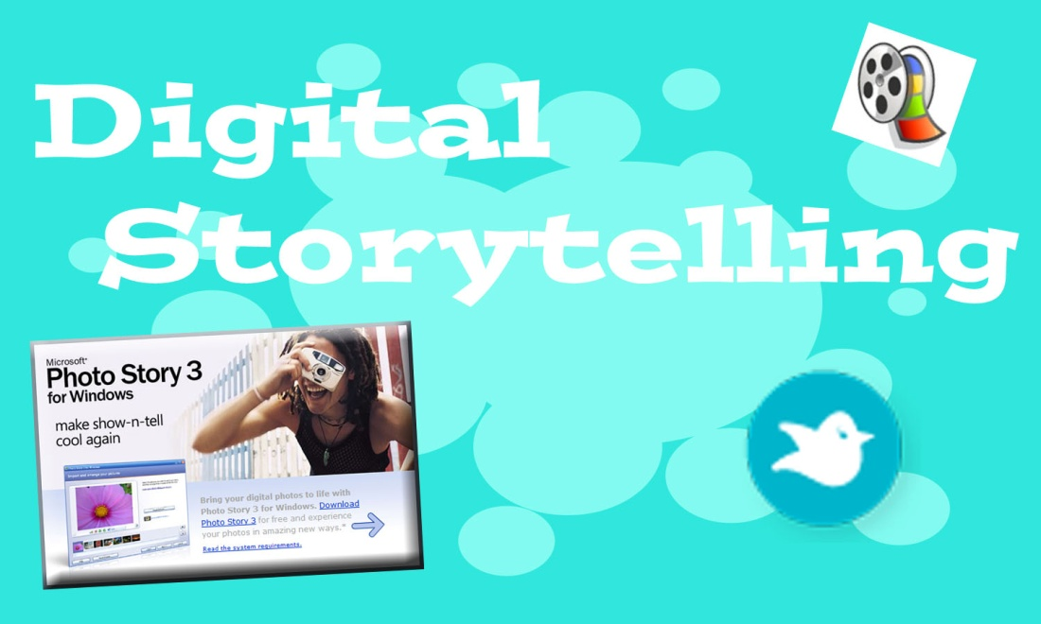
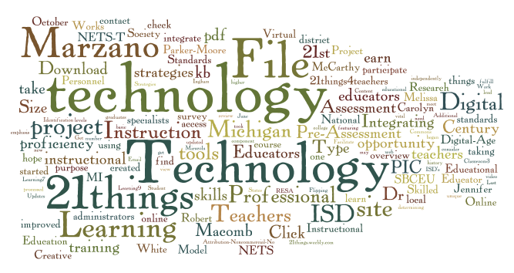
Summarizing
Rule-based summarizing
Delete unimportant words, repeats
Use analogies, replacement words, and topic sentences
Summary frames
The use of reciprocal teaching
Summarizer
Questioner
Clarifier
Predictor
Who, what, where, when, why and how?
Source: Classroom Instruction that Works, 2nd ed.
Notes:
Participants may utilize word processing, GDocs, or other tools to create documents to support this strategy.
Summarizing using the digital storytelling or presentation tools also supports this strategy.
Using Wordle, Tagxedo, etc. can be a form of summarizing.

Slide 28
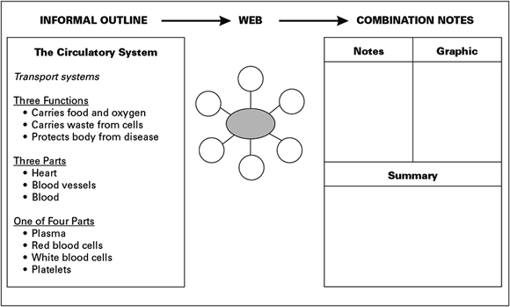
Note-taking
Teacher prepared notes
Revision, review, and opportunities for use
Multiple formats
Webbing
Informal outline
Combination notes
Image Source: http://www.ascd.org/publications/books/106009/chapters/Summarizing-and-Note-Taking.aspx from Using CITW with ELL
Source: Classroom Instruction that Works, 2nd ed.
Notes:
Participants should understand the role of note-taking.
Technology applications include word processing and digital image tools to create outlines or combination notes; using visual learning tools to web (Bubbl.us, Gliffy, etc.)
Image from: http://www.ascd.org/publications/books/106009/chapters/Summarizing-and-Note-Taking.aspx

Slide 29
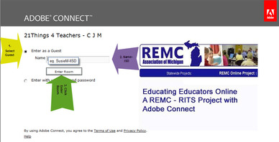
Assigning Homework and Providing Practice
Communication, clarifying purpose, selecting skills, questioning, commenting, and scheduling practice
Ex: Communication and practice, inter-actives, homework help and tutoring, online courses
Khan Academy
Notes:
Participants will have opportunities to “Flip their Classroom” using screencasting tools. In addition, participants will utilize the Tubes (TeacherTube, SchoolTube, YouTube, EduTube, etc.) and iTunes in “Online Video and Audio Tools”
The Course is delivered using Adobe Connect, a web conferencing site product. Connect Now is the FREE version taught in the course.
Using videos found at Khan Academy, Annenberg, and other sites is one way to support this strategy
Image source: Jim Wilson/The New York Times
Image source: http://effectiveonlineteaching.org/tag/flipped-classrooms-objectives

Slide 30
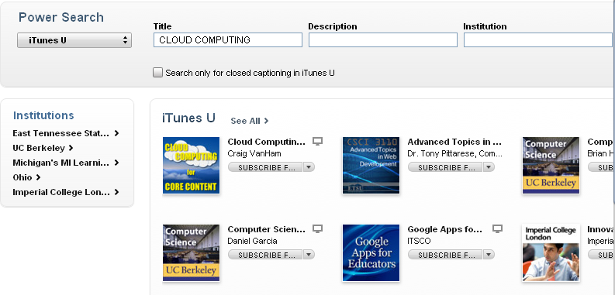
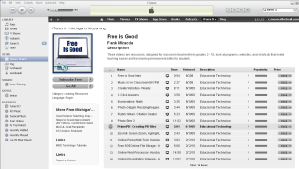
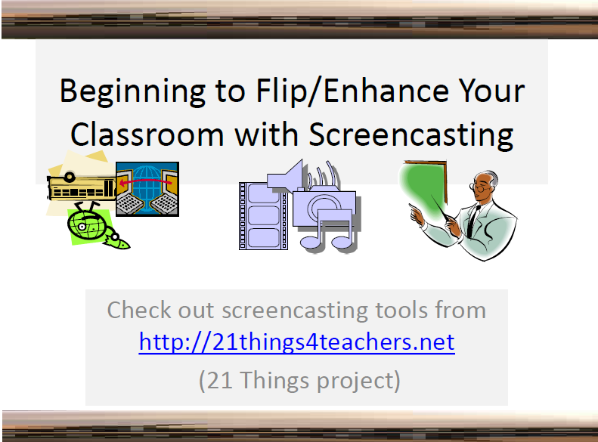
Assigning Homework
iTunes
Homework with Purpose
Prepare for new learning
Elaborate on information to increase understanding
Practice to increase speed, accuracy, fluency, etc.
Source: Classroom Instruction that Works, 2nd ed.
Notes:
Teachers often post their own videos to sites such as SchoolTube, TeacherTube, YouTube (which may be blocked), and iTunes U
Also reference McREL blog posting:
Turning classroom instruction on its head
http://mcrel.typepad.com/mcrel_blog/2011/04/turning-classroom-instruction-on-its-head.html
http://mcrel.typepad.com/mcrel_blog/classroom-instruction-that-works/
Boring Economics Teacher
http://youtu.be/dxPVyieptwA
Jamie yoos – chemistry teacher – 2010 teacher of year
http://youtu.be/gMMRzhAAHHY

Slide 31
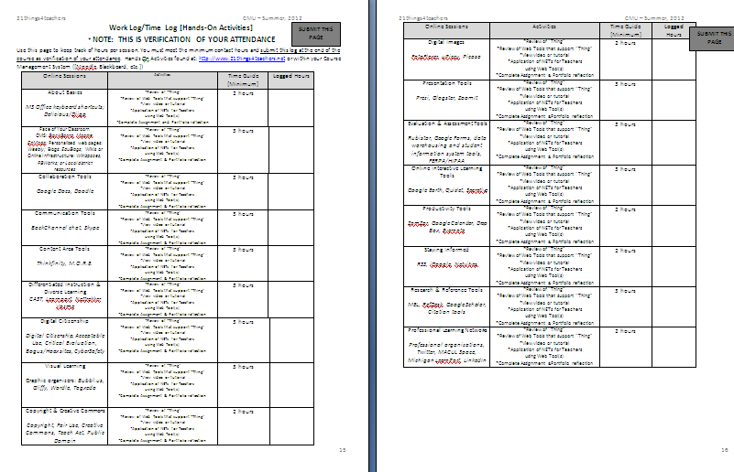
Providing Practice
Practice with purpose
Short, focused, and distributed over time
Include feedback on practice
WorkLogs track practice on each “Thing”
Source: Classroom Instruction that Works, 2nd ed.
Notes:
Participants will practice the use of tools; feedback will be given on screenshots and reflections on practice
Worklogs will provide a record of practice

Slide 32
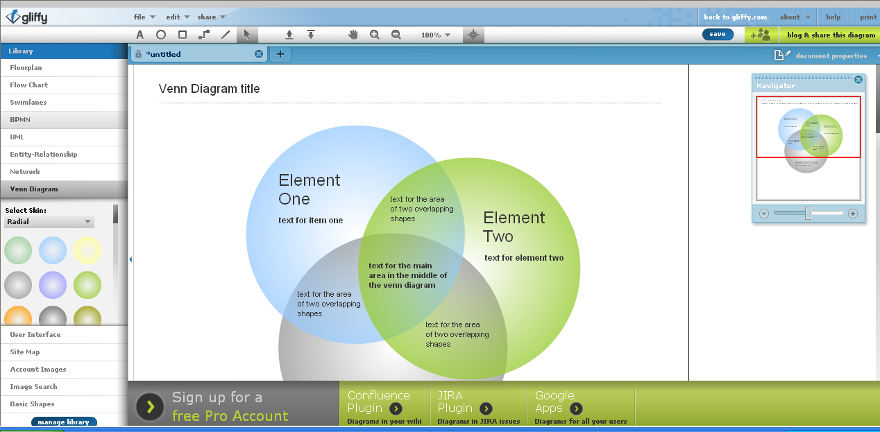
Identifying Similarities and Differences
Comparing, classifying, creating metaphors, creating analogies
Ex: Venn Diagrams, word and picture sorts, visual tools or web formats, online interactive games
Notes:
Participants will utilize “Visual Learning” tools such as Gliffy.
Thinkfinity, Read-Write-Think, and Illuminations have many interactive games the support this strategy.

Slide 33
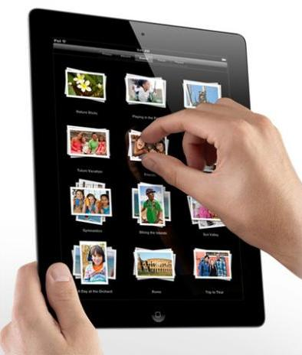
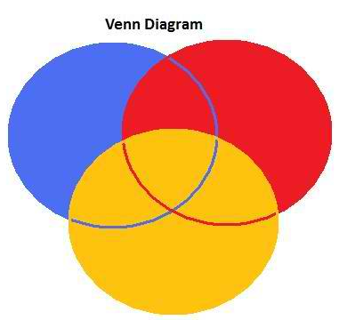
Identifying Similarities and Differences
Compare
Classify
Metaphors
Analogies
Good teachers:
Teach ways to identify similarities and differences
Guide students in the process
Provide cues
Source: Classroom Instruction that Works, 2nd ed.
Notes:
Explain Compare – Classify – Metaphors – Analogies
Compare – grouping by attributes
Classify – identify items, describe key attributes to base classification, create categories
Metaphors – identify themes or patterns of information
identify element, the pattern, and create new information or situation that follows that pattern
Analogies – identify 2 elements, state the relationship, identify another pair that is similar

Slide 34
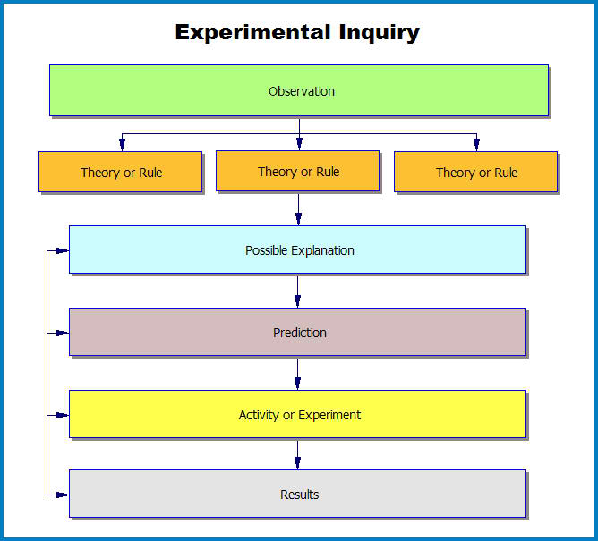
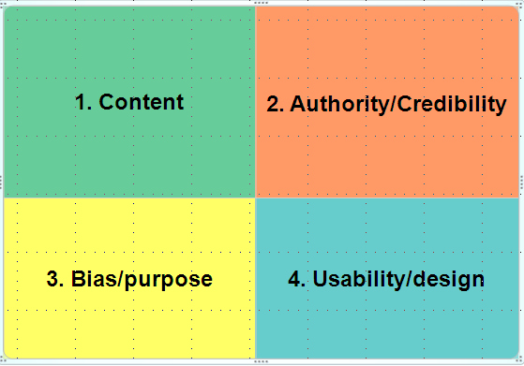
Generating and Testing Hypothesis
System analysis, problem solving, decision making, historical investigation, experimental inquiry and invention
Ex: Researching, reference tools and citations, graphic organizers, content area tools, inter-actives
Notes:
Participants will use “Research and Reference Tools” to evaluate educational databases, wikis, blogs, and Google Scholar
“Digital Citizenship” advocates for critical evaluation of information found on the Internet
See Also: http://flynnl.blogspot.com/2011/03/generating-and-testing-hypotheses-in.html

Slide 35
Generating and Testing Hypothesis
Systems analysis
Analyze how parts interact
Problem solving
Overcoming obstacles to meet goals
Investigation
Explore an area where there is confusion or contradiction
Experimental inquiry
Generating or testing explanations
Participants will be researching new technology and best practice.
Source: Classroom Instruction that Works, 2nd ed.
Notes:
Participants will be asked to generate and test hypothesis through reflection within the portfolio and capstone activities. This would include the “Digital Citizenship” thing in which participants are asked to create a lesson to address the problem of Cyber Bullying, investigating an issue within the “Research and Reference” thing, and craft a plan or policy for one-to-one computing in “Portable Mobile Devices”.
Inductive vs. deductive reasoning
Steps for experimental inquiry, systems analysis, problem solving, investigations – refer to text
Systems – purpose of system, describe parts that affect one another, identify part or system and describe change – hypothesize what may occur, test hypothesis
Experimental – observe something, explain observation and possible theories/rules that relate, make predictions, set up experiment, explain results
Problem solving – identify goal, describe barriers/obstacles, identify solutions, test solution, explain whether hypothesis was accurate
Investigations – describe event, identify what is known/agreed upon and what is confusing/contradictory, offer hypothesis, analyze evidence

Slide 36
When strategies are effectively implemented, achievement gains occur…
Similarities & Differences
Summarizing & Note-Taking
Effort & Recognition
Homework & Practice
Non-Linguistic Representations
Cooperative Learning
Objectives & Feedback
Hypotheses
Questions, Cues & Advance Organizers
45
34
29
28
27
27
23
23
22
Average Percentile Point Gains on Student Achievement Tests
Taken from Classroom Instruction That Works, P.7 (Marzano, Pickering, Pollock, 2004)

Slide 37
Additional Research Marzano expands the 9 to 22
Advance Organizers
Building vocabulary
Complex cognitive tasks
Cooperative learning
Cues and questions
Effort and recognition
Engagement strategies
Feedback
Graphic organizers
Homework
Identifying similarities and differences
Interactive games
Kinesthetic activities
Nonlinguistic representations
Note taking
Partial vocabulary
Practice
Setting goals/objectives
Student discussion/chunking
Summarizing
Tracking student progress and scoring scales
Voting technology
For additional information about these strategies, visit:
http://www.marzanoresearch.com/research/researched_strategies.aspx
Notes:
First edition author, Robert Marzano, has created a Meta-Analysis database. Dr. Marzano incorporates multiple research studies to expand the 9 strategies of best practice instruction to 22 through meta-analysis.
This will NOT be an emphasis of this course, but is presented for enrichment only.
The following slides provide information found at his website describing each of the 22 strategies.
Note how technology has influenced instruction and improved learning for many.
Advance Organizers: Providing students with a preview of new content
Building vocabulary: Using a complete six-step process to teach vocabulary that includes teacher explanation, student explanation, student graphic or pictographic representation, review using comparison activities, student discussion of vocabulary terms, and use of games.
Complex cognitive tasks: Working on complex tasks such as investigation, problem solving, decision making, and experimental inquiry.
Cooperative learning: Students working together in small groups.
Cues and questions: Using hints and questions to activate prior knowledge and deepen student understanding
Effort and recognition: Reinforcing and tracking student effort and providing recognition for achievement
Engagement strategies: – Using activities designed to help capture students’ attention.
Feedback: Providing students with information relative to how well they are doing regarding a specific assignment
Graphic organizers: Providing a visual display of something being discussed or considered (e.g., using a Venn diagram to compare two items)
Homework: Providing students with opportunities to increase their understanding through assignments completed outside of class
Identifying similarities and differences: Identifying similarities and/or differences between two or more items being considered
Interactive games: Using academic content in game-like situations
Kinesthetic activities: Students representing new content physically
Nonlinguistic representations: Providing a representation of knowledge without words (e.g., a graphic representation or physical model)
Note taking: Recording information that is considered important
Partial vocabulary: Using one or more aspects of a six-step process to teach vocabulary which may include teacher explanation, student explanation, student graphic or pictographic representation, review using comparison activities, student discussion of vocabulary terms, and use of games
Practice: Massed and distributed practice on a specific skill, strategy, or process
Setting goals/objectives: Identifying a learning goal or objective regarding a topic being considered in class
Student discussion/chunking: Breaking a lesson into chunks for student or group discussion regarding the content being considered
Summarizing: Requiring students to provide a brief summary of content
Tracking student progress and scoring scales: Using scoring scales and tracking student progress toward a learning
Voting technology: Using interactive clicker technology to collect data regarding student knowledge during class
© Copyright 2009 Marzano Research Laboratory.

Slide 38
Work Cited
Dean, C. B., Stone, B., Hubbell, E., & Pitler, H. (2012). Classroom instruction that works: Research-based strategies for increasing student achievement (2nd ed.). Alexandria, VA: ASCD.
Marzano, R. J., Pickering, D. J., & Pollock, J. E. (2001). Classroom instruction that works: Research-based strategies for increasing student achievement. Alexandria, VA: Association for Supervision and Curriculum Development.
Marzano Meta Analysis Database retrieved online at http://www.marzanoresearch.com/research/researched_strategies.aspx
Marzano Research Laboratories retrieved online at http://www.marzanoresearch.com/research/researched_strategies.aspx
Pitler, H., Kuhn, M., & Hubbell, E.R. (2012). Using technology with classroom instruction that works, 2nd.ed. Alexandria, VA: Association for Supervision and Curriculum Development.
Putting the Pieces Together: Integrating Technology with Marzano’s Instructional Strategies, Sherri Miller retrieved online at http://gets.gc.k12.va.us/VSTE/2008/index.htm

Slide 39
Questions?
Project Partners and Co-Creators of 21things:
Carolyn McCarthy cjmccarthy56@gmail.com
Melissa White mwhite@inghamisd.org
Dr. Jennifer Parker-Moore jpmoore@misd.net
Janice Harding jharding@misd.net
Mid-continent Research for Education and Learning
http://www.mcrel.org

