Slide 1

Mentoring Matters: Supporting New Teacher Success

Slide 2

Welcome and Introductions

Slide 3

The Complex Job of Teaching

Slide 4

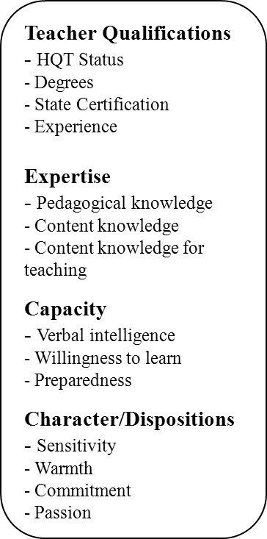


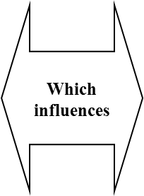


Moving From “Qualified” to “Effective”

Slide 5
New Teacher Attrition
Why do good teachers leave?
  Isolation or non-supportive
  teaching environments
  Dissatisfaction with working conditions
  Overwhelming
  teaching assignments
Note. From Teacher Attrition: A Costly Loss to the Nation and to the States (Issue Brief), August 2005, Washington, DC: Alliance for Excellent Education.

Slide 6
Mentor
From Greek Mythology
Mentor was the friend of
Odysseus. Odysseus entrusted
his son, Telemachus, to Mentor
when he went on long journeys.
Mentor’s role was to provide
advice, guidance, and support
to Telemachus in his father’s
absence.

Slide 7

The Importance of Mentoring
Mentoring is a demonstration of caring for individuals in the profession.
Mentoring is part of a comprehensive plan for professional growth grounded in what we know about adult learning and development.
A successful mentoring program can help teachers intentionally respond with effective strategies to the needs of a diverse population if learners.
Mentoring provides the beginning teacher with a one-on-one relationship with an experienced teacher who serves as the confidante, the cheerleader, and the trusted counselor.

Slide 8

Partnering for Success
Group 1 – Describe the attributes of a successful teacher…
Group 2 – Describe the attributes of a successful Mentor/Coach…

Slide 9

Metaphors for a Mentoring Relationship

Slide 10
The Five Phases….
Anticipation Phase
Survival Phase
Disillusionment Phase
Rejuvenation
Reflection

Slide 11
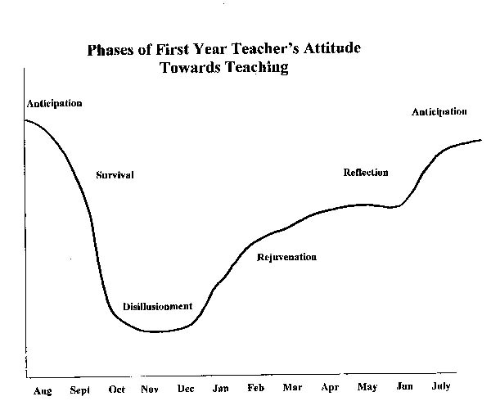
Phases of First Year of Teaching

Slide 12
ANTICIPATION PHASE
The anticipation phase begins during the student teaching.
The closer student teachers get to completing their assignment, the more excited and anxious they become about their first teaching position.
This phase usually lasts through the first few weeks of school.

Slide 13
DISILLUSIONMENT PHASE
After about 6-8 weeks, new teachers are faced with several new events (parent conferences, evaluations by administrator, etc. )
New teachers start questioning both their commitment and competence, express self-doubt, and have lower self esteem.

Slide 14
SURVIVAL PHASE
During the first month, beginning teachers are often bombarded with a variety of problems that they had not planned on.
There is little time for new teachers to stop and reflect on their experiences.
New teachers spend up to 70 hours a week on schoolwork.
Become focused and consumed with the day-to-day routines of teaching.

Slide 15
REJUVENATION
Usually occurs in January, soon after returning from winter break.
There is a slow rise in the new teacher’s attitude toward teaching.
They gain new coping strategies and skills to prevent, reduce, or minimize problems.

Slide 16
REFLECTION
“It is critical that we assist new teachers and ease the transition from student teacher to full-time professional.”
We need to know the ways to help new teachers during their first years, so they have a more positive experience.

Slide 17
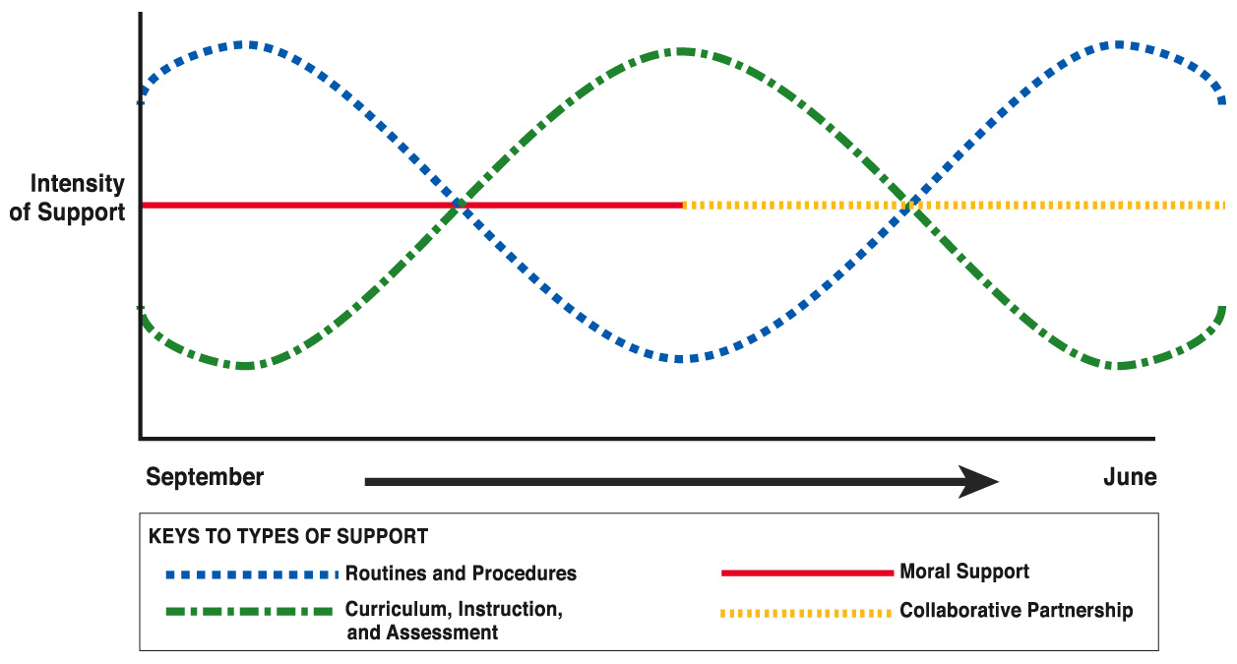
Types of Mentor Support
Note. Developed from “Perceived Problems of Beginning Teachers,” by Simon Veenman, 1984,
Review of Educational Research, 54 (2).

Slide 18
Developmental
Stages of Concern
Frances Fuller (1969) asked teachers to describe their chief concerns about teaching. The study resulted in the identification of three developmental levels of teacher concern.
Notes:
Another model for beginning teacher growth comes from Frances Fuller. Even though Fuller identified these Stages of Concern over forty years ago, they are still relevant to beginning teachers today.
Source: Fuller, F. 1969. Concerns of teachers: A developmental continuum. American Educational Research Journal 6 (2):207-26.

Slide 19
The Stages of Concern
Stage 1: Survival
Stage 2: Task
Stage 3: Impact
Notes:
The Stages of Concern describe teacher development, including the first year in the classroom and beyond. As with any developmental sequence, remember that this one is not linear. Beginning teachers, in fact all teachers, may pass through the stages many times in their careers.

Slide 20
The SURVIVAL Stage
Survival Stage
Stage One
Self
Support mentors can provide beginning teachers during the Survival Stage:
  Look for opportunities to provide specific praise
  Show interest in the beginning teachers’ ideas
  Facilitate reflection on things that are going well and on how setbacks can be avoided in the future
  Invite beginning teachers to social and professional activities
  Share coping skills
  Encourage beginning teachers to live balanced lives with time for self, family, and friends
Notes:
Think about what it’s like to learn something for the first time, whether it’s cooking, caring for your first pet, or even swimming. When learning to swim, we are just trying to keep our heads above water. How do you think teachers are feeling in the Survival Stage?
Fuller’s Stage 1 is similar to Moir’s Phase 2. At this stage, beginning teachers talk a lot about “I” and “me.” They feel that no one else understands them. Mentors need to be aware of and listen for key phrases that indicate this focus on self.
When beginning teachers are in the Survival Stage, they need different kinds of support than they will at other stages. The following are the kinds of support mentors can provide beginning teachers during the Survival Stage. Mentors should:
Look for opportunities to provide specific praise;
Show interest in the beginning teachers’ ideas;
Facilitate reflection on things that are going well and on how setbacks can be avoided in the future;
Invite beginning teachers to social and professional activities;
Share coping skills; and
Encourage beginning teachers to live balanced lives with time for self, family, and friends.

Slide 21
The TASK Stage
Stage Two
Stage One
Task Stage
Time/
Task
Self
Survival Stage
Support mentors can provide beginning teachers during the Task Stage:
  Help beginning teachers prioritize all of their tasks
  Invite beginning teachers to look at and adapt lesson plans
  Share methods of accomplishing common teaching and management tasks
  Arrange for beginning teachers to speak to and observe other colleagues
  Invite beginning teachers to reflect on their rationales for instructional decisions
Notes:
In the Task Stage, we are able to stay afloat by dog paddling. We are starting to learn some other strokes.
In the Task Stage, teachers are primarily concerned with the tasks of teaching. They may feel overwhelmed with all the intricacies of educating and the limited amount of time in which to complete all the tasks they have on their plates. Beginning teachers in this stage may feel as if they are working as hard as they can but still cannot get everything done.
When beginning teachers are in the Task Stage, mentors need to provide support that is appropriate for this stage of concern. The following are the kinds of support mentors can provide beginning teachers during the Task Stage. Mentors should:
Help beginning teachers prioritize all of their tasks;
Invite beginning teachers to look at and adapt lesson plans;
Share methods of accomplishing common teaching and management tasks;
Arrange for beginning teachers to speak to and observe other colleagues; and
Invite beginning teachers to reflect on their rationales for instructional decisions.
Note that this stage is similar to Moir’s Phase 4, which was covered earlier in the module.

Slide 22
The IMPACT Stage
Stage Three
Stage Two
Stage One
Impact Stage
Student
Learning
Time/Task
Task Stage
Survival Stage
Self
In the Impact Stage, the beginning teacher is having the most effect on students and their learning. It is the mentor’s job to listen and watch for ways to help the beginning teacher move to this stage. The mentor should always be cognizant of the phases a teacher goes through and how those phases might align with the Stages of Concern.
Notes:
The Impact Stage is similar to Moir’s Phase 5. In the Impact Stage, the beginning teacher is having the most effect on students and their learning. This stage is where we would like them to be. It is the mentor’s job to listen and watch for ways to help the beginning teacher move to this stage. However, the mentor should always be cognizant of the phases a teacher goes through and how those phases might align with the Stages of Concern. Mentors need to be aware of all the signs beginning teachers exhibit in order to provide the most appropriate support in the moment.

Slide 23

The New Landscape
How New Teachers Earn Tenure and How Administrators Evaluate Them.

Slide 24
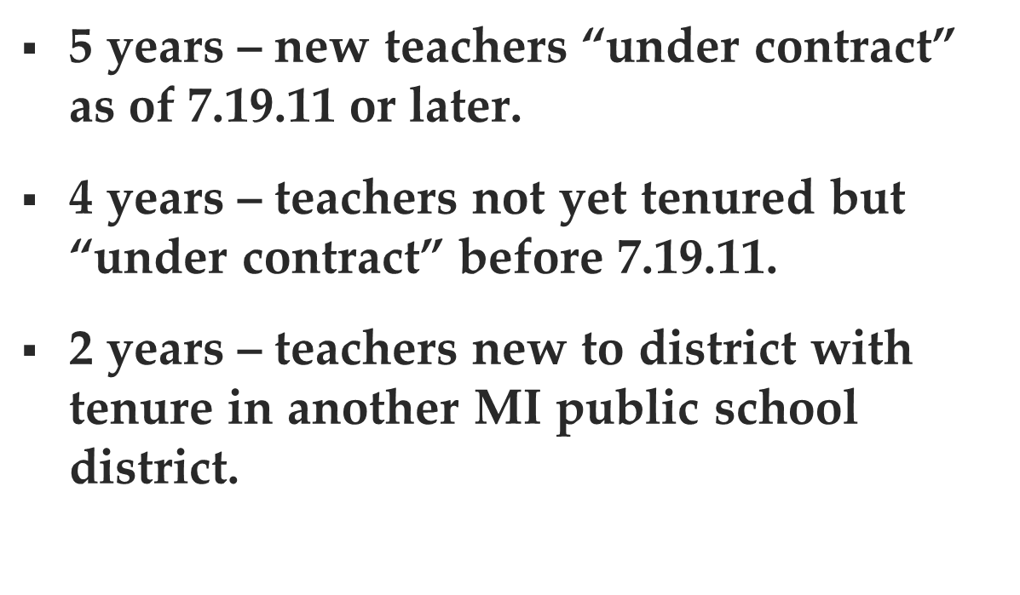
LENGTH OF PROBATIONARY PERIOD

Slide 25
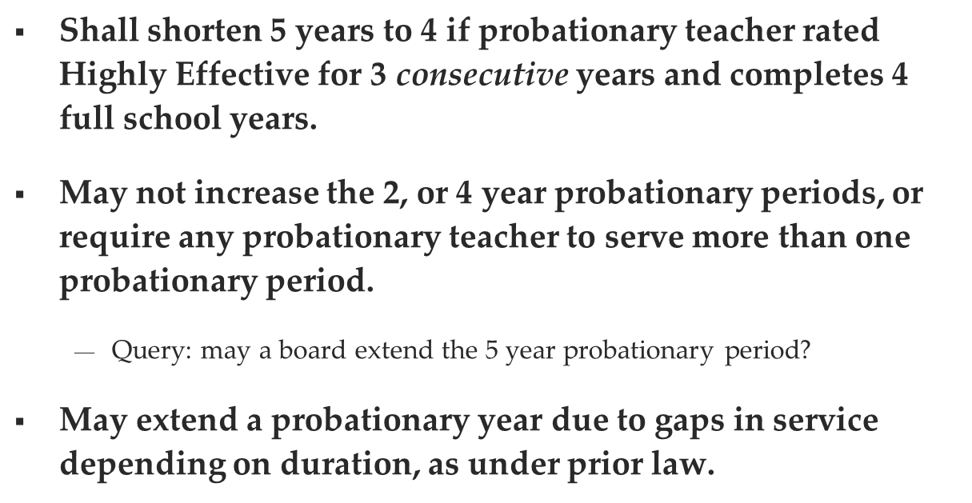
May District Modify Probationary Period?

Slide 26
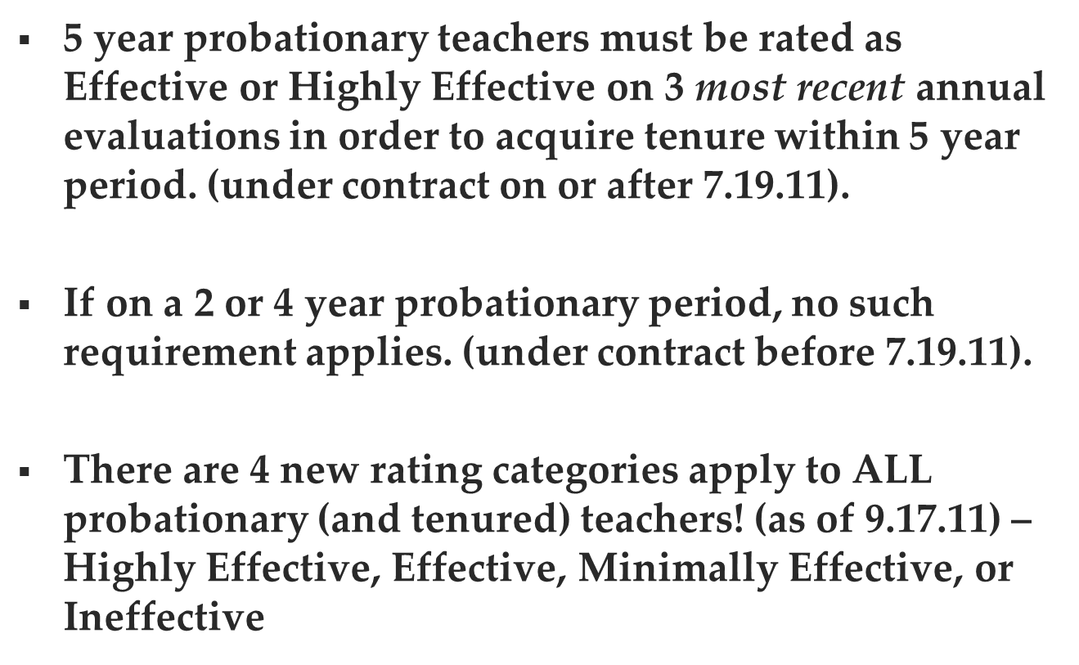
How Probationers Acquire Tenure

Slide 27
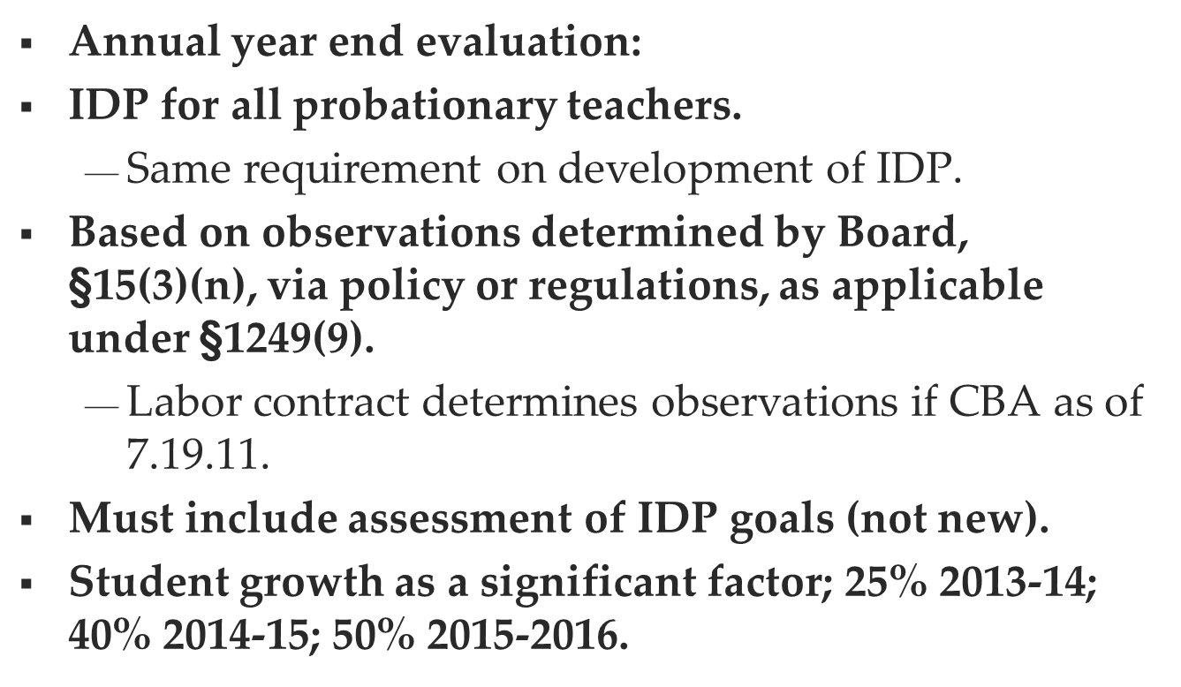
Probationary Teacher Evaluations

Slide 28
Individual Performance Measures
Instructional Leadership Abilities
Demonstrated Pedagogical Skills
Classroom Management
Rapport with Parents and Other Teachers
Teacher Attendance/Disciplinary Record
Evidence of Student Growth

Slide 29


Slide 30
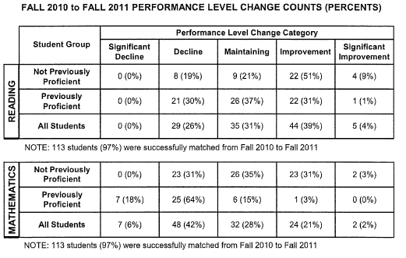

Slide 31
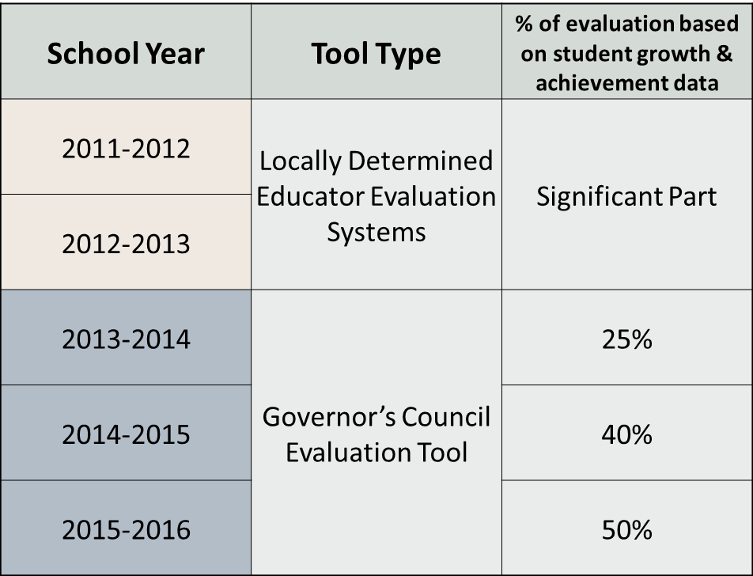
TIMELINE

Slide 32
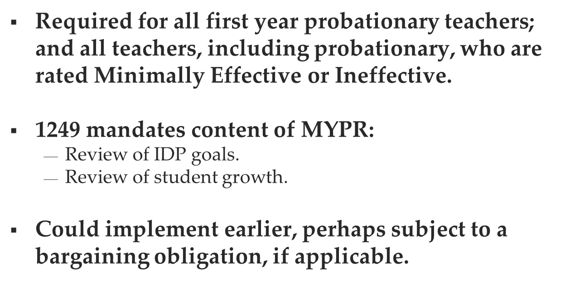
2013-2014: Mid-Year Progress Report

Slide 33


What Might An IDP Look Like?

Slide 34
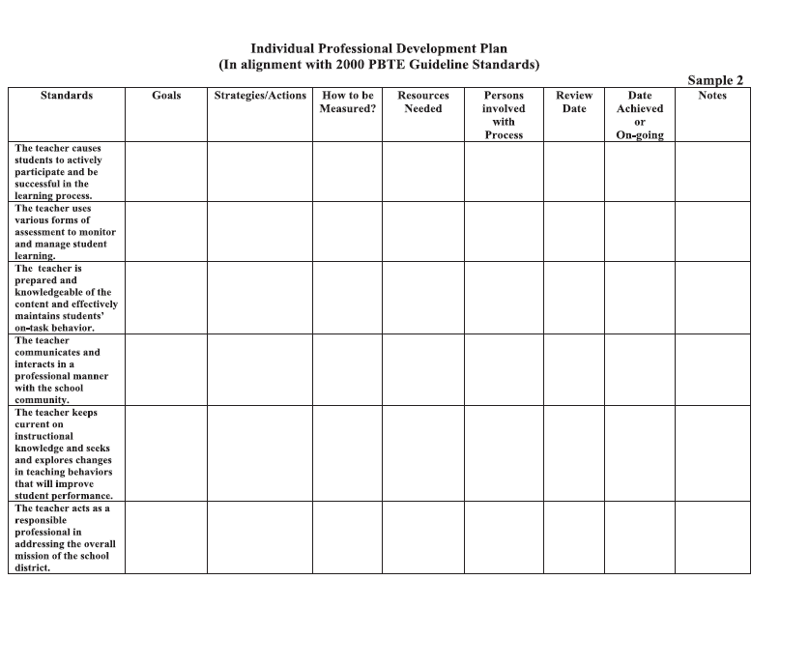

Slide 35
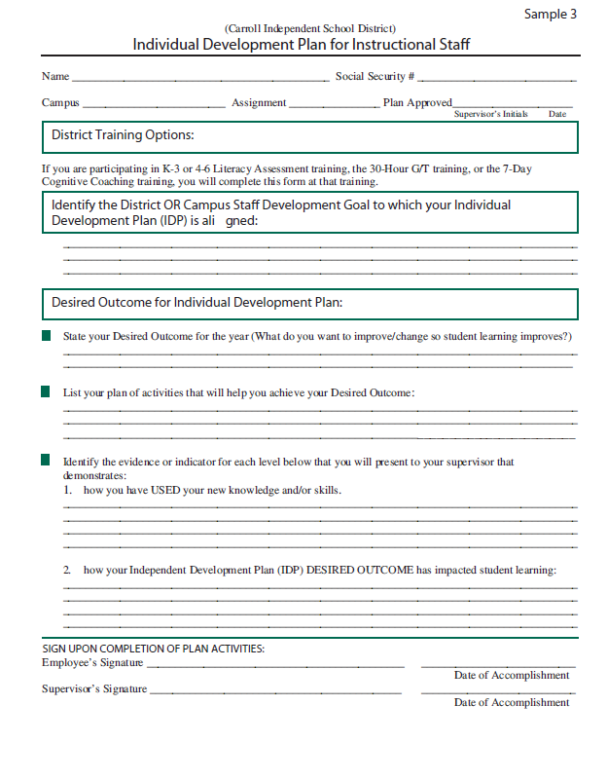

Slide 36
Teacher Ratings & Dismissal
If a teacher receives a rating of Ineffective of minimally effective, the district must provide an IDP that requires the teacher to make progress within 180 days.
A teacher who is rated as ineffective for 3 consecutive years MUST be dismissed.
Beginning in 2015-16, a teacher whose last two year-end ratings were ineffective, the school MUST send letters to parents.

Slide 37
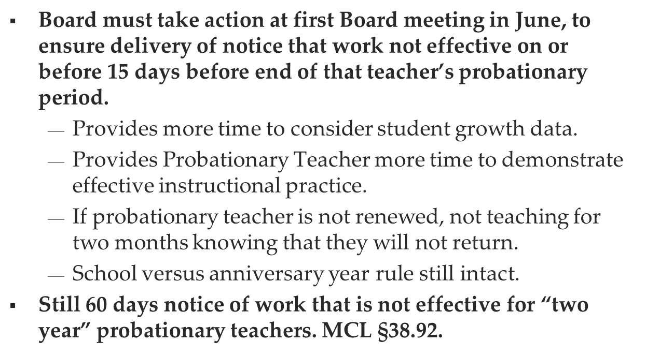
Nonrenewal of Probationary Teachers

Slide 38
Broadening our image of mentoring…
Fitting in
How is it going?
Open door for resources
Listening/valuing ideas
Including in norm development
Learning to teach (Expanding Beyond “Buddy” Mentoring
Sharing learning together
Helping in the classroom
Asking questions to push thinking
Adapted from MSU Assist

Slide 39
Mentoring for survival is NOT enough
“It’s funny, we talk about them in the survival stage and…if we’re helping them to survive, that shouldn’t be our only role. I mean, there should be more to it. I can’t say, ‘I’m going to help you just survive’, because that’s not what they want either.”
–Jake (pseudonyn) Michigan mentor teacher (in Stanulis, Meloche & Ames, 2005).

Slide 40
Categories of Support
Organization and managing classrooms
Maintaining student discipline
Pacing lessons.
Planning for instruction
Using time effectively
Diagnosing student learning needs/Evaluating student progress.
Motivating students.
Inviting self-reflection
Providing instructional resources and materials.
Communicating with parents.
Dealing with stress.
Preparing for and conducting parent conferences.
Understanding the different learning styles of students.
Becoming familiar with system-wide policies.
(Curriculum Review, 2003)

Slide 41
Mentoring Conversations
Find out what the beginning teacher needs
(build trust, identify successes and challenges)
Establish a clear focus for your work
(paraphrase and clarify)
Support the teacher in moving his/her practice forward
(direct teaching, collaborative problem solving, questioning)
Promote accountability for growth
(identify specific next steps and setting time for follow-up)
from the New Teacher Center, USCS, 2005

Slide 42
“The most important characteristic of a successful mentor is a commitment to provide personal time and attention to the beginner.”
“How to Help Beginning Teachers Succeed”
By Steven Gordon
Notes:
Through this kind of personalized time and attention, mentors can determine where beginning teachers are in their phases of development and stages of concern and can tailor support accordingly.

