Slide 1

What’s the Big Idea? – Personal Bests
  What is “High Impact Teaching”?
  How do you define Success?

Slide 2
The Essential Why: Why are You Teaching?
Developing a high-impact mindset requires having an idea of why you are teaching. What is it you want?
  Recognition?
  Appreciation?
  Satisfaction from serving others?
Make a list…

Slide 3
Expectations
What are your expectations for yourself and
for your students?
These are crucial and become high-impact performance controls – like a mental dimmer switch.
Expectations influence outcomes. It follows the “law of belief” – You see what you believe. You tend to get what you expect.
Positive expectations fuel performance. Negative one tend to lower achievement.
Write your expectations and put them in a sealed envelope. You can open and reflect on these in the Spring…

Slide 4
Classroom
Management
Content
Planning
The Big Four
Assessment For
Learning
Instruction

Slide 5
Content Planning
Notes:
5

Slide 6
Levels of Learning
Learning is not – “ta da”
Learners do not suddenly learn skills and
concepts.
Learning Research & Brain Research show
learners progress through levels of learning
  Each level takes the learner to a further depth of
  understanding
  Learners become more capable of applying skills and
  concepts to their lives as they progress through the
  levels
Notes:
6
Review of learning
Using Dimensions of Learning as the basis for understanding learning, we use 3 levels of learning in this adapted model.
If these are the levels of learning, then how do we make sure that all learners pass through the levels? This provides the Learning-Focused model for lessons and units.
From a combination of cognitive psychology research and brain research, we know that acquisition is 70% short term memory. That means that if we learned 10 things today, 20 days from now the entire group on average would remember about 2-3. We would have an approximate drop in memory of 7.
We have to go deeper with student learning, especially on the most important concepts and skills.

Slide 7
Levels of Learning
I. Acquisition
Essential question
Linking prior knowledge
Scaffolding/preview
Collaborative pairs
Distributed practice
Distributed summarizing
Graphic organizers
II. Extending
& Refining
Cause/Effect
Compare/Contrast
Classify
Construct Support
Analyze Perspectives
Justification
Induction
Deduction
Error Analysis
Evaluation
Abstracting
Example To Idea
Idea To Example
Writing Prompts
III. Authentic, Meaningful
Use, Understanding, & Mastery
Decision Making
Problem Solving
Investigation
Invention
Experimental Inquiry
(Adapted From Marzano: ASCD, 1992)
Notes:
Plan for Learning! Also, new tests use this to structure item stems.

Slide 8
KEY LEARNING: A full statement of what is essential for students to know and do, representing the most important ideas key to understanding the content.
UNIT ESSENTIAL QUESTION(S):
Written as a thought provoking and engaging question about the content that provides a view of the ‘Big Picture’ and acts as the ‘Mental Velcro’ for students to make connections. Written in student language. Meant to guide instruction and to be answered by students at the end of the unit of study.
Concepts: The ‘heart’ of the unit’s content. A broad abstract idea or guiding general principle. | Concepts: Key ideas that connect the skills or knowledge to the overarching topic. | Concepts: Nouns in the ‘Performance Objectives’ of each state’s standards.
Lesson Essential Questions: Concept specific but links to and supports the unit essential question. | Lesson Essential Questions: Driven by the K-U-D Organizer. Frames the study of the topic and guides the learning. Designed to cause ‘higher level thinking.’ | Lesson Essential Questions: Used as an activating strategy at the beginning of a lesson and the summarizing strategy at the end.
Vocabulary: Words that are critical and essential to understanding the concept & content being taught. | Vocabulary: Multiple meaning words and words that are easily misunderstood. | Vocabulary: Words related to concepts and skills being taught.

Slide 9
Curriculum Map for Kindergarten/Social Studies: My Earth
Key Learning: Geography, climate, and natural resources affect the way people live and play.
Unit Essential Question:
What affects the way we live and play?
Maps &
Globes
Climate &
Weather
Taking Care
of the Earth
LEQs:
What is a map?
How do we use a map?
What is a globe?
How do we use a globe?
LEQs:
What is climate?
What are the 4
seasons?
LEQs:
1. What are natural
resources?
2. Why do we need to
recycle?
Vocabulary:
Earth ocean
country lake
mountain forest
jungle
Vocabulary:
climate season
Fall Autumn
Spring Summer
Winter weather
Vocabulary:
natural resource
recycle
reuse
reduce

Slide 10
Student Learning Map
My Earth
Unit Essential Question:
What affects the way we live and play?
Maps &
Globes
Climate &
Weather
Taking Care
of the Earth

Slide 11
Student Learning Map
My Earth
Unit Essential Question:
What affects the way we live and play?
Maps &
Globes
Climate &
Weather
Taking Care
of the Earth
Vocabulary:
Earth
Country
mountain
Jungle
Ocean
Lake
forest

Slide 12
Student Learning Map
My Earth
Unit Essential Question:
What affects the way we live and play?
Maps &
Globes
Climate &
Weather
Taking Care
of the Earth
Vocabulary:
Earth
Country
mountain
Jungle
Ocean
Lake
forest
Vocabulary:
climate
Season
Fall
Autumn
Spring
Winter
Autumn
Summer
weather

Slide 13
Student Learning Map
My Earth
Unit Essential Question:
What affects the way we live and play?
Maps &
Globes
Climate &
Weather
Taking Care
of the Earth
Vocabulary:
Earth
Country
mountain
Jungle
Ocean
Lake
forest
Vocabulary:
climate
Season
Fall
Autumn
Spring
Winter
Autumn
Summer
weather
Vocabulary:
natural resource
recycle
reuse
reduce

Slide 14
Kindergarten/Social Studies: My Earth
Key Learning: Geography, climate, and natural resources affect the way people live and play.
Unit Essential Question:
What affects the way we live and play?
Maps &
Globes
Climate &
Weather
Taking Care
of the Earth
LEQs:
What is a map?
How do we use a map?
What is a globe?
How do we use a globe?
LEQs:
What is climate?
What are the 4
seasons?
LEQs:
1. What are natural
resources?
2. Why do we need to
recycle?
Vocabulary:
Earth ocean
country lake
mountain forest
jungle
Vocabulary:
climate season
Fall Autumn
Spring Summer
Winter weather
Vocabulary:
natural resource
recycle
reuse
reduce

Slide 15
English Literature: High School
Key Learnings: To define and understand the elements and characteristics of
Shakespearean tragedy. Explore the tragic heroes in the Shakespearean tragedies and
identify the flaws, events, and influences that led to the tragedy of each hero.
Unit Essential Questions: Why a tragedy? What are the characteristics of a
Shakespearean tragedy?
Concept: Character Analysis
Concept: Literary Analysis
Concept: Drama Characteristics
LEQ(s):
1. Why do we call them tragic
heroes?
2. What are the common
characteristics of William
Shakespeare’s tragic
heroes?
LEQ(s):
1. What are the literary elements
of a Shakespearean play?
2. How do these elements work
together to develop a tragedy?
LEQ(s):
1. How do Shakespearean
drama characteristics
enhance the portrayal of the
tragic hero?
Vocabulary:
Protagonist
Intellectual
Virtuous
Avenging
Flawed
Antagonist
Vocabulary:
Setting
Characterization
Theme
Plot/Conflict
Imagery
Dramatic Irony
Vocabulary:
Monologue
Soliloquy
Aside
Foil
Catastrophe
Staging

Slide 16
Shakespeare’s Tragedies
Unit Essential Questions: Why a tragedy?
What are the characteristics of a Shakespearean tragedy?
Character Analysis
Literary Analysis
Drama
Characteristics

Slide 17
Shakespeare’s Tragedies
Unit Essential Questions: Why a tragedy?
What are the characteristics of a Shakespearean tragedy?
Character Analysis
Literary Analysis
Drama
Characteristics
Vocabulary:
Protagonist
Intellectual
Virtuous
Avenging
Flawed
Antagonist

Slide 18
Shakespeare’s Tragedies
Unit Essential Questions: Why a tragedy?
What are the characteristics of a Shakespearean tragedy?
Character Analysis
Literary Analysis
Drama
Characteristics
Vocabulary:
Protagonist
Intellectual
Virtuous
Avenging
Flawed
Antagonist
Vocabulary:
Setting
Characterization
Theme
Plot/Conflict
Imagery
Dramatic Irony

Slide 19
Shakespeare’s Tragedies
Unit Essential Questions: Why a tragedy?
What are the characteristics of a Shakespearean tragedy?
Character Analysis
Literary Analysis
Drama
Characteristics
Vocabulary:
Protagonist
Intellectual
Virtuous
Avenging
Flawed
Antagonist
Vocabulary:
Setting
Characterization
Theme
Plot/Conflict
Imagery
Dramatic Irony
Vocabulary:
Monologue
Soliloquy
Aside
Foil
Catastrophe
Staging

Slide 20
English Literature: High School
Key Learnings: To define and understand the elements and characteristics of
Shakespearean tragedy. Explore the tragic heroes in the Shakespearean tragedies and
identify the flaws, events, and influences that led to the tragedy of each hero.
Unit Essential Questions: Why a tragedy? What are the characteristics of a
Shakespearean tragedy?
Concept: Character Analysis
Concept: Literary Analysis
Concept: Drama Characteristics
LEQ(s):
1. Why do we call them tragic
heroes?
2. What are the common
characteristics of William
Shakespeare’s tragic
heroes?
LEQ(s):
1. What are the literary elements
of a Shakespearean play?
2. How do these elements work
together to develop a tragedy?
LEQ(s):
1. How do Shakespearean
drama characteristics
enhance the portrayal of the
tragic hero?
Vocabulary:
Protagonist
Intellectual
Virtuous
Avenging
Flawed
Antagonist
Vocabulary:
Setting
Characterization
Theme
Plot/Conflict
Imagery
Dramatic Irony
Vocabulary:
Monologue
Soliloquy
Aside
Foil
Catastrophe
Staging

Slide 21
Curriculum Maps & Student Learning Maps: Why are they so important?
Communication device
Conceptualize a unit
Enable consistent curriculum pacing and planning
Highlight important vocabulary
Enable students to "see" the knowledge gained over time and their learning

Slide 22
Difference between a Curriculum Map and a Student Learning Map
2’s turn to 1’s and explain three similarities between CMs and SLMs.
1’s write them down.
1’s turn to 2’s and explain three differences between CMs and SLMs

Slide 23
An Example of a Student Learning Map

Slide 25
Good Examples of Student Learning Maps

Slide 26
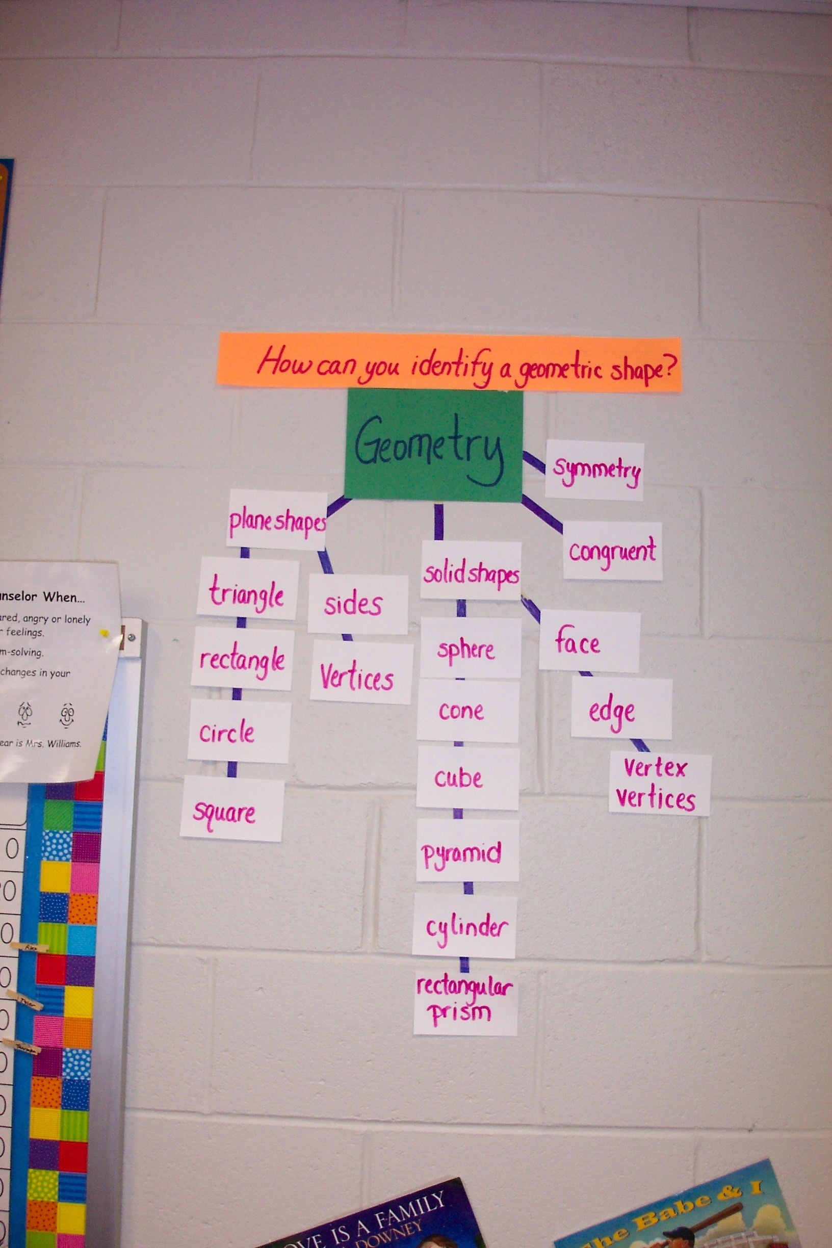

Slide 27
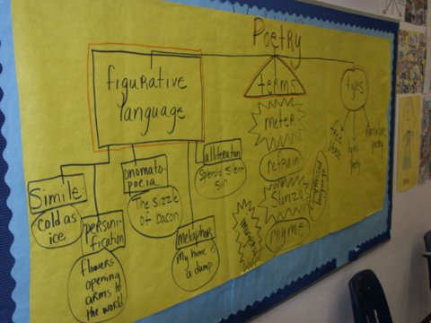

Slide 28
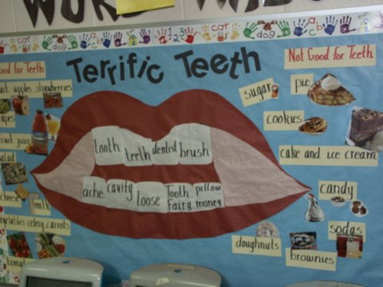
Kindergarten Adaptation

Slide 29
Examples of Student Learning Maps
That Need Work!

Slide 30
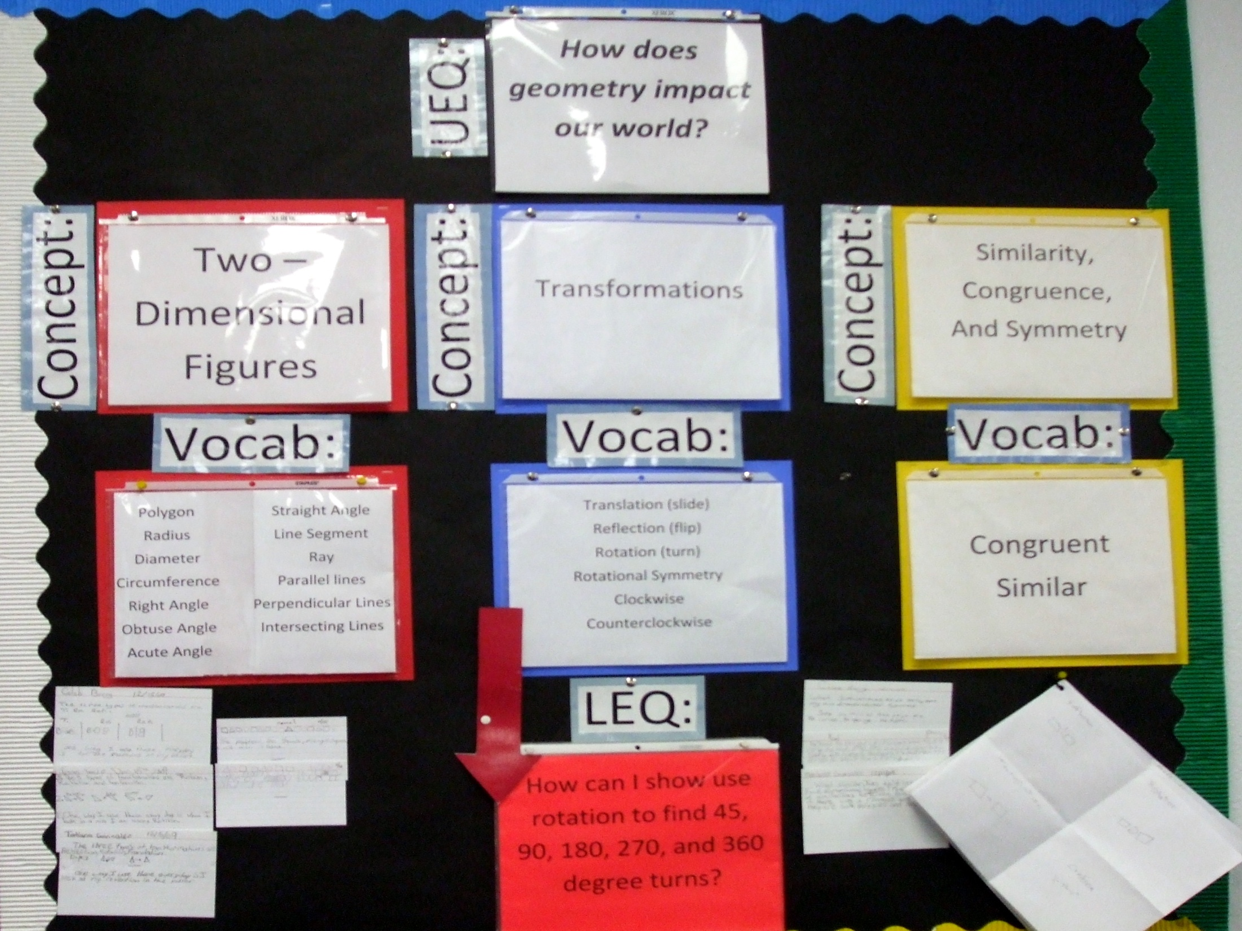

Slide 31
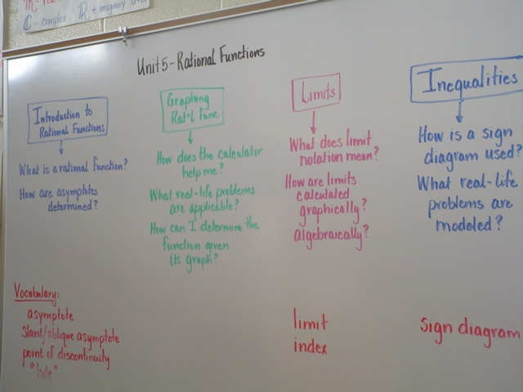

Slide 32
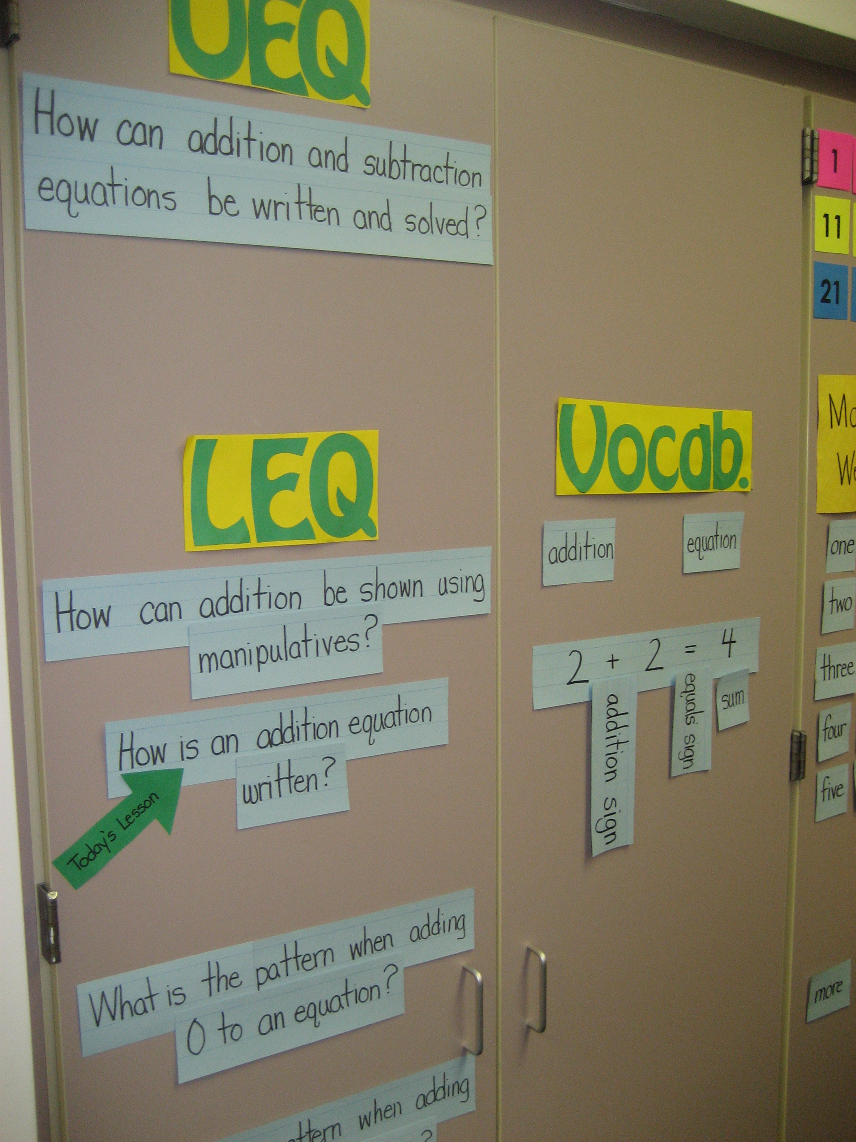

Slide 33
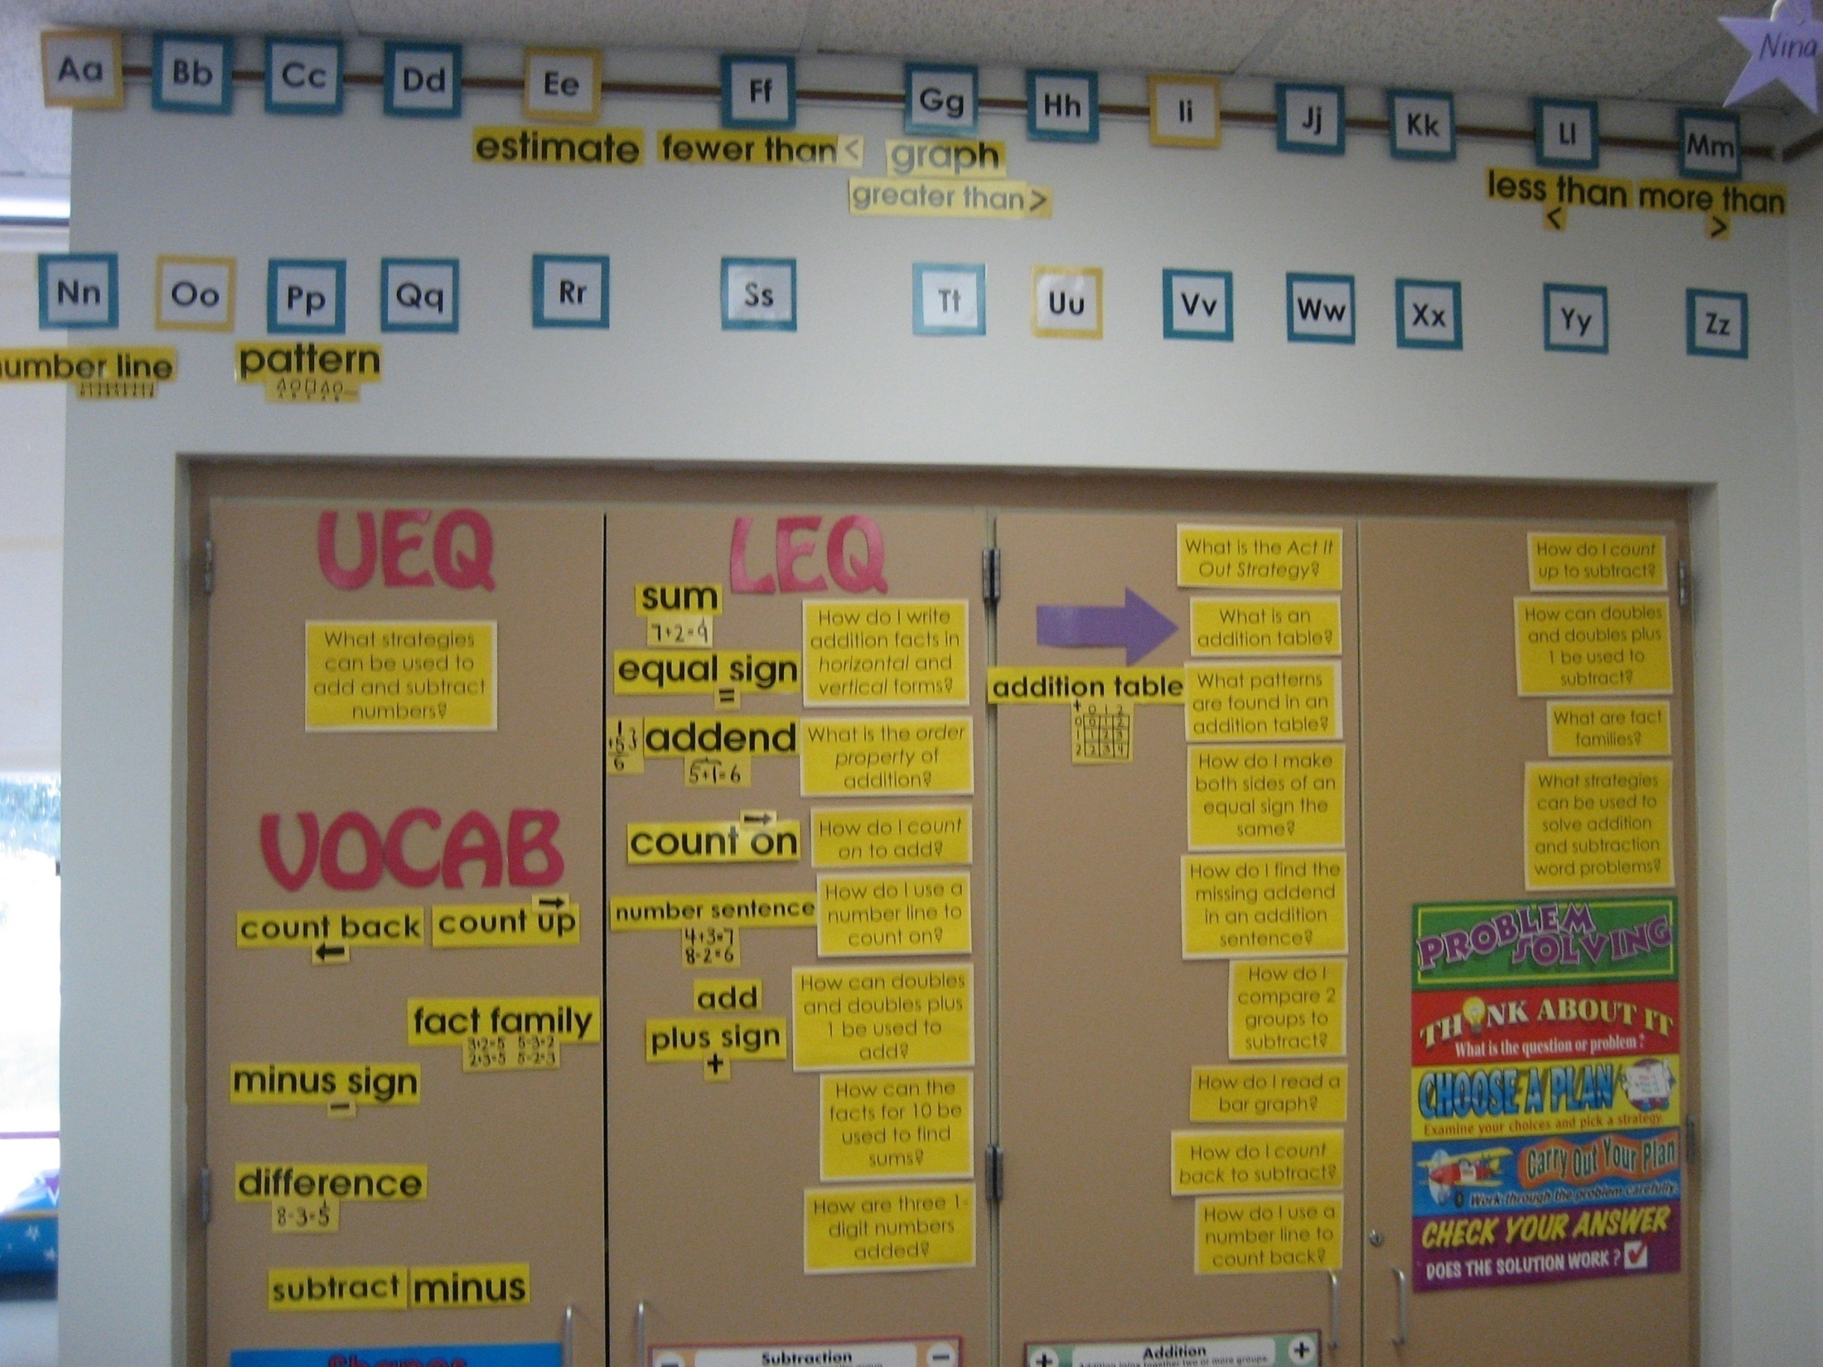

Slide 34
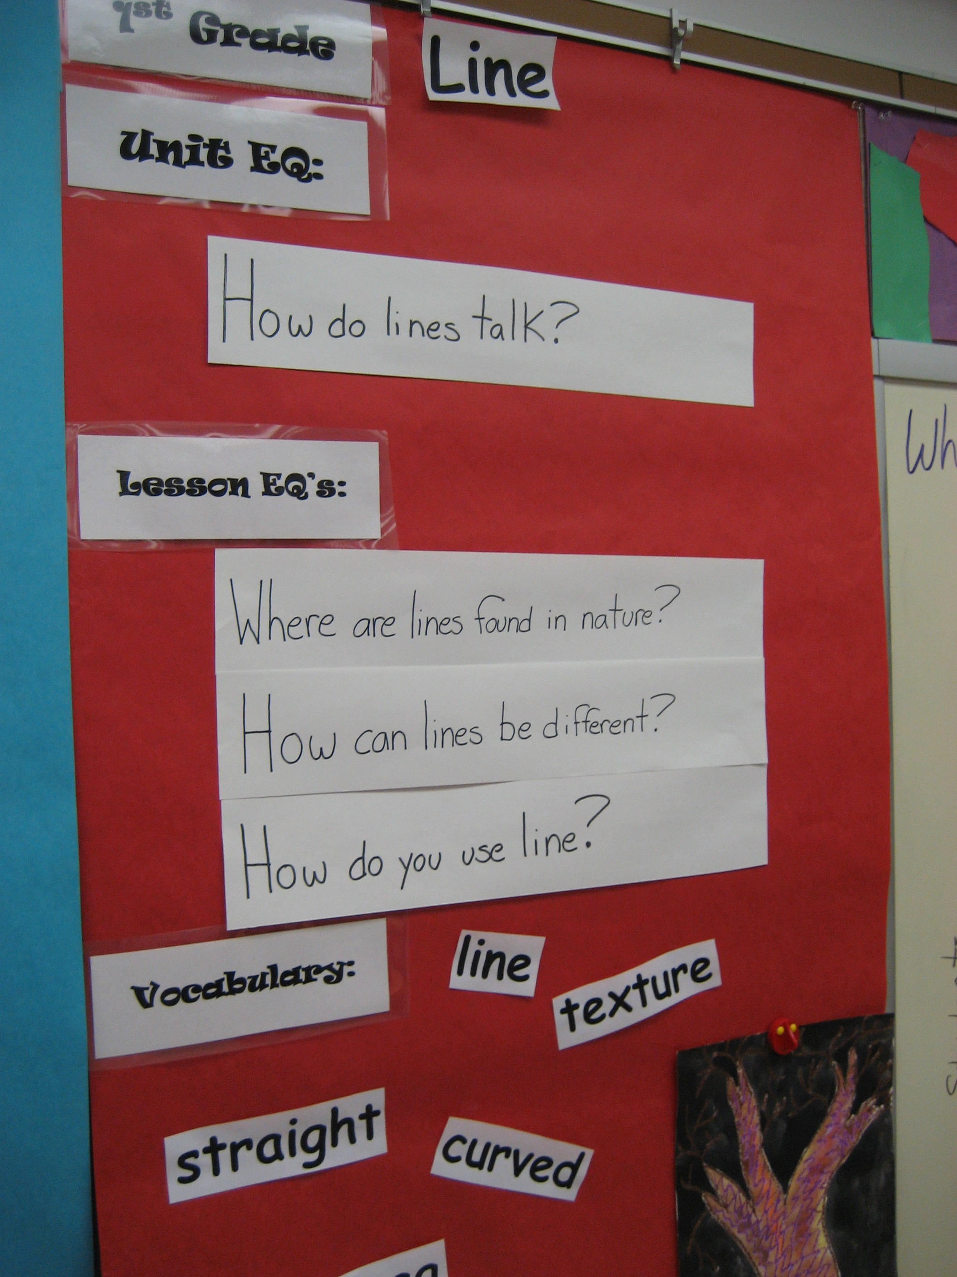

Slide 35
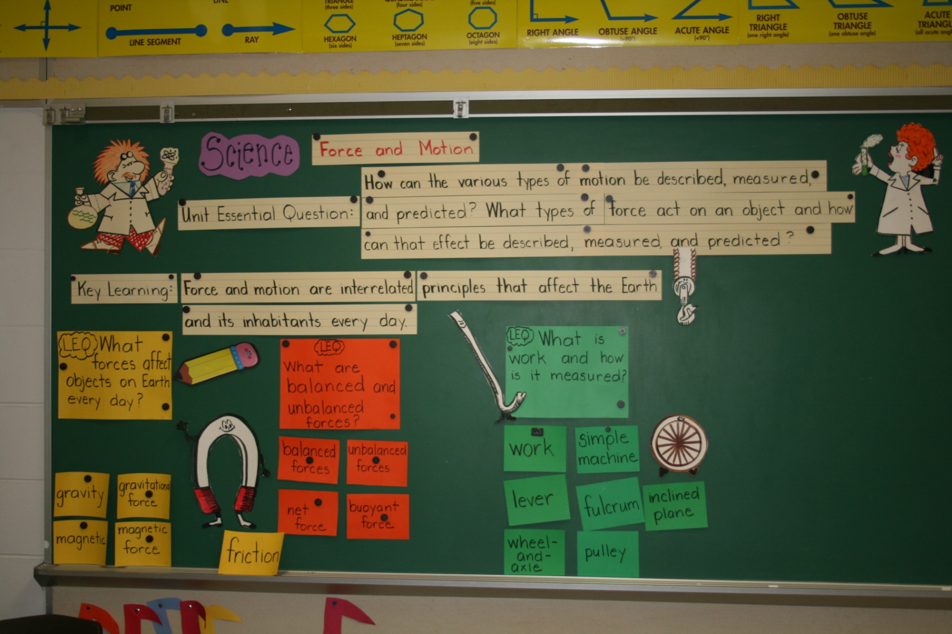

Slide 36
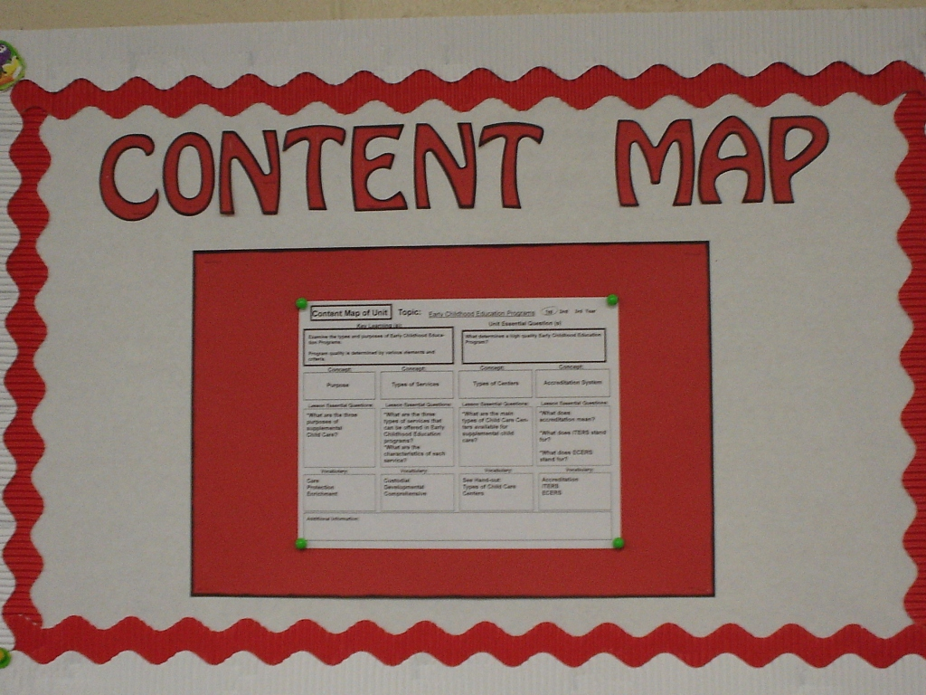
Teacher Interested Only in Compliance

Slide 37
Student Learning Maps
If you are a 2, answer the following question
How can teachers make student learning maps more effective and interactive?
If you are a 1, answer the LEQ:
Why is curriculum clarity and consistency so imperative in schools today?

Slide 38
REMEMBER: (E.A.T.S.)
Although we teach in the order of:
Essential Question
Activating Strategy
Teaching Strategy
Summarizing Strategy
We plan in a different order.

Slide 39
Lesson Plan
Essential Question:
What do students have to know in order to answer the LEQ:
______________________________ = AP1
______________________________ = AP2
______________________________ = AP3
Activating Strategy: Key Vocabulary:
Teaching Strategies:
Thinking Skill Focus: Graphic Organizer:
Instruction:
AP#1: ____________________________________________
AP#2: ____________________________________________
AP#3: ____________________________________________
Summarizing Strategy:

Slide 40
First: Go to curriculum standards and identify which ones you are teaching in the lesson. Then think about what you want them to know/do by the end of the lesson and then WRITE THE ESSENTIAL QUESTION.

Slide 41
Habitats and Adaptations
Key Learning: Organisms can only survive in habitats in which their needs can be met.
Unit Essential Question: How do living things survive within their habitats?
Adaptations
Plant Adaptations
Food Chains
Change
What strategies help to compare/contrast more than 2 things in my writing?)
How do adaptations play a role in the food chain?
How does cause/effect deepen understanding of reading?)
How are organisms adapted to live where they do?
How are organisms adapted to defend themselves?
How do organisms adapt to seasonal changes?
How do I summarize what I read describing cause/effect?)
How are plants adapted to survive in different habitats?
How can I use my experience and reading to construct support when writing about cause/effect?)
How are organisms affected when their
environment changes?
How do humans impact the survival of organisms?
producer
consumer
Decomposer
Behavioral adaptations
Physical adaptations
organism
adaptation
locomotion
camouflage
migration
hibernation
seed dispersal
tropism
natural events
survival
Notes:
Recall the content map is first step in creating a learning unit. It is the big picture of the unit – a picture of the content (concept and skills) that students are learning in this unit.
Use the slide to point out the parts of the content map.
Key Learning is major idea/concept you want students to learn. The broad understandings that a teacher wants students to carry with them over time.
Unit essential question is a broad question that captures the Key Learning desired for the unit.
The major concepts are based on the curriculum objectives.
Lesson Essential questions (Acquisition Lessons) are created for each Major Concept.
Key terms and phrases are listed for each LEQ.
Talk about the use of the Content Map during the Launch of the unit.
Point out the optional spot where teaches may place examples, steps, formulas if these are needed to complete the key learning in the unit.

Slide 42
Lesson Plan
Essential Question: How are plants adapted to survive in different habitats?
What do students have to know in order to answer the LEQ:
_______________________________________________ = AP#1
__________________________________________ = AP#2
Activating Strategy: Key Vocabulary:
Teaching Strategies:
Thinking Skill Focus: Graphic Organizer:
Instruction:
AP#1: ____________________________________________
AP#2: ____________________________________________
AP#3: ____________________________________________
Summarizing Strategy:

Slide 43
Second: Decide what Thinking Skill or Reading Comprehension Skill will help students best understand the content of this lesson.

Slide 44
Lesson Plan
Essential Question: How are plants adapted to survive in different habitats?
What do students have to know in order to answer the LEQ:
___________________________________________________ = AP#1
___________________________________________________ =AP#2
Activating Strategy: Key Vocabulary:
Teaching Strategies:
Thinking Skill Focus: Cause & Effect Graphic Organizer:
Instruction:
AP#1: ____________________________________________
AP#2: ____________________________________________
AP#3: ____________________________________________
Summarizing Strategy:

Slide 45
Third: CREATE A GRAPHIC ORGANIZER. It is based on the thinking skill you choose and will guide students’ thinking and learning during the lesson. It will also contain key points of the lesson that answer that essential question.

Slide 46
Lesson Plan
Essential Question: How are plants adapted to survive in different habitats?
What do students have to know in order to answer the LEQ:
___________________________________________________ = AP#1
___________________________________________________ =AP#2
Activating Strategy: Key Vocabulary:
Teaching Strategies:
Thinking Skill Focus: Cause & Effect Graphic Organizer: C&E Fishbone
Instruction:
AP#1: ____________________________________________
AP#2: ____________________________________________
AP#3: ____________________________________________
Summarizing Strategy:

Slide 47
Fourth: Decide what students have to know in order to answer the Lesson Essential Question.

Slide 48
Lesson Plan
Essential Question: How are plants adapted to survive in different habitats?
What do students have to know in order to answer the LEQ:
Physical Adaptation
Causes and Effects of Adaptation
Activating Strategy: Key Vocabulary:
Teaching Strategies:
Thinking Skill Focus: Cause & Effect Graphic Organizer: C&E Fishbone
Instruction:
AP#1: ____________________________________________
AP#2: ____________________________________________
AP#3: ____________________________________________
Summarizing Strategy:

Slide 49
Fifth: For each item that students need to know, select or develop a higher-order thinking skill question or activity as an Assessment Prompt for the lesson.

Slide 50
Lesson Plan
Essential Question: How are plants adapted to survive in different habitats?
What do students have to know in order to answer the LEQ:
Physical and Behavioral Adaptation
Causes and Effects of Adaptation
Activating Strategy: Key Vocabulary:
Teaching Strategies:
Thinking Skill Focus: Cause & Effect Graphic Organizer: C&E Fishbone
Instruction:
AP#1: Given a list of adaptations, classify each one as either a physical or a
behavioral adaptation.
AP#2: Using the graphic organizer, write a description of 1 plant and its
habitat and explain how it had to adapt in order to survive.
Summarizing Strategy:

Slide 51
Sixth: How will students answer the EQ? What summarizing strategy will be used?
Will it be in writing?
Seventh: How will I use collaborative pairs as part of the summarizing / answering the LEQ?
Now I know how the lesson will end and what students have to know and do.

Slide 52
Lesson Plan
Essential Question: How are plants adapted to survive in different habitats?
What do students have to know in order to answer the LEQ:
Physical and Behavioral Adaptation
Causes and Effects of Adaptation
Activating Strategy: Key Vocabulary:
Teaching Strategies:
Thinking Skill Focus: Cause & Effect Graphic Organizer: C&E Fishbone
Instruction:
AP#1: Given a list of adaptations, classify each one as either a physical or a
behavioral adaptation.
AP#2: Using the graphic organizer, write a description of 1 plant and its
habitat and explain how it had to adapt in order to survive.
Summarizing Strategy: Journal writing – Describe 2 of the most interesting
plant adaptations in 2 different habitats.

Slide 53
Eighth: Then I think about “HOW WILL STUDENTS GET THE iNFORMATION?” – reading, lecture, video (viewing), demonstration? What teaching strategies will be used?
HOW WILL THE GRAPHIC ORGANIZER BE COMPLETED? Will it guide note taking, guided reading, or be a summary tool? Then, HOW WILL THE ORGANIZER BE USED WHEN IT IS COMPLETE? Will it be used to guide writing, guide a process, create a drawing, or a presentation, or to answer questions?...
I have completed the teaching part at this point…

Slide 54
Lesson Plan
Essential Question: How are plants adapted to survive in different habitats?
What do students have to know in order to answer the LEQ:
Physical and Behavioral Adaptation
Causes and Effects of Adaptation
Activating Strategy: Key Vocabulary:
Teaching Strategies:
Thinking Skill Focus: Cause & Effect Graphic Organizer: C&E Fishbone
Teaching Strategies: Guided reading with cause/effect graphic organizer to determine plant adaptations in different habitats
Discuss adaptations as behavioral or physical
AP#1: Given a list of adaptations, classify each one as either a physical or a
behavioral adaptation.
AP#2: Using the graphic organizer, write a description of 1 plant and its
habitat and explain how it had to adapt in order to survive.
Summarizing Strategy: Journal writing – Describe 2 of the most interesting
plant adaptations in 2 different habitats.

Slide 55
9. Then CREATE THE ACTIVATING STRATEGY to hook and link, checking to make sure you have all students involved at some point.
10. Now, look at the curriculum standards, the LEQ, and the LEQ answer, and select 1-2 key vocabulary words that are critical to understanding the lesson.

Slide 56
Lesson Plan
Essential Question: How are plants adapted to survive in different habitats?
What do students have to know in order to answer the LEQ:
Physical and Behavioral Adaptation
Causes and Effects of Adaptation
Activating Strategy: 4 pieces of chart paper around the room are labeled with a “What If’” question. Small groups rotate around the room responding in writing to the prompt on each piece of paper: What if…you couldn’t use your thumb? What if…you had 4 legs? What if…you couldn’t turn your head? What if…your knees didn’t bend?
Preview Vocabulary: physical adaptations and behavioral adaptations
Thinking Skill Focus: Cause & Effect Graphic Organizer: C&E Fishbone
Teaching Strategies: Guided reading with cause/effect graphic organizer to determine plant adaptations in different habitats
Discuss adaptations as behavioral or physical
AP#1: Given a list of adaptations, classify each one as either a physical or a
behavioral adaptation.
AP#2: Using the graphic organizer, write a description of 1 plant and its
habitat and explain how it had to adapt in order to survive.
Summarizing Strategy: Journal writing – Describe 2 of the most interesting
plant adaptations in 2 different habitats.

Slide 57
Now the lesson is complete.

Slide 58
Lesson Plan
Essential Question: How are plants adapted to survive in different habitats?
What do students have to know in order to answer the LEQ:
Physical and Behavioral Adaptation
Causes and Effects of Adaptation
Activating Strategy: 4 pieces of chart paper around the room are labeled with a “What If’” question. Small groups rotate around the room responding in writing to the prompt on each piece of paper: What if…you couldn’t use your thumb? What if…you had 4 legs? What if…you couldn’t turn your head? What if…your knees didn’t bend?
Preview Vocabulary: physical adaptations and behavioral adaptations
Thinking Skill Focus: Cause & Effect Graphic Organizer: C&E Fishbone
Teaching Strategies: Guided reading with cause/effect graphic organizer to determine plant adaptations in different habitats
Discuss adaptations as behavioral or physical
AP#1: Given a list of adaptations, classify each one as either a physical or a
behavioral adaptation.
AP#2: Using the graphic organizer, write a description of 1 plant and its
habitat and explain how it had to adapt in order to survive.
Summarizing Strategy: Journal writing – Describe 2 of the most interesting
plant adaptations in 2 different habitats. When finished, 2’s explain why.

Slide 59
Now that the lesson is planned, list out the activities in the order in which they occur across 1-2-3-4 days.

Slide 60
Day 1 Day 2
1. Activating Strategy
2. Preview Vocabulary
3. Thinking Skill:
4. Graphic Organizer:
5. Teaching:
6. Assessment Prompt #1
7. Teaching
8. Assessment Prompt #2
9. Summarizing Activity
10. Answering the LEQ

Slide 61
What are the BIG IDEAs...???
Group 1: Guiding Questions (P.29)
Group 2: Formative Assessment (p.53)
Group 3: Learning Maps (p.87)
Create a poster that highlights the BIG IDEAS and the benefits to teachers/students.

