Slide 1
The Effective Teacher:
Classroom Management
New Teacher Survival and Success Series
Cheryl Wyatt
CGRESD Instructional Consultant
October 24, 2013

Slide 2

CONNECTOR
Share with the group one of the positive events or situations that occurred during the month of September.
Was there a situation that pushed you to “grow” as an educator?
Notes:
Review slide

Slide 3
100 beginning teachers were surveyed and asked the question: In what areas do you feel you would like guidance?
The top three answers were …
1. Classroom management
2. Staying on top of everything
3. How to plan lessons
(Gordon and Butters, 2003)
3
Notes:
Gives motivation for learning classroom management techniques.

Slide 4

The Most Important factor affecting Student Achievement
Quality of the classroom experience
      Teachers!!!

Slide 5
Critical Role of Classroom Management
“One of the most important” of the various roles of a classroom teacher
Effects of a School & Teacher on Students:
  Average S/Average T=50
  Least S/Least T=3
  Most S/Least T=37
  Most S/Most T=96
  Least S/Most T=63
WOW!

Slide 6
The Impact of Teacher Effectiveness
Percentile Ranking
after two years of instruction
Percentile Ranking
Average School/Average Teacher | 50th | 50th
Highly Ineffective School/ Highly Ineffective Teacher | 50th | 3rd
Highly Effective School/Highly Ineffective Teacher | 50th | 37th
Highly Ineffective School/ Highly Effective Teacher | 50th | 63rd
Highly Effective School/Highly Effective Teacher | 50th | 96th
Highly Effective School/Average Teacher | 50th | 78th
Robert Marzano, Classroom Instruction that Works
Notes:
^{This} is research cited by Marzano out of the Classroom Instruction that Works. What they did was estimate growth of students based on whether or not a child was in an average school with an average teacher or in a highly effective school with a highly effective teacher or maybe in a highly effective school with an effective teacher and they said that if you have a child who is in the middle of the pack, at the 50th percentile and they were exposed to that kind of setting for two years. Where would they be at the end of those two years? Well, what they found was that by definition a student who was in an average school with an average teacher after two years in that setting would remain at the 50th percentile. But lets look at some differences. If you have a highly effective school and an ineffective teacher, the kid looses ground. But at the same point, if you have an ineffective school but a very effective teacher, they can still have the students gaining ground relative to other students. What we would like to look at is if we have a highly effective school with even just our average teacher, the student still makes significant gains. So, from a systems stand point we really want to establish highly effective school systems but we also want to make sure we are improving the skill of our teachers so that we can make sure. (Click to next slide)
Trainer Note: Marzano does not explicitly define what consitutes a highly effective school. Keep in mind, Marzano did an extrapolation of the data not a research study. But what it boils down to is that highly effective schools were schools where there is a guaranteed and viable curriculum, clear focus on goals, data is used, teachers have collaboration and communication with one another. Two sources are used for this information (Classroom Instruction that Works and What Works in Schools)

Slide 7
Critical Role of Classroom Management
Three Major Roles of a Teacher:
  Making wise choices about the most effective instructional strategies to employ
  Designing classroom curriculum to facilitate student learning
  Making effective use of classroom management techniques
Effective teaching and learning cannot take place in a poorly managed classroom!

Slide 8
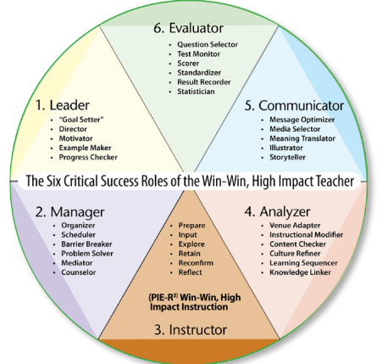

Slide 9
Positive Teaching and Learning Environments support academic performance
Behavior
Academic
If we get TLE right, we will spend far less time on RED: urgent problems
80-90% of our efforts should be GREEN: preventative and proactive…
80-90% of our efforts should be GREEN: preventative and proactive…
1 – 5 %
Individualized
5 – 10 %
- At Risk Group Interventions
80 – 90 %
All Students
- Preventative, Proactive

Slide 10
Classroom Management
Turn and Talk:
What impact does classroom management have on learning?

Slide 11
Dimensions of Classroom Time
Allocated time: amount designated for a particular topic or subject
Instructional time: amount left for teaching after routine management and administrative tasks are completed
Engaged time: time students actually spend actively involved in learning activities
Academic learning time: amount of time students are both engaged and successful

Slide 12
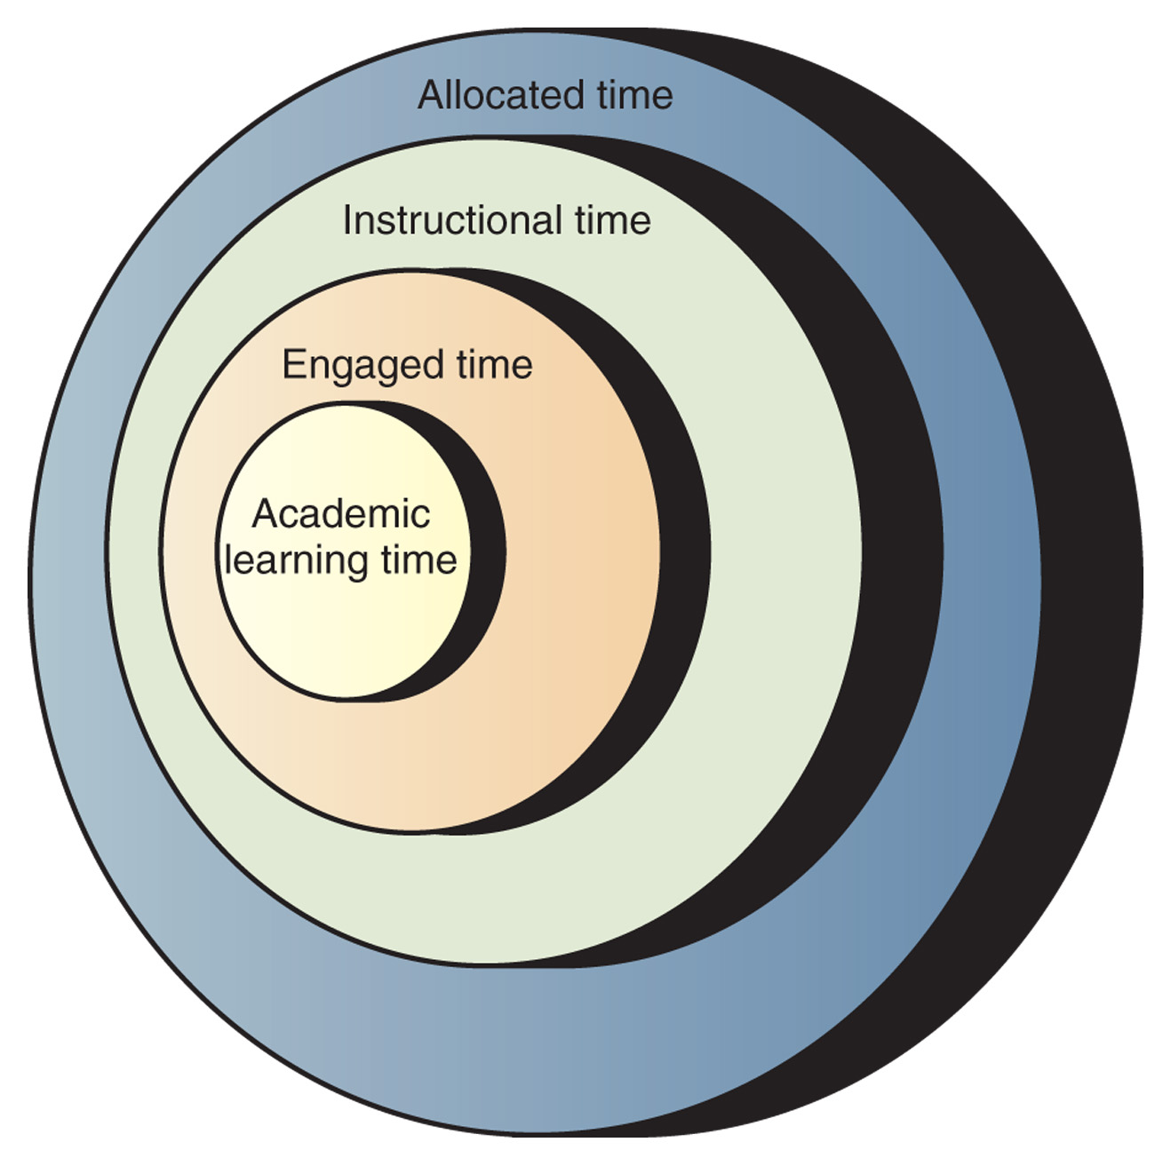

Slide 13
Definition 1
Effective classroom management is……..
The creation of a productive learning environment.
The increase of appropriate behavior.

Slide 14
Definition2
Classroom management is all the things a teacher does to organize students, space, time, materials, so that student learning can take place.
Harry Wong

Slide 15
Classroom as
Learning Communities
Inclusiveness: all students participate and believe they can succeed.
Respect for others: students respect the teacher and other students.
Safety and security: students feel safe and protected.
Trust and connectedness: students count on each other for help and assistance.

Slide 16
Effective Manager Characteristics!
Plan
Routines
Rules
Positive Consequences
Negative Consequences
Behaviors are Taught
Comfortable
Consistent
Parental Involvement
High Expectations
Climate of Management

Slide 17
A Framework for Teaching:
Components of Professional Practice
Domain 1: Planning and Preparation
Demonstrating knowledge of content and pedagogy
Demonstrating knowledge of students
Setting instructional outcomes
Demonstrating knowledge of resources
Designing coherent instruction
Designing student assessments
Domain 2: The Classroom Environment
Creating an environment of respect and rapport
Establishing a culture for learning
Managing classroom procedures
Managing student behavior
Organizing physical space
Domain 4: Professional Responsibilities
Reflecting on teaching
Maintaining accurate records
Communicating with families
Participating in a professional Community
Growing and developing professionally
Demonstrating professionalism
Domain 3: Instruction
Communicating with students
Using questioning and discussion techniques
Engaging students in learning
Using assessment in instruction
Demonstrating flexibility and responsiveness
Danielson 2007
Notes:
Handout FFT Placemat Card
The FFT provides a common language that guides professional conversations

Slide 18
4 key factors to Effective
Classroom Management
The physical environment of the classroom
Classroom climate
Expectations and procedures
Teacher-student relationships

Slide 19
I. The Physical Environment of the classroom
Things to consider:
The management of space should be conducive to learning.
The physical environment of the classroom should support the tasks that will be carried out there.
How will the students be working? Alone? In pairs? In small groups? (Student desks should be arranged accordingly)

Slide 20
II. Classroom Climate
Setting the classroom climate is key.
It’s about creating an environment:
Where people treat each other with courtesy and respect
Where students understand behavior expectations and follow rules, not out of fear, but because they feel ownership for them.
Where the teacher’s goal is not so much to control students’ behavior, but to create opportunities for students to develop and exercise control over their own behavior.

Slide 21
III. Expectations and Procedures
Behavior Expectations and procedures are a prerequisite for effective classroom management and effective instruction.
4 principles:
Rules must be reasonable and necessary.
Rules must be meaningful and understandable.
Rules must be consistent with instructional goals.
Classroom rules must be be consistent with school rules.

Slide 22
IV. Teacher-student relationships
Learners' opinions of teachers
Learners prefer teachers who are :
Slightly strict
Scrupulously fair
Treat them as individuals
Have a sense of humour, but not one based on sarcasm

Slide 23
The Positive Classroom-
Establishing a classroom of Respect and Rapport
http://www.youtube.com/watch?v=kCHjvb2AXl8

Slide 24
How is Managing a Classroom different than
Discipline ?
Notes:
Discuss the difference between managing and disciplining a classroom.
MANAGING: process oriented, getting things done
DISCIPLINING: reacting to behaviors that interrupt or prevent instruction/learning.

Slide 25
What is a poorly managed classroom like?
Look Like Sound like

Slide 26
What is a well- managed classroom like?
Look Like Sound like

Slide 27
SEARCHING FOR SOLUTIONS
Management vs. Discipline
Three students
Two pencils
Both pencils belong to Mary
Mary lends to Bob
Mary changes mind - lends to Chuck
Bob and Chuck argue
Teacher questions Bob
Bob and Chuck argue again
Mary adds two cents
All three are now arguing at once
What would you do?
What’s the problem?
What’s the solution?
Management or Discipline?

Slide 28
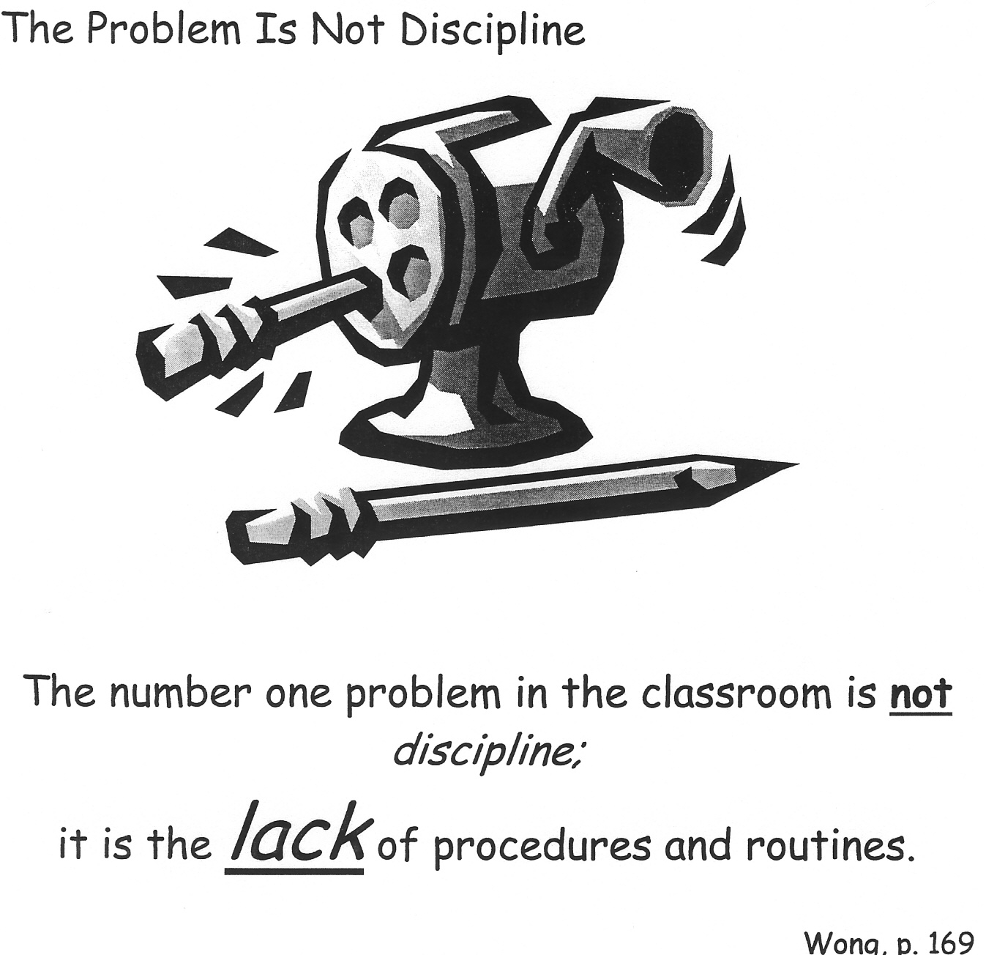
THE PROBLEM IS NOT DISCIPLINE

Slide 29
Rules versus Procedures
Rules = behavior
Procedures = way something is done
Rules are a dare to be broken
Procedures need to become routines
Notes:
Review information from the DVD,

Slide 30
Discipline v. Management
Discipline: The reaction to misbehavior AFTER it has occurred.
Management: Actions that prevent misbehavior from occurring.
Management is identifying the problem and searching for the solution.

Slide 31
Building Your Plan:
Procedures/Routines
Wong, p. 167-173
A rule is a DARE to be broken, whereas a procedure is not. A procedure is a DO, a step to be learned.
Students must know from the very beginning how they are expected to behave and work in a classroom work environment.
Procedure – how you want something done
Routine – what the student does automatically without prompting or supervision
Establish a consistent system for dealing with a recurring task in the classroom.
1) Identify tasks needing procedures.
2) Break each task into simple steps.
3) Teach the procedure to the students until it becomes routine behavior.

Slide 32
Evidence Based Practices in Classroom Management
Maximize structure in your classroom.
Post, teach, review, monitor, and reinforce a small number of positively stated expectations.
Actively engage students in observable ways.
Establish a continuum of strategies to acknowledge appropriate behavior.
Establish a continuum of strategies to respond to inappropriate behavior.
(Simonsen, Fairbanks, Briesch, Myers, & Sugai, accepted)

Slide 33
1. Maximize structure in your classroom.
Develop Predictable Routines
  Teacher routines: volunteers, communications, movement, planning, grading, etc.
  Student routines: personal needs, transitions, working in groups, independent work, instruction, getting, materials, homework, etc.
Design environment to (a) elicit appropriate behavior and (b) minimize crowding and distraction:
  Arrange furniture to allow easy traffic flow.
  Ensure adequate supervision of all areas.
  Designate staff & student areas.
  Seating arrangements (groups, carpet, etc.)

Slide 34
Teaching Procedures
Procedures need to become routines
Explain
Rehearse
Reinforce
Notes:
ROUTINE: What is done automatically, even if the teacher is absent or busy doing something else.

Slide 35
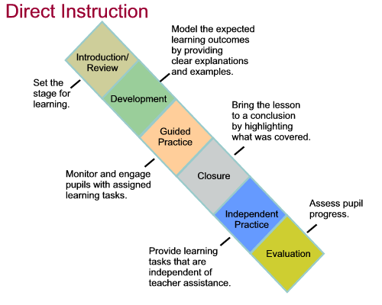

Slide 36
2. Post, Teach, Review, Monitor, and reinforce a small number of positively stated expectations.
Establish
Teach
Prompt
Monitor
Evaluate
Notes:
Sarah

Slide 37
Module 7

Slide 38
3. Actively engage students in observable ways.
Provide high rates of opportunities to respond
  Vary individual v. group responding
  Increase participatory instruction (enthusiasm, laughter)
Consider various observable ways to engage students
  Written responses
  Writing on individual white boards
  Choral responding
  Gestures
  Other: ____________
Link engagement with outcome objectives

Slide 39
3. Range of evidence based practices that promote active engagement
Direct Instruction
Computer Assisted Instruction
Class-wide Peer Tutoring
Guided notes
Response Cards

Slide 40

4. Establish a continuum of strategies to acknowledge appropriate behavior.
Specific and Contingent Praise
Group Contingencies
Behavior Contracts
Token Economies
Notes:
Amy

Slide 41
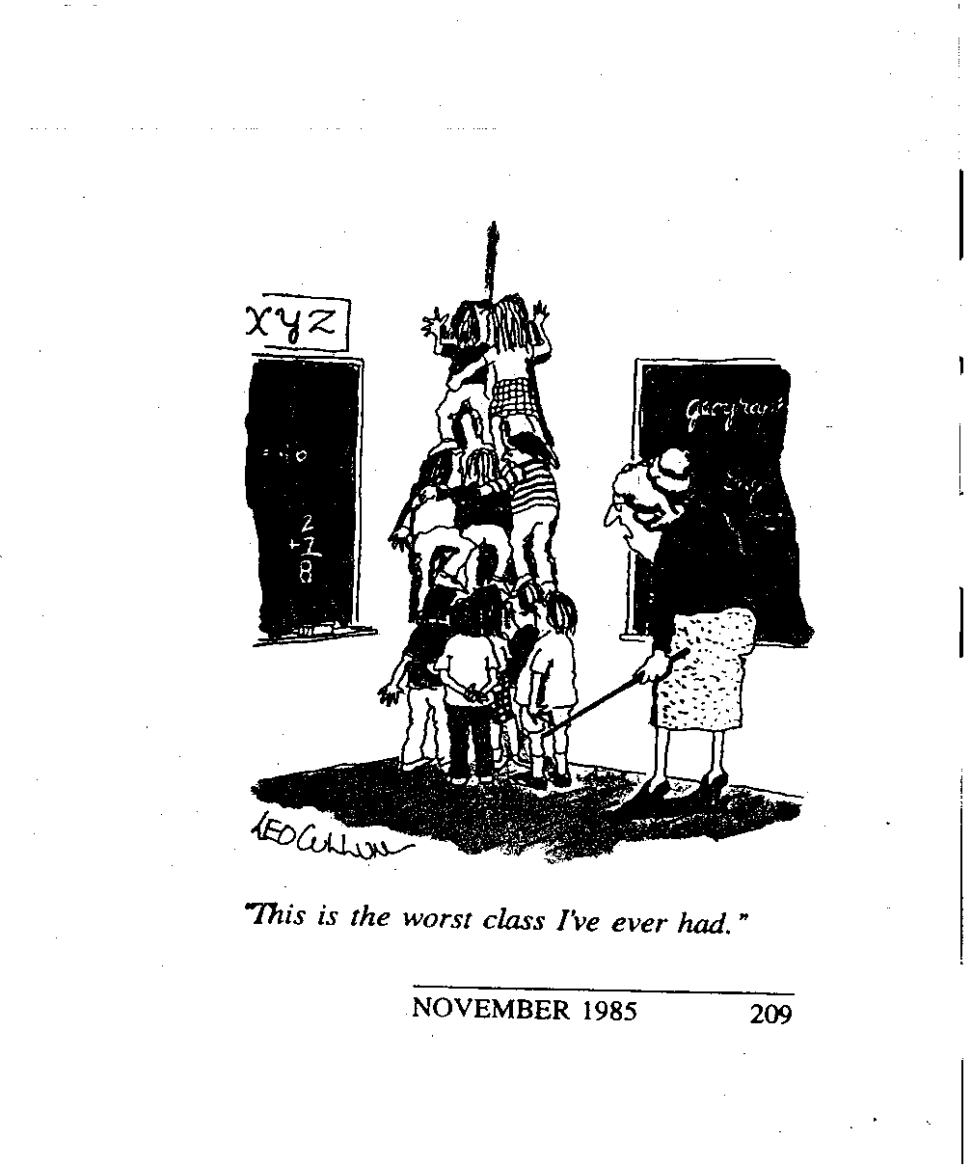
5. Establish a continuum of strategies to respond to inappropriate behavior.
Error Corrections
Differential Reinforcement
Planned ignoring
Response Cost
Time out from reinforcement

Slide 42
ESTABLISHING
CONSEQUENCES
-
+
The method of dealing with student behavior has little or no effect on how much change occurred.
No one consequence, positive or negative, is any better than any other consequence.
WHAT DID MATTER?
Successful behavior management is primarily a matter of
PREVENTING
problems before they occur, not the ability or technique to deal with them after they emerge.
PROACTIVE
Notes:
Review

Slide 43
ESTABLISHING
CONSEQUENCES
-
+
CONSEQUENCES
Both Positive and Negative
POSITIVE
Any action that puts the student in a position to realize that the identified behavior was appropriate and acceptable.
NEGATIVE
Any action that puts the student in a position to realize that the identified behavior was inappropriate and unacceptable.
Research in both education and psychology show:
When a verbal reinforcer follows a response or action, academic or behavior, the response or action is more likely to occur again. Whether the reinforcer is positive or negative has little if any meaning.
POSITIVE BEFORE NEGATIVE
3 to 1
NO LESS THAN 50/50
Notes:
Review

Slide 44
How do you plan to ……
Get students’ attention?
Know a student needs help?
Collect, distribute papers?
Divide into groups?
Dismiss class?
Notes:
At tables, discuss what you each do in this area? Is it a procedure? Can you identify the steps it requires?
How often do students follow the procedures? What happens when they don’t?

Slide 45
Classroom Procedures
Brainstorm with your table group procedures that may be unique for your classroom situation, grade, or subject area.
Notes:
What about procedures that are unique in the following areas?
PE
Art
Science lab classes
Vocational/technical classes?
Kindergarten?
Others?

Slide 46

CHAMPS
CHAMPS assists classroom teachers to design (or fine tune) a proactive and positive classroom management plan that will overtly teach students how to behave responsibly
http://www.youtube.com/watch?v=V7E6mrNYeHw

Slide 47

Questions or Thoughts

Slide 48
Thanks!
If you need anything, please contact me at cwyatt@cgresd.net or call 386-8670

