Slide 1

August 15 & 16, 2013

Slide 2
WELCOME!!!
Introductions
Day One Overview
Stage Setting/Context
  Historical Perspective
  And the Data Says…
  Opportunity – MDE MTSS Grant
Notes:
introduce ourselves here and briefly state our role in this initiative. Then we can outline their materials (agenda etc), let them eat breakfast, and have that lead into the RtI vs. MTSS activity on the next Slide.

Slide 3
How Do We Compare To Our Neighbors?
 | Student Pop | Free/Reduced
COOR | 7360 | 77.4
MOISD | 8859 | 75.7
CGRESD | 7553 | 72.9
WMISD | 8707 | 74.8

Slide 4
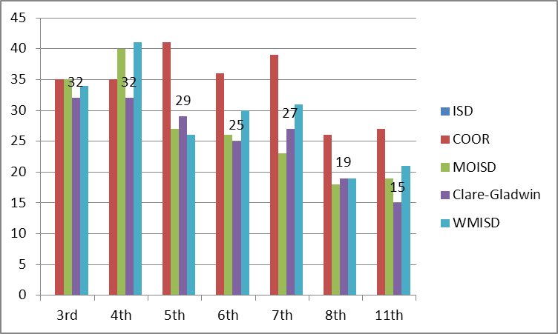
NMLC Data Comparison
Math 2011-2012

Slide 5
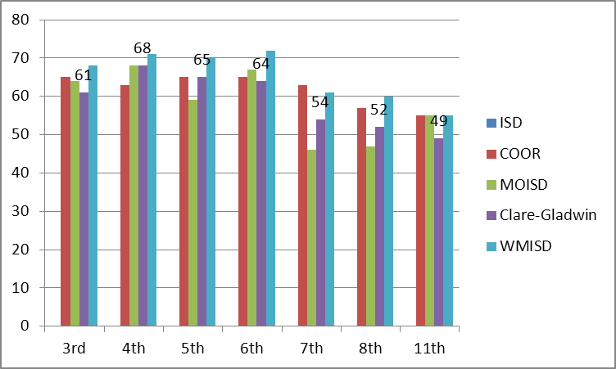
NMLC Data Comparison
Reading 2011-2012

Slide 6
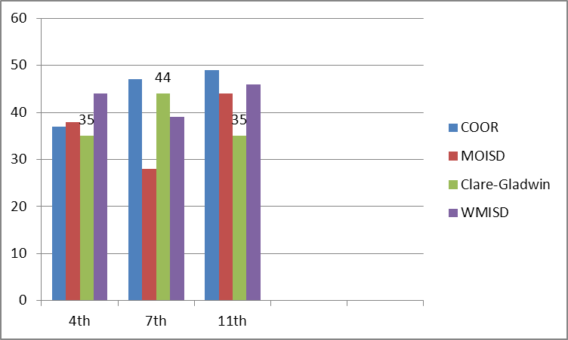
NMLC Data Comparison
Writing 2011-2012

Slide 7
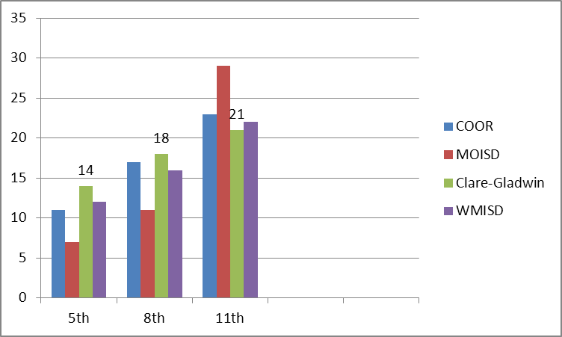
NMLC Data Comparison
Science 2011-2012

Slide 8
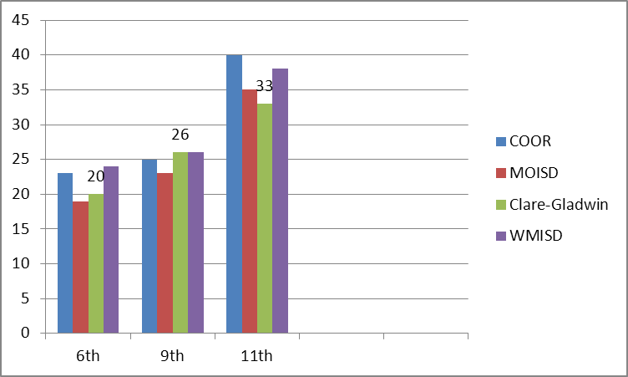
NMLC Data Comparison
Social Studies 2011-2012

Slide 9
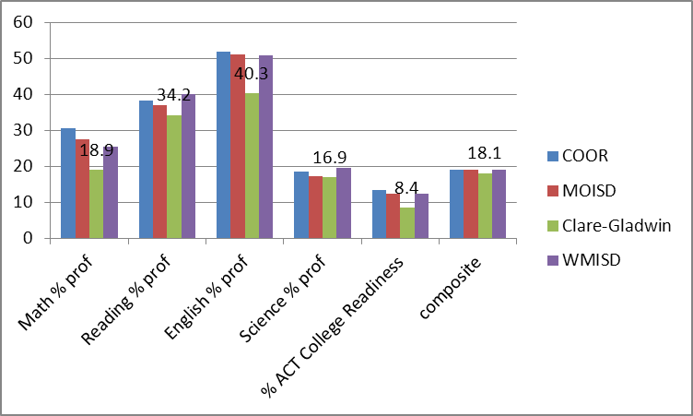
NMLC Data Comparison
ACT 2011-2012

Slide 10
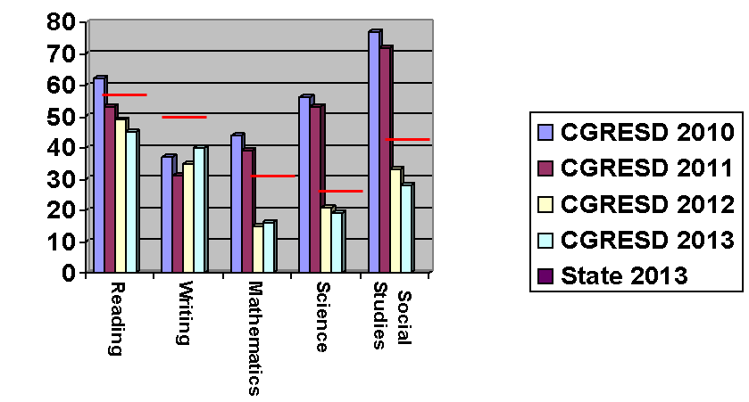
Michigan Merit Exam Spring 2013
Notes:
Data drives SIP for both the LEA and for CGRESD. This chart reflects old cut scores for 2009, 2010, and 2011 and illustrates how the RESD as a whole has done. 2012 data reflects new cut scores and you can note the drop we took.
Note:
CGRESD, as a whole, continues to perform below the state average in all content areas, with the greatest performance gaps occurring in writing and mathematics – note the red circles.

Slide 11
MME Reading Proficiency
2009 – 2013

Slide 12
MME Writing Proficiency
2009 – 2013
State 49%

Slide 13
MME Math Proficiency
2009 – 2013

Slide 14
MME Science Proficiency
2009 – 2013
State 26%

Slide 15
MME Social Studies Proficiency
2009 – 2013

Slide 16
MEAP 2012 3rd Grade Math
All Students
% Proficient
% Not Proficient

Slide 17
MEAP 2012 3rd Grade Math
Econ. Dis. Students
% Proficient
% Not Proficient

Slide 18
MEAP 2012 3rd Grade Math
Students w/ Disabilities
% Proficient
% Not Proficient

Slide 19
MME 2013 Math
All Students
% Proficient
% Not Proficient

Slide 20
MME 2013 Math
Econ. Dis. Students
% Proficient
% Not Proficient

Slide 21
MME 2013 Math
Students w/ Disabilities
% Proficient
% Not Proficient

Slide 22
MME 2013 Reading
All Students
% Proficient
% Not Proficient

Slide 23
MME 2013 Reading
Econ. Dis. Students
% Proficient
% Not Proficient

Slide 24
MME 2013 Reading
Students w/ Disabilities
% Proficient
% Not Proficient

Slide 25
Special Education Identification Rates for SLD
 | Total SpEd Count | SLD Students | SLD %
Statewide | 211,380 | 68,636 | 32.5%
Clare-Gladwin Regional Education Service District | 1,299 | 472 | 36.3%
Clare Public Schools | 158 | 52 | 32.9%
Farwell Area Schools | 195 | 83 | 42.6%
Harrison Community Schools | 275 | 109 | 39.6%
Beaverton Rural Schools | 244 | 112 | 45.9%
Gladwin Community Schools | 279 | 116 | 41.6%

Slide 26

If you do what you always did, you will get what you always got. — Albert Einstein

Slide 27
MDE MTSS Grant
OPPORTUNITY TO:
    Explore
    Adopt
    Implement
  …A CGRESD MTSS Model

Slide 28
Multi-Tiered System of Support
MTSS is an integrated, multi-tiered system of instruction, assessment, and intervention designed to meet the achievement and behavioral needs of all students.
MTSS is meant to be embedded into the school improvement process to provide a framework for meeting the needs of ALL students.
Notes:
It is not uncommon to hear the term RtI and Multi‐Tier System of Supports (MTSS) used interchangeably. However in many instances the meaning applied to RtI does not align with the principles and practices of a MTSS. The principles and practices of a MTSS are based upon what research has shown to be effective in both creating successful and sustainable system change as well as what is necessary in providing the most effective instruction to all students. The MTSS framework is designed to address the academic and behavioral needs of every student, regardless of whether the students are struggling or have advanced learning needs.
The meaning and practices referred to as RtI vary from a narrow view point such as the identification of students with specific learning disabilities under IDEA to a broad paradigm shift. Since all models labeled RtI do not always have the same purpose or practices, MDE is intentionally calling this model a Multi tiered System of supports.
I like to think of RtI as the foundation for MTSS, or a piece of it. MTSS expands RtI. The term RtI is typically much narrower than what is meant by MTSS. Some “RtI” topics include: the identification of a student with specific learning disabilities under IDEA, individual student problem solving approach to interventions, standard protocol approach to interventions or possibly a school wide approach.
MTSS will NOT be the same in all schools, quite the contrary.

Slide 29
Multi-Tiered System of Support
Is embedded into the school improvement process
Provides the framework that focuses on ALL students
Encompasses the flexible tier structure for instruction and intervention, academic and non-academic core components and school and district system of supports
Notes:
The flexible tiers represent a robust and responsive educational environment that provides students with a continuum of multiple supports to meet their needs. The tiers represent increasing intensity of academic and non-academic support and interventions. There is flexibility of the system and the programming to allow movement between the tiers (to both a more or less intensive type of support/intervention).
The academic and non-academic core components of MTSS are:
high-quality core curriculum and instruction implemented with fidelity; and
research-based academic interventions and assessment practices; and
research-based behavioral interventions and supports; and
universal screening and progress-monitoring; and
collaboration and communication between educators and parents.
The school and district system of supports align with the State and District Standards and will provide the structure needed to develop the policies, practices, and procedures to successfully implement MTSS.

Slide 30
MTSS
Not Regular Education
Not Special Education
“Education”

Slide 31
“MTSS requires systems change . . .
rethinking how schools meet the
needs of ALL students through
core curriculum and
instruction.”
Dr. Diane DeBacker
Notes:
Core MTSS beliefs
Every child will be provided a rigorous and research‐based curriculum
Every child will be provided effective and relentless teaching
Interventions will be provided at the earliest identification of need
Policy will be based on evidence based practice
Every educator will continuously gain knowledge and develop expertise to build
capacity and sustain effective practice
Resources will be intentionally designed and redesigned to match student needs
Every leader will be responsible for planning, implementing and evaluating
Academic and behavioral data will be used to inform instructional decisions
Educators, families and community members will be part of the fundamental
practice of effective problem‐solving and instructional decision making
An empowering culture will be enhanced/developed that creates collective
responsibility for student success.

Slide 32
11 Essential Elements
1. Implement effective instruction for all children
2. Intervene Early
3. Provide multi-tiered model of instruction and intervention
4. Utilize a collaborative problem solving model
5. Assure Research based core curriculum
6. Implement research-based, valid interventions and instruction
7. Monitor progress to inform instruction
8. Use data to make instructional decisions
9. Use assessments for screening, diagnostics, and progress monitoring
10. Implement with fidelity
11. Engage parents and community
Notes:
Through the Continuous School Improvement Process and the development of your SIP, you may recognize that your school has key systems missing. This may lead you to MTSS and implementing these essential components in order to fill the voids.

Slide 33
Essential Components Clusters
Instruction and Intervention
  Implement effective instruction for all learners
  Intervene early
  Provide a milt-tiered model of instruction and intervention
Notes:
Essential Elements Cluster: Instruction & Intervention

Slide 34
Essential Components Clusters
Problem Solving
  Utilize a collaborative problem solving model
Notes:
Essential Elements Cluster: Problem Solving

Slide 35
Essential Components Clusters
Implementation of Evidence-based Practices
  Assure a research-based core curriculum (aligned with Michigan’s state standards)
  Implement research/evidence-based, scientifically validated instruction/interventions
  Implement with fidelity
Notes:
Essential Elements Cluster: Implementation of Evidence-based Practices

Slide 36
Essential Components Clusters
Data/Assessment
  Monitor student progress to inform instruction
  Use data to make instructional decisions
  Use assessments for three purposes: universal screening, diagnostics, and progress monitoring
Notes:
Essential Elements Cluster: Data/Assessment

Slide 37
Essential Components Clusters
Stakeholder Engagement
  Engage parents and community (and students!)
Notes:
Essential Elements Cluster: Stakeholder Engagement

Slide 38
RtI
MTSS
How are the terms being used by your ISD/Districts currently?
Is changing names going to be an issue?
Do you have a working definition?
Have you provided Professional learning opportunities around one or the other?
Table talk and Processing
Notes:
Opening Activity, discussion at tables around the differences between the two, if they need prompting questions, insert the following questions.
How are the terms being used by your ISD/Districts currently?
Is changing names going to be an issue?
Do you have a working definition?
Have you provided Professional learning opportunities around one or the other?
Many existing terms and initiatives share the common elements of data-based problem-solving to inform instruction and intervention (e.g., Positive Behavior Support [PBS], Problem Solving/Response to Intervention [RtI], Continuous Improvement Model [CIM], Lesson Study, Differentiated Accountability). Although several initiatives share this core characteristic of data-based problem-solving, the differences in the use of terms (i.e., the labels used to describe them), who has responsibility for implementing data-based problem-solving (e.g., general education, special education, student services), and the language used to describe the initiatives have often resulted in high levels of variability in the implementation of the model at state, district and school levels. These differences serve to potentially limit the impact of this model on both the integrity of implementation and on student growth.
The primary function of district leadership is to 1) ensure that a common-language, common-understanding exists around the rationale for and the purpose and expected outcomes of implementation, 2) clearly identify who has the responsibility for what and how those individuals will be held accountable, 3) ensure that district policies are supportive of, and not barriers to, the implementation of the model, 4) provide sufficient support (professional development, technical assistance) to ensure that the implementation plan and timelines can be achieved and 5) identify clearly the district- and school-level leaders who will have implementation expectations as part of their annual performance reviews.

Slide 39

Let’s Take 15 Mins

Slide 40
Essential Components Clusters
Instruction and Intervention
  Implement effective instruction for all learners
  Intervene early
  Provide a milt-tiered model of instruction and intervention
Notes:
Essential Elements Cluster: Instruction & Intervention

Slide 41
Essential Components Clusters
Problem Solving
  Utilize a collaborative problem solving model
Notes:
Essential Elements Cluster: Problem Solving

Slide 42
Essential Components Clusters
Implementation of Evidence-based Practices
  Assure a research-based core curriculum (aligned with Michigan’s state standards)
  Implement research/evidence-based, scientifically validated instruction/interventions
  Implement with fidelity
Notes:
Essential Elements Cluster: Implementation of Evidence-based Practices

Slide 43
Essential Components Clusters
Data/Assessment
  Monitor student progress to inform instruction
  Use data to make instructional decisions
  Use assessments for three purposes: universal screening, diagnostics, and progress monitoring
Notes:
Essential Elements Cluster: Data/Assessment

Slide 44
Essential Components Clusters
Stakeholder Engagement
  Engage parents and community (and students!)
Notes:
Essential Elements Cluster: Stakeholder Engagement

Slide 45
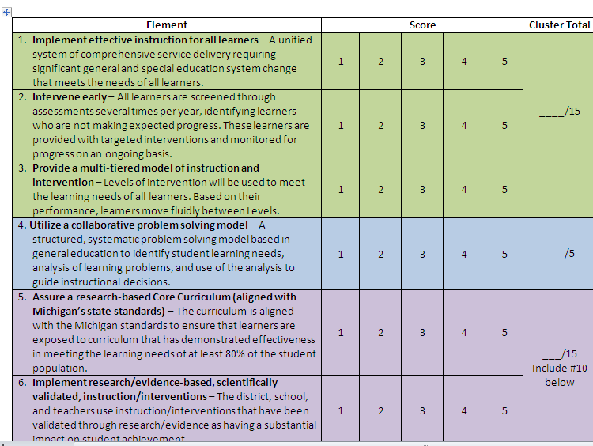

Slide 46
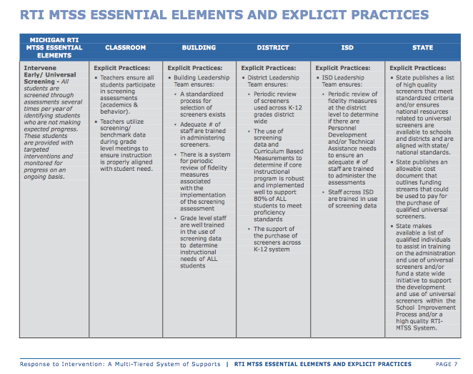

Slide 47
“Big 5”
Team Activity – Chart Paper
Key Learnings from “Big 5”
Where did you see convergence?
Where did you see divergence?

Slide 48
Group Share Out
ISD Findings
District Teams

Slide 49
Lunch Time
Do educators in your school district share a vision for achieving excellence?

Slide 50
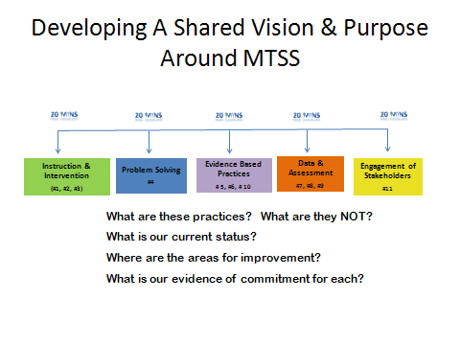
What Do We Believe?
http://www.teachit.co.uk/custom_content/Timer/timer.htm l

Slide 51
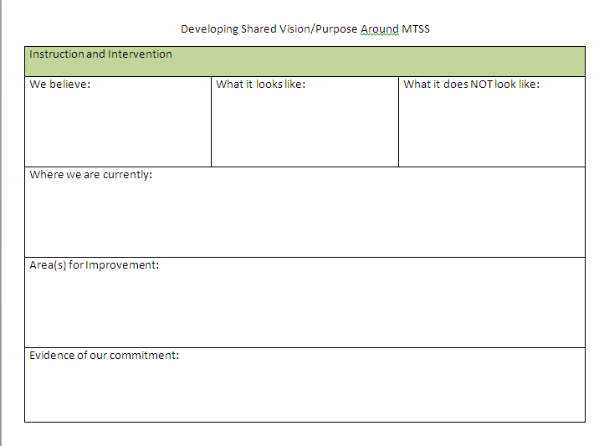
Notes:
20 minutes for each component
Make sure they all record for next day activity – Multi District Team Discussion
Number off before leaving -

Slide 52



Day One Recap

Slide 53
WELCOME BACK
Day Two Overview-Deeper Dive into the “Big 5” MTSS Essential Components
  Number Off (1-5)for Multi-District Team Activity
  Gallery Walk – group findings
Alignment with School Improvement
Supporting MTSS Implementation
MTSS Self-Assessment
Notes:
introduce ourselves here and briefly state our role in this initiative. Then we can outline their materials (agenda etc), let them eat breakfast, and have that lead into the RtI vs. MTSS activity on the next Slide.

Slide 54
Multi-District Group Activity
Using your “Shared Vision/Purpose” notes, answer the following questions:
1. a) List 3-5 features of what the essential component looks like when done well. b) What does it NOT look like?
2. What common strengths or capacities emerged?
3. What common areas for improvement emerged?
4. What evidence would exist to show commitment?

Slide 55

Creating Effective Systems to Support School Improvement
Notes:
If we are dealing with some misconceptions or quite frankly disbelief that school improvement can actually be used to move more students achieve at higher rates. It begins with creating the systems, the host environment to make this all happen. When I go around working with schools and administrators I recite this quote from Results Now, “If you put a good person in a bad system the system wins every time.” I absolutely feel that is true. I have seen wonderful teachers who use great instructional strategies and m

Slide 56
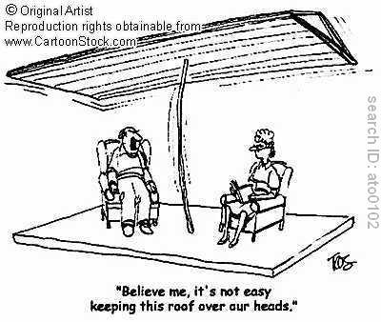

Slide 57
School Improvement Overview
Ongoing Continuous Improvement & Student Success
 |  |  | MDE Statewide Plan
 |  | ISD SI Plan (driven by District Plans, and coming soon, Needs Assessment)
 | District SI Plan (driven by Building Plans, Needs Assessment (District Process Rubrics)
Building SI Plans (driven by Comprehensive Needs Assessment SPR 40/90, SDP/A)
Alignment
RtI/MTSS
Alignment

Slide 58
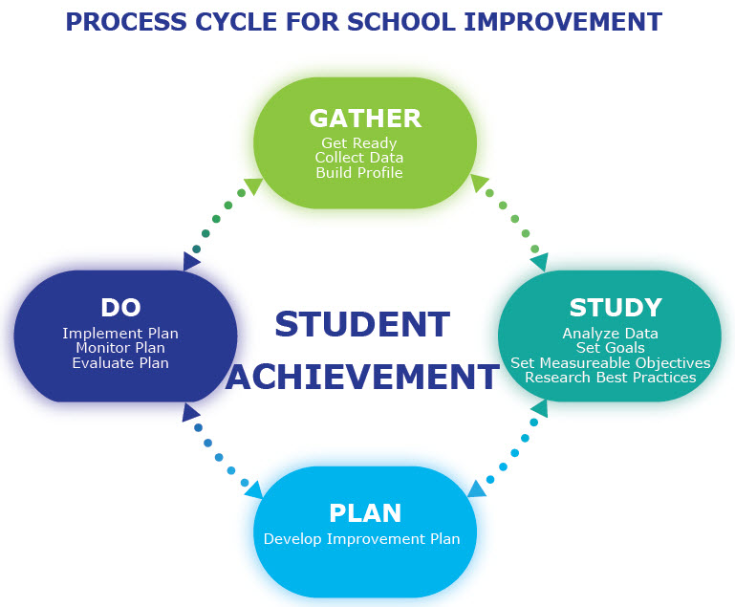

Slide 59
School Improvement Process
with an MTSS Lens
Goals
Objectives
Strategies
Activities
Resources
Goal: Broad goal statement (academic or organizational)
Objective: S.M.A.R.T.
Strategy: Adult actions – Teacher will…
Activity: Specific action – road map

Slide 60
Sample SIP w/MTSS
Goal: All students will be proficient in reading.
Objective: 85% of all students will demonstrate a proficiency in all reading standards in ELA by 06/30/2022 as measured by state level assessment, where an annual 4% increase will occur from the baseline of 46% in 2011.
Strategy: Teachers will use _________, a research based strategy in the classroom.
Activity: Teachers attend prof. learning in _______ .

Slide 61
School Improvement Process
with an MTSS Lens
Goals
Objectives
Strategies
Activities
Resources
We want to strategically embed MTSS language and practices within our school improvement planning and process.
How do we do this???

Slide 62
School Improvement Process
through an MTSS Lens
Goals
Objectives
Strategies
Activities
Resources
In your teams, review one goal with accompanying objectives, strategies, and activities through an MTSS lens at your table.
Highlight evidence for each of the “Big 5”.
Where might it be strengthened to reflect the “Big 5”?
Revise your goal based on this…

Slide 63
Answer in your groups…
How can you fit MTSS into your SIP?
What would need to happen at an ISD level to make this happen?

Slide 64
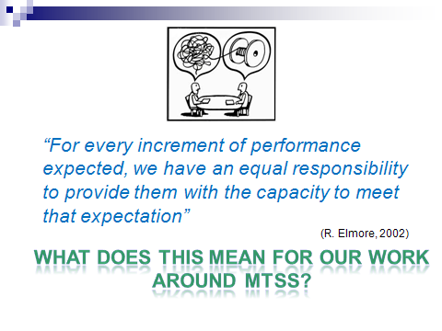
Lunch Time

Slide 65
Developing an RESD Approach for Supporting MTSS
Developing Personnel Competency
Investing in Systems and Infrastructure
Assuring Leadership Capacity

Slide 66
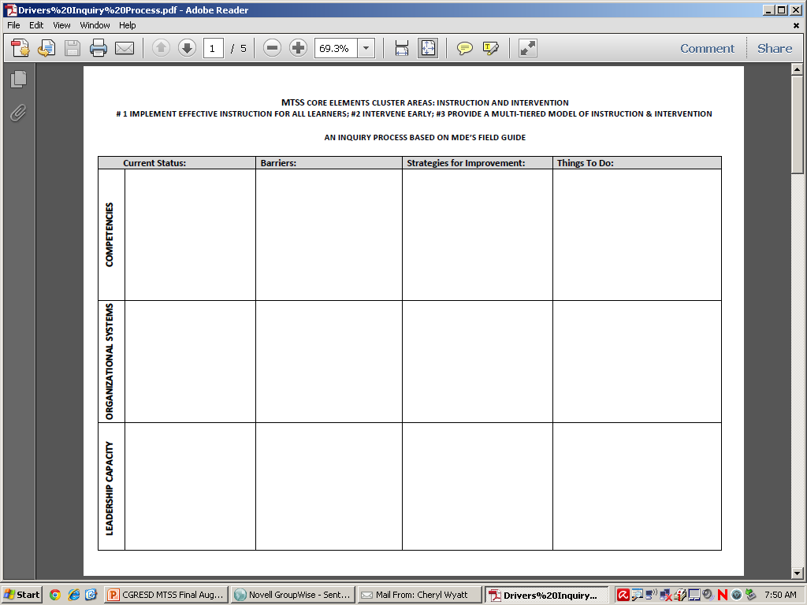

Slide 67

School Improvement Team completes School Building Self-Assessment of Essential MTSS Practices.
CGRESD Rep meets with District Leadership Team to review and understand LEA needs.
Technical Assistance Plan tailored to meet LEA needs.
Notes:
SO WHAT ARE YOUR NEXT STEPS?????
Improve Tier 1 curriculum and instruction
Curriculum
Assessment
Serve students who need Tier 2 interventions and Tier 3 interventions
In time, IF outcome data are used to make all decisions, the district can actually achieve the dream of 80% needing only Tier 1, 15% needing Tier 2, 5% needing Tier 3

Slide 68

Book Study Possibilities
Visible Learning for Teachers: Maximizing Impact on Learning
John Hattie
Topic: Practical step-by-step guidance to the successful implementation of visible learning and visible teaching in the classroom.

Slide 69

Book Study Possibilities
Simplifying Response to Intervention: Four Essential Guiding Principles
Buffum, Mattos, & Weber
Topic: This book is an update to the authors' first book Pyramid Response to Intervention. It answers many of the questions that practitioners have had as they've implemented the PLC practices in their schools related to providing time and support for students struggling to learn. It is easy to read and practical to apply.

Slide 70

Book Study Possibilities
RtI: The Forgotten Tier
Allain & Eberhardt
Topic: An essential resource for teachers, administrators, RtI teams, and Professional Learning Communities who want to make RtI work for all students. The great promise of RtI is the potential to reach and teach all students.

Slide 71

Book Study Possibilities
RtI: Asssessment for Intervention
Brown-Chidsey & Andren
Topic: Problem-solving assessment is an essential component of multi-tiered systems of support such as response to intervention (RTI) and positive behavioral interventions and supports (PBIS). This authoritative work provides a complete guide to implementing a wide range of problem-solving assessment methods.

