Slide 1
MICHIGAN COLLEGE APPLICATION WEEK
Coordinated by
Clare Gladwin Career Center
Educational Talent Search
Mid Michigan Community College
November 4-8, 2013
National College Application Week

Slide 2
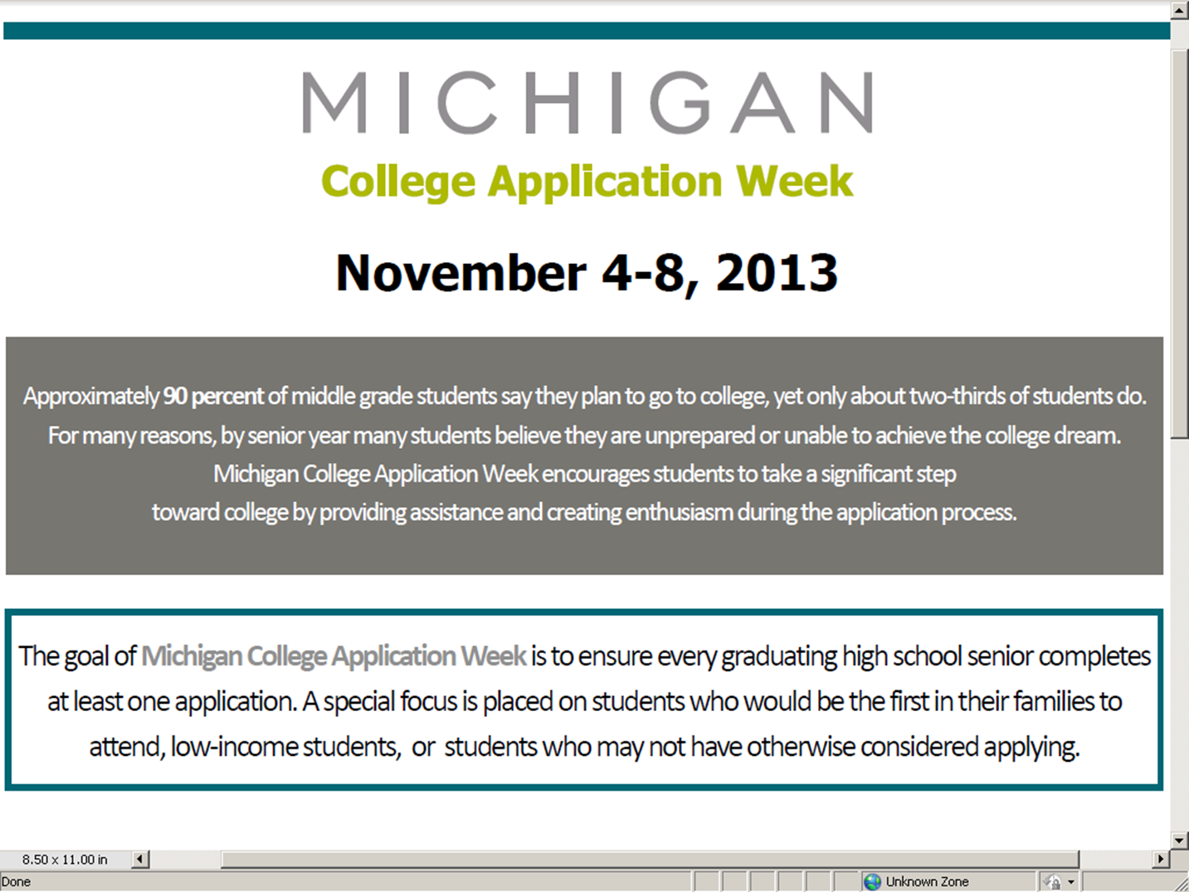

Slide 4
Sample Schedule
Week of October 28- Presentation to seniors
Week of November 4 (or beginning the Wednesday prior 10/30)
Monday: (Wednesday) Do online College Scavenger Hunt during advisory time
Tuesday: (Thursday) All staff wear their College Sweatshirt and encourage students to “ASK ME” about my college
Wednesday: (Friday) Pass out College BINGO Activity- to be completed throughout the day
Thursday: (Monday) Begin working with seniors on applications
(groups of 22-30, possibly during their Language Arts class)
Friday: (Tuesday) Wrap up

Slide 5
What We Need From You
A commitment to participate
Allow us to present at a staff meeting to get “buy in” from your staff
Send out Family Informative letter to all seniors
Set up a time to present to your students
Provide access to computers and a printer
Ask your Language Arts teachers to assign the “Common Application Essay” sometime in the month of October
___________________________________________________

Slide 6
Contact Information
Margie Dill, Clare Gladwin Career Center
989-229-8710
Karry Kiste, Educational Talent Search
989-386-6622 ext. 533
Chris Pellerito, Mid Michigan Community College
989-386-6660

Slide 7
QUESTIONS???

