Slide 1
Implementing the CCSS in Mathematics
August 2011

Slide 2
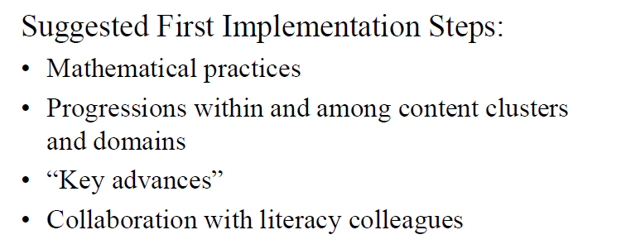
Implementing the CCSS in Mathematics

Slide 3
Underlying Framework

Slide 4
Underlying Framework

Slide 5
Our Task…

Slide 6
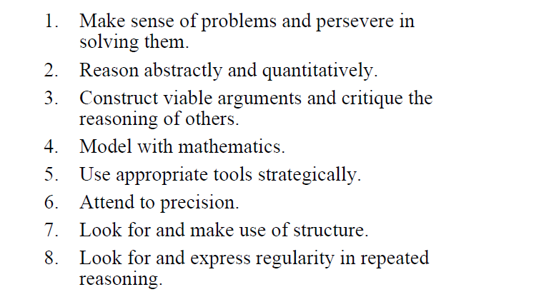
Mathematical Practices

Slide 7
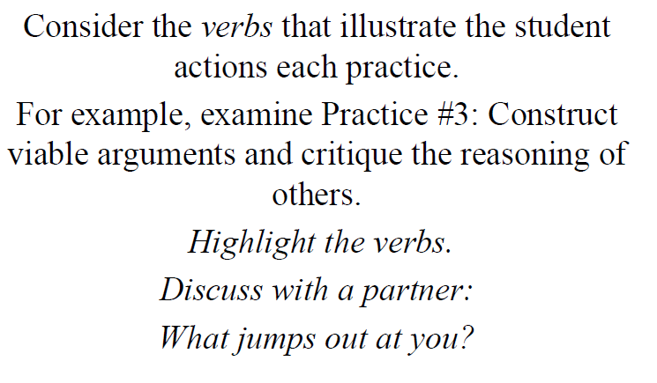
Standards of Mathematical Practice

Slide 8
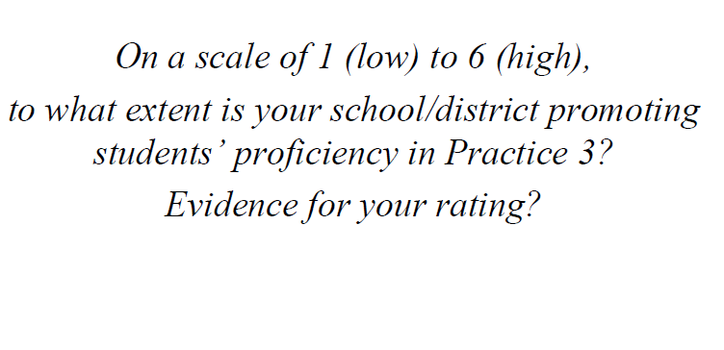
Standards of Mathematical Practice

Slide 9
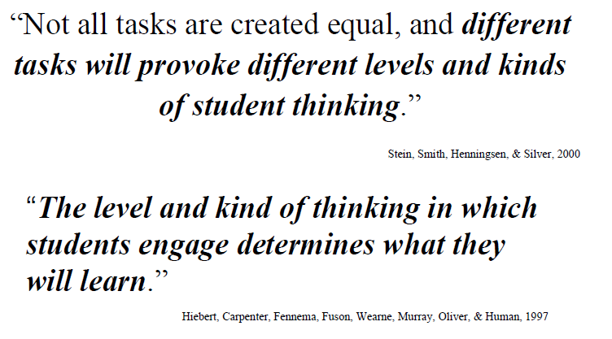
Alignment Issues

Slide 10
The Nature of Tasks used in the Classroom …

Slide 11
Teachers and Tasks to Learning

Slide 12
Mathematical Practices in the Classroom

Slide 13
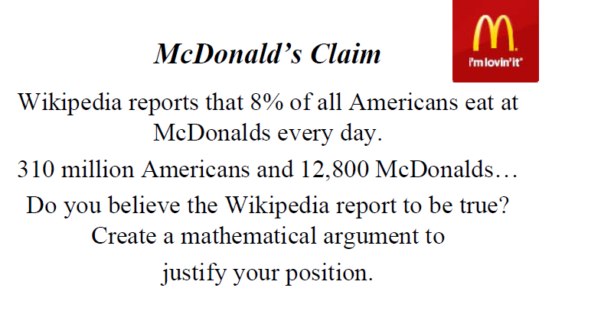
Mathematical Practices in the Classroom

Slide 14
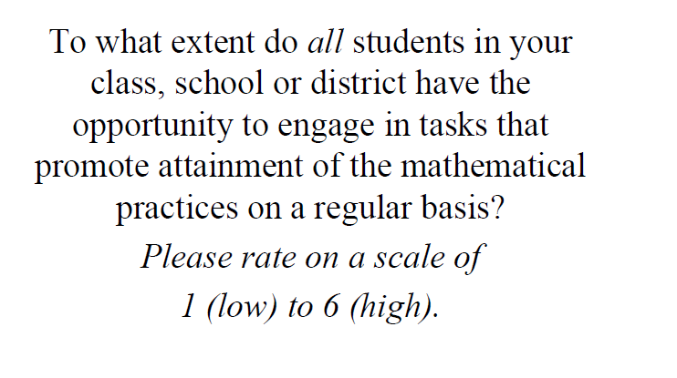
Guaranteed Curriculum
Standards Based Mathematics at Mathwire

Slide 15
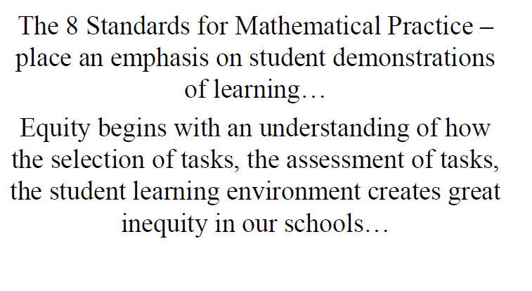
Implementing the CCSS

Slide 16
Curriculum Challenges!
Response to Intervention may be misused to sort students into groups that receive fundamentally different instruction.
Goal:
Target and monitor high-quality, Tier I (first good instruction) for all students.
All students need access to the core curriculum and opportunity to learn.

Slide 17
Curriculum Challenges!
Focus and coherence are not in the CCSS document.
Focus and coherence are in interpretations of the document.
Goal:
Coherence must be clear in the minds of teachers and students.
“What do students have to know and be able to do?”
MDE Crosswalk Documents

Slide 18
Curriculum Challenges!
Unpacking standards may perpetuate the check-list mentality.
Goal:
Unpack for essential understanding.
Unpack for big ideas.
Unpack for application and problem solving.

Slide 19
Implementing the CCSS

Slide 20
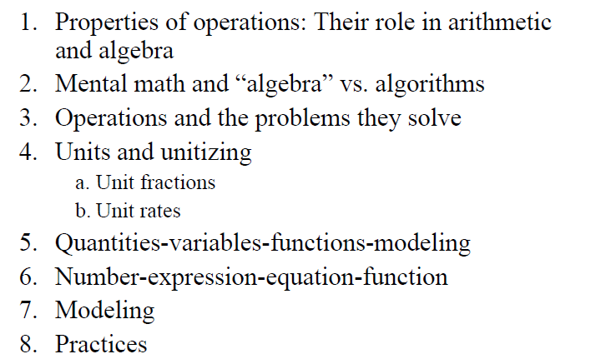
Key Advances
Page 90
Pages 88-89
Modeling:
Appendix A Pages 24-25
and Page 57

Slide 21
Curriculum Challenges!
Crosswalk documents may encourage rearrangements of low-quality curriculum materials and frameworks.
Goal:
Aim for focused, forward-thinking crosswalk documents.
Target the big ideas. Be skeptical of easy alignment and quick fixes.
Michigan Focal Points aligned with CCSS
Data Director MEAP/MME Strand Reports

Slide 22
Implementing the CCSS

Slide 23
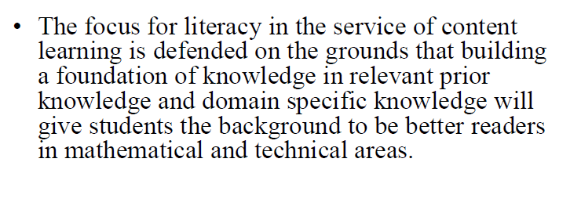
Content Learning and Literacy

Slide 24
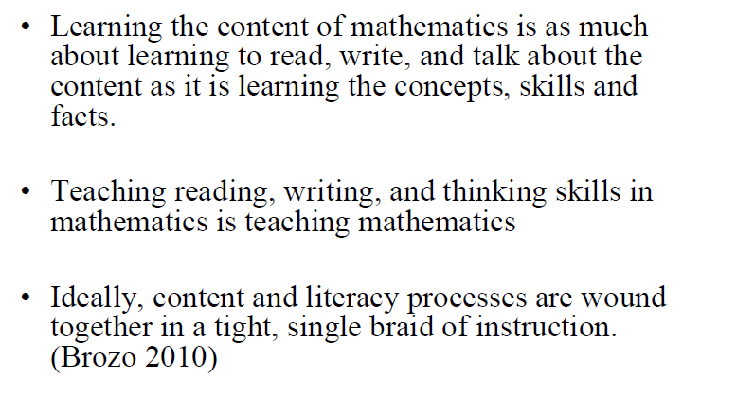
Content Learning and Literacy

Slide 25
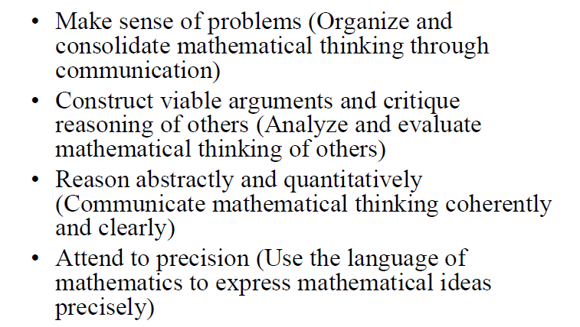
Mathematical Practices Support Communication

Slide 26
Implementing the CCSS

Slide 27
Tools and Resources
North Carolina Clarification
Learning Progressions (CCSS Team)
Ohio Model Curriculum
http://education.ohio.gov/GD/Templates/Pages/ODE/ODEDetail.aspx?page=3&TopicRelationID=1704&ContentID=83475&Content=107635
Michigan Model CCSS Lessons

Slide 28
Tools and Resources
Problem Solving Model
Inside Mathematics
http://www.insidemathematics.org/index.php/home
Hyperlinked CCSS Document
Mathematics Assessment Project
Mathematics Problem Solving Work Sample Tasks - Oregon Department of Education

Slide 29
Implementing the CCSS

