Slide 1
Collaborative Curriculum Groups
Common Core Initiative
MS Mathematics
CGRESD 2011 - 2015

Slide 2
Complete the Task at Your Table
Not all tasks are created equal:
Different tasks will provoke different
levels and kinds of student thinking.
The level and kind of thinking students engage in determines what they learn.
Hiebert, Carpenter, Fennema, Fuson, Wearne, Murray,
Oliver, and Human 1997

Slide 3
Curriculum Development
Next steps take us here.
2012 – 2013
2013 - 2014
Curriculum
Alignment
Curriculum
Mapping
The pacing guide is not your curriculum.
Curriculum
Pacing

Slide 4
Curriculum Mapping and Support 2012 - 2013
Curriculum mapping is a process that helps teachers monitor what is actually taught and learned throughout an entire year. We document and hold ourselves accountable to:
Common assessment development, revision, and use
  Common Interim Assessment Project
  Assessment Revision (Data Director Item Bank, etc.)
  Social Studies Assessment Project
Common unit design, revision, and implementation
  Rubrics for Unit/Lesson Review and Revision
  Resources and Materials
Common lesson planning
Common resource implementation
Common implementation of instructional strategies
  RAISE – Adolescent Literacy
  Argumentative Writing Book Study
  Mathematics for Teaching (K – 5)
  EMATHS Algebra I
Common implementation of strategies for meeting the needs of all students
  Gold Seal Lessons for Application and HOTS
  February Professional Learning – Differentiated Instruction
Common systems of support and acceleration
Curriculum mapping together with pacing moves us towards a fully articulated curriculum.

Slide 5
Today’s Outcomes
By the end of the session, participants will:
Identify and clarify assessment and instructional revision and support needed for student success with career and college readiness
Clarify and enhance understanding of the Depth of Knowledge Levels within CCSS and SBAC assessment items
Understand the types of SBAC assessment items

Slide 6
A Balanced Assessment System
Summative assessments
Benchmarked to career and college readiness
Teachers and schools have information and tools they need to improve teaching and learning
Common Core State Standards specify
K-12 expectations for career and college readiness
All students leave
high school career and college
ready
Teacher resources for
formative assessment practices
to improve instruction
Interim assessments
Flexible, open, used for actionable feedback
Our Work Lies Here
Taken from PPT from Dr. Dean @ MDE

Slide 7
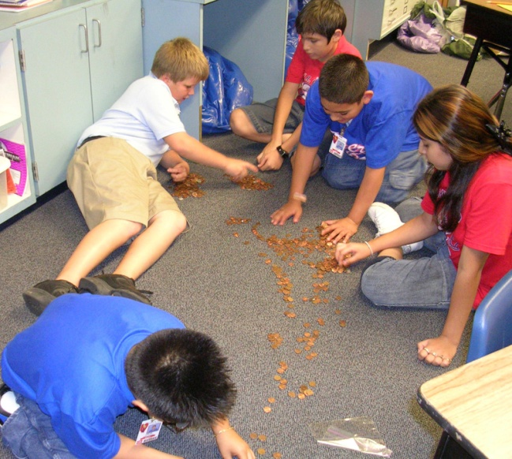

Standards for Mathematical Practice
The eight Standards for Mathematical Practice place an emphasis on students doing mathematics and demonstrating learning.
Equitable achievement will begin with an understanding of how the selection of tasks, the assessment of tasks, and the student learning environment can support or undermine equity in our schools.
Notes:
CCSS require a shift in professional practice and in student performance. If we are doing what we did last year, we are not aligning to the CCSS.
Central to this shift in practice are the tasks we choose to use each day in our classrooms.

Slide 8
CCSS Foundation: Reduce “Answer Getting”
How can I teach my kids to get the answer to this problem?
as opposed to…
CCSS Foundation:
How can I use this problem to teach the mathematics of this unit for student understanding?
YOU NEED TO: Be prepared to explain the difference between these two ways of approaching mathematics teaching. The mathematical practices must take center stage in all facets of the implementation of the CCCSSM.

Slide 9
Mathematics
Concepts and Procedures
  “Students can explain and apply mathematical concepts and interpret and carry out mathematical procedures with precision and fluency.”
Problem Solving
  “Students can solve a range of complex well-posed problems in pure and applied mathematics, making productive use of knowledge and problem solving strategies.”
Communicating Reasoning
  “Students can clearly and precisely construct viable arguments to support their own reasoning and to critique the reasoning of others.”
Data Analysis and Modeling
  “Students can analyze complex, real-world scenarios and can use mathematical models to interpret and solve problems.”
(a/o Round 2 – released 12/9/11)
Notes:
Claims – come from the CCR Standards and are the big picture of what we want kids to know and be able to do.
Summative assessment data from SMARTER will come back to us by claims, not by CCSS. Our work will begin to monitor student learning connected to claim #2.

Slide 10

DOK is about complexity
Every CCSS has been assigned a DOK level.
The type of thinking and application of intended student learning outcome determines the DOK level.
Instruction and classroom assessments must reflect the DOK level of the objective or intended learning outcome.
"I can recall what Webb's DOK is."
"I can recall critical characteristics of each of the four DOK levels”
Notes:
The complexity

Slide 11
Cognitive Rigor
Depth of Knowledge: The Role of Task
The level of complexity of the cognitive demand.
  Level 1: Recall and Reproduction
    Requires eliciting information such as a fact, definition, term,
    or a simple procedure, as well as performing a simple algorithm
    or applying a formula.
  Level 2: Basic Skills and Concepts
    Requires the engagement of some mental processing beyond
    a recall of information.
  Level 3: Strategic Thinking and Reasoning
    Requires reasoning, planning, using evidence, and explanations
    of thinking.
  Level 4: Extended Thinking
    Requires complex reasoning, planning, developing, and
    thinking most likely over an extended period of time.
Notes:
Smarter Balanced items and tasks will elicit evidence that students have the ability to integrate knowledge and skills across multiple assessment targets and are ready to meet the challenges of college and careers.
{+}
Items and tasks must be constructed at various levels of cognitive rigor. Smarter Balanced has defined four levels of depth of knowledge.
{+}
The first level focuses on recall and reproduction of facts and other types of information.
{+}
The second level focuses on basic skills and concepts that require cognitive processes that extend beyond the recall of information.
{+}
The third level focuses on strategic thinking and reasoning.
{+}
The fourth and final level requires extended thinking that includes complex reasoning, planning, development, and cognition that occurs over an extended period of time.
Let’s take a look at a sample item for each of the four levels of depth of knowledge.

Slide 12

DOK is not about difficulty...
Difficulty is a reference to how many students answer a question correctly.
“How many of you know the definition of exaggerate?”
DOK 1 – recall
If all of you know the definition, this question is an easy question.
“How many of you know the definition of high-muck-a muck?”
DOK 1 – recall
If most of you do not know the definition, this question is a difficult question.
"I can recall what Webb's DOK is."
"I can recall critical characteristics of each of the four DOK levels”
Notes:
Do we need this slide with the last one?

Slide 13
Karin Hess’ Differences Between Webb’ Depth of Knowledge and Bloom’s Taxonomy
Bloom focuses on “type of thinking” are you analyzing, evaluating, etc.
Webb focuses on “how deeply do you have to know the content and what mental processes do you need to engage in to be successful.
Webb’s DOK is not about difficulty or the type of thinking, but about complexity.

Slide 14
DOK Item/Task Review
What to do:
CCSS and DOK
Use your assessment and the brief description of the four levels of DOK.
Select at least ten (10) of the items (tasks) on your assessment. Assign each a DOK. Give a sentence or two explanation of why you selected the level you did to your shoulder partner.
Report out the percent of questions at which level as compared to the CCSS and implications for revision and alignment.

Slide 15
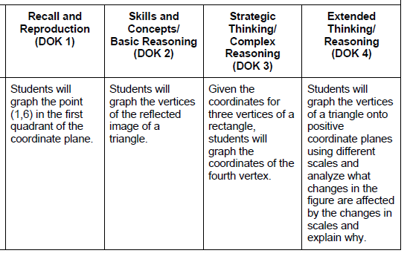
Revising Task for Cognitive Rigor
Using the same verb across DOK levels:

Slide 16
Reflection:
What? So What? Now What?
What have you learned? What is important about the learning? What actions will you take based on what we have talked about so far in regards to tasks, DOK, and higher level thinking?
  What do you/your colleagues need to know?
  What do you/your colleagues need to integrate into your practice?
  What steps will you take to share your understanding with your building leadership?

Slide 17
Common Core Mathematics Claims
Concepts and Procedures
  “Students can explain and apply mathematical concepts and interpret and carry out mathematical procedures with precision and fluency.”
Problem Solving
  “Students can solve a range of complex well-posed problems in pure and applied mathematics, making productive use of knowledge and problem solving strategies.”
Communicating Reasoning
  “Students can clearly and precisely construct viable arguments to support their own reasoning and to critique the reasoning of others.”
Data Analysis and Modeling
  “Students can analyze complex, real-world scenarios and can use mathematical models to interpret and solve problems.”
(a/o Round 2 – released 12/9/11)
Notes:
Claims – come from the CCR Standards and are the big picture of what we want kids to know and be able to do.
Summative assessment data from SMARTER will come back to us by claims, not by CCSS. Our work will begin to monitor student learning connected to claim #2.

Slide 18
Claim 1
Targeted by Grade Level
Concepts and Procedures:
Students can explain and apply mathematical concepts and interpret and carry out mathematical procedures with precision and fluency. (~ 40% of the SBAC assessment)
Selected Response
Constructed Response
Technology-Enhanced
Extended Response and Performance Tasks
Notes:
For mathematics, there are four claims.
{+}
Claim 1 focuses on Concepts and Procedures. Claim 1 requires students to explain and apply mathematical concepts and interpret and carry out mathematical procedures with precision and fluency. The focus is on content knowledge learned at the grade level being assessed. A variety of item types are used to collect evidence for Claim 1, including:
{+}
selected response, constructed response, and technology-enhanced items and tasks that focus on a particular skill or concept.
{+}
Content for this claim may also be evaluated at a deeper level with extended-response items and performance tasks. Items and tasks have a direct connection to and emphasis on the content domains and clusters of the Common Core State Standards for Mathematics.

Slide 19
Formats and Components of
Selected Response Items
Traditional Selected Response Item
Key and Distractor Analysis
Which number is both a factor of 100 and a multiple of 5?
A. 4
B. 40
C. 50
Did not consider criteria
of “multiple of 5”
Did not consider criteria
of “factor of 100”
Correct
Multiplied 100 and 5
Which number is both a factor of 100 and a multiple of 5?
A. 4
B. 40
C. 50
D. 500
RATIONALE
STEM
Statement of
the question
KEY
DISTRACTOR
OPTIONS: Possible answers the students must select from
DOK 1
Notes:
The Smarter Balanced Assessment will be using both traditional and non-traditional selected response items. First let’s take a look at the format and components of a traditional selected response item.
{+}
This item is a traditional multiple-choice item with a stem and four options.
{+}
The stem is the statement of the question to which the student responds.
{+}
The options are possible answers from which students must select. Options should be arranged according to a logical order such as numerically or alphabetically. There are four different ways to respond to this item and only one correct answer.
{+}
Distractors are the incorrect options.
{+}
A key and distractor analysis accompanies each selected response item.
{+}
The key identifies the correct response.
{+}
In addition, a rationale for each incorrect response is provided. Incorrect responses should be based on the likely errors students will make and common misunderstandings. For example in the case of a two-step problem, a student may solve only the first step, making the solution to the first step an excellent distractor. The distractor analysis explains the rationale a student might use to select each option. It is important the distractors and the key are balanced. No one option should be obviously different from the others.

Slide 20
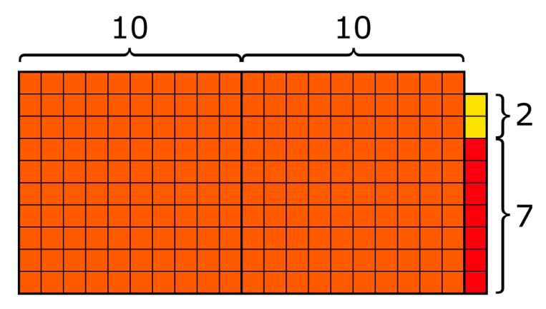
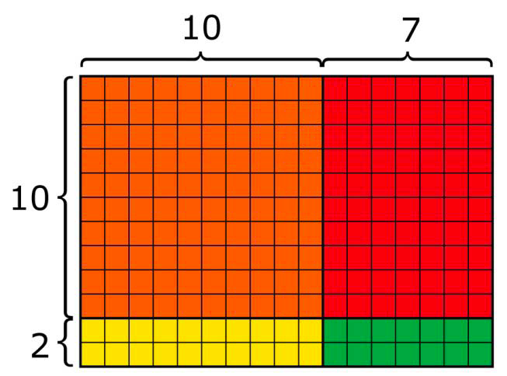
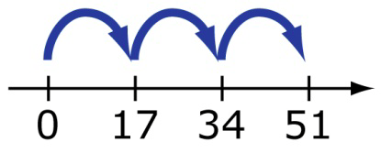
SBAC Non-Traditional
Selected Response Item
STEM
STIMULUS
Which model(s) below could represent the solution to this problem?
Select all that apply.
A multiplication problem is shown below.
17 × 12
Which model(s) below could represent the solution to this problem?
Select all that apply.
17 × 12
(1×1)+(1×7)+(1×2)+(2×7)
A.
B.
C.
DOK 2
F.
D.
E.
(17×2)+(17×1)
Notes:
This is a more complex selected-response item. This item has a stem, stimulus, and six options.
{+}
Like the previous item, the stem is the statement of the question to which the student responds and the options are possible answers the students must select from.
{+}
The stimulus is the text, source, and/or graphic about which the item is written.
The stimulus provides the context of the item or task to which the student must respond. Here the student is provided with options in which more than one option is correct.
{+}
Unlike the prior item that had only one correct response, this item contains more than one option that is correct.

Slide 21
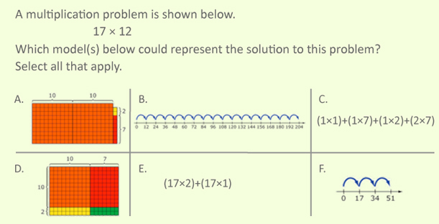
SBAC Non-Traditional
Selected Response Item
Key and Distractor Analysis:
Does not understand how to model
multiplication of two two-digit
numbers using area models.
Correct
Did not account for the values
of the digits in the tens places.
Correct
Did not understand that the 1 represents 10 in the multiplication problem
Showed multiplication of 17 and (1 + 2) instead of 17 and 12
Responses to this item will receive 0–2 points, based on the following:
2 points: B, D
1 point: Either B or D
0 points: Any other combination of selections.
Notes:
The scoring rubric describes how points are awarded for an item or task. The number of points a student can earn on a selected response item will vary.
{+}
This item is worth two points. The student earns two points for selecting options B and D, 1 point for selecting only option B or only option D, and no points for any other combination of selections.

Slide 22
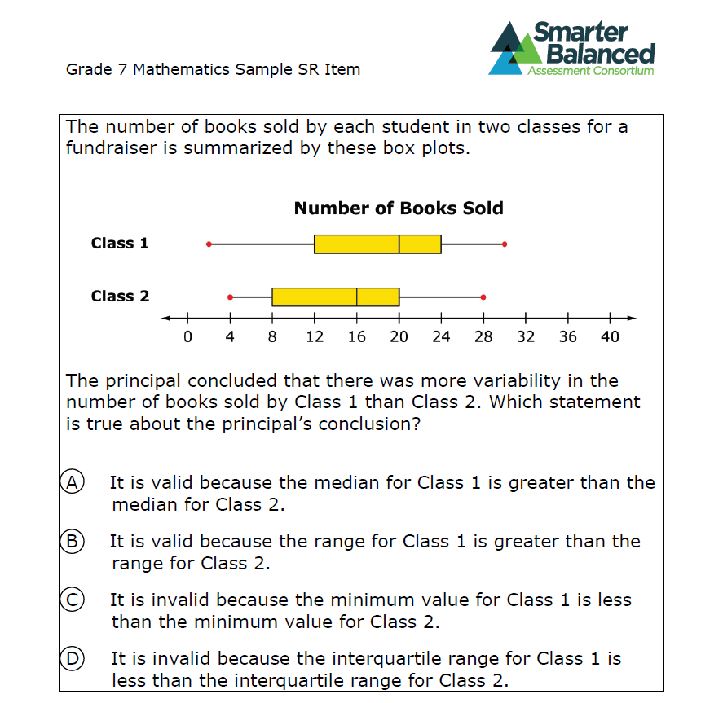
SBAC Non-Traditional
Selected Response Item
DOK 2

Slide 23
Constructed Response Items
Rationale:
Administration:
  Address assessment targets and claims that
  are of greater complexity
  Require more analytical thinking and reasoning
  Will be either brief or extended
Administered during the computer-adaptive component
Scored using artificial intelligence
Most constructed response items take between 1 and 5 minutes to complete
Some more complex items may take up to
10 minutes to complete
Notes:
Constructed response items are brief open-response items that focus on a particular skill or concept. Constructed response items address assessment targets and claims that are of greater complexity, requiring more analytical thinking and reasoning than a selected response can elicit.

Slide 24
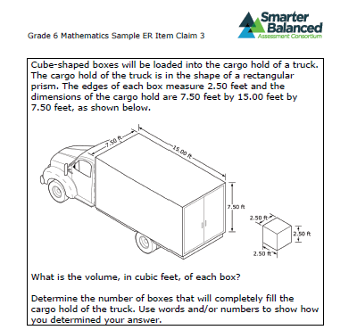
Components of
Constructed Response Item
STIMULI
DOK 2
STEM
Notes:
All constructed response items are worth from 2 to 4 points.
{+}
Let’s take a look at an example of a 2 point constructed response item.
{+}
Like selected response items, constructed response items have a stem and stimulus.
All constructed response items also include a scoring rubric and a sample top score.
{+}
The scoring rubric for each task should reflect the values set out for the claim being assessed, giving substantial weight to the choice of appropriate methods for solving the problem presented by the task, to reliable application of skills to develop a solution, and to explanations of what has been found.
{+}
The sample top score is an example of a complete and thorough top-score response. The language should model what is expected from a student at the grade level being assessed.

Slide 25
Technology-Enhanced Items
Specialized interaction
May have digital media for stimulus
Same requirements as selected and constructed response items
Students manipulate information
Defined responses
View SMARTER Balanced Sample Items
http://sampleitems.smarterbalanced.org/itempreview/sbac/index.htm
Notes:
Technology-enhanced items are computer delivered items that require
{+}
specialized interactions students must perform to produce a response. Responses produced by a technology-enhanced item require students to do something other than write text or numbers, or select from among a set of options.
{+}
These items may also include digital media as the stimulus.
{+}
Technology-enhanced items should conform to the same essential requirements that we already discussed for writing quality selected response and constructed response items.
{+}
The only difference is that they allow students to manipulate information in ways that are not possible with traditional selected response and constructed response items.
{+}
Like selected response items, technology-enhanced items have defined responses that can be scored in an automated manner.

Slide 26

Implementing the Common Core
http://blog.mrmeyer.com/
http://threeacts.mrmeyer.com/splittime/
Snapshots: Implementing the Common Core

Slide 27
Claim 2 – Problem Solving
Across All Grade Levels
Selected Response, Constructed Response, Extended Response, and Technology-Enhanced items that focus on problem solving
Items and tasks require students to construct their own pathway to the solution
Relevant verbs include:
  understand, solve, apply, describe, illustrate, interpret, and analyze
Notes:
Claim 2 focuses on problem solving and requires students to solve a range of complex, well-posed problems in pure and applied mathematics, making productive use of knowledge and problem solving strategies.
{+}
Evidence for Claim 2 is elicited through selected response, constructed response, extended response, and technology-enhanced items and tasks that focus on problem solving.
{+}
Claim 2 items and tasks should require students to construct their own pathway to the solution.
{+}
Some relevant verbs that identify content clusters and/or standards for Claim 2 include understand, solve, apply, describe, illustrate, interpret, and analyze.

Slide 28
Assessment Targets
Claim 2 – Problem Solving
Claim 2: Students can solve a range of complex well-posed problems in pure and applied mathematics, making productive use of knowledge and problem solving strategies.
Apply mathematics to solve well-posed problems arising in everyday life, society, and the workplace
Select and use tools strategically
Interpret results in the context of the situation
Identify important quantities in a practical situation and
map their relationships.
Notes:
Claim 2 focuses on Problem Solving. The purpose of this claim is to elicit evidence that students can solve a range of complex well-posed problems in pure and applied mathematics and can make productive use of knowledge and problem solving strategies. Items and tasks written to assessment targets for this claim will ask students to:
{+}
Apply mathematics to solve well-posed problems arising in everyday life;
{+}
select and use tools strategically;
{+}
Interpret results in the context of a situation;
{+}
And identify important quantities in practical situations and to map their relationships.
Items and tasks written for Claim 2 will provide evidence for several of the Claim 2 assessment targets. Each target should not lead to a separate task: it is in using content from different areas, including work studied in earlier grades, that students demonstrate their problem solving proficiency.”

Slide 29
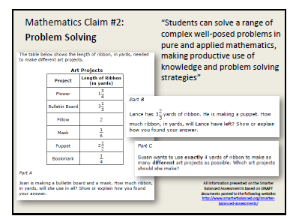
Claim #2: Problem Solving
DOK 3

Slide 30
Claim 3 – Communicating Reasoning
Across All Grade Levels
Constructed Response, Extended Response, and Technology-Enhanced items and tasks that focus on mathematical reasoning
Relevant verbs include:
  understand, explain, justify, prove, derive, assess, illustrate, and analyze
Notes:
Claim 3 focuses on communicating reasoning and requires students to clearly and precisely construct viable arguments to support their own reasoning and to critique the reasoning of others.
{+}
Evidence for Claim 3 is elicited through constructed response, extended response, and technology-enhanced items and tasks that focus on mathematical reasoning.
{+}
Relevant verbs that identify content clusters and/or standards for Claim 3 include understand, explain, justify, prove, derive, assess, illustrate, and analyze.

Slide 31
Assessment Targets
Claim 3 – Communicating Reason
Claim 3: Students can clearly and precisely construct viable arguments to support their own reasoning and to critique the reasoning of others.
Test propositions or conjectures with specific examples.
Construct, autonomously, chains of reasoning that justify or refute propositions or conjectures.
State logical assumptions being used.
Use the technique of breaking an argument into cases.
Distinguish correct logic or reasoning from that which is flawed,
and—if there is a flaw in the argument—explain what it is.
Base arguments on concrete referents such as objects, drawings, diagrams, and actions.
Determine conditions under which an argument does and
does not apply.
Notes:
Claim 3 focuses on Communicating Reasoning. The purpose of this claim is to elicit evidence that students can clearly and precisely construct viable arguments to support their own reasoning and to critique the reasoning of others. Items and tasks written for this claim will ask students to explain his or her reasoning, justify a conjecture, and assess the validity of a claim.
The Claim 3 targets require students to:
{+}
Test propositions or conjectures;
{+}
Construct chains of reasoning that justify or refute propositions or conjectures;
{+}
State logical assumptions that are made;
{+}
Use techniques of breaking arguments into cases;
{+}
Distinguish correct logic and flawed reasoning and explain what it is
{+}
Base arguments on concrete referents
{+}
And determine conditions under which an argument does and does not apply.
Items and tasks written for Claim 3 will provide evidence for several of the Claim 3 assessment targets. Each target should not lead to a separate task. Tasks generating evidence for Claim 3 in a given grade will draw upon knowledge and skills articulated in the standards in that same grade, with strong emphasis on the major work of the grade.”

Slide 32
Common Interim Tasks 1 - 9
Extended
Constructed Response
Address Claims 2 and 3 and Claim 1 ‘mathematics content’
Address the Math Practices
Rubric Scored
Our Work:
Teachers and schools have information and tools they need to improve teaching and learning
Teacher resources for
formative assessment practices
to improve instruction
Interim assessments
Flexible, open, used for actionable feedback

Slide 33
Shift in How We Instruct
Reducing “Teaching for Answer Getting”
Teacher instructs students in a concept or skill.
Teacher solves example problems with the class.
Students practice on their own while the teacher assists individual students.
Teacher introduces problems.
Students struggle with the problem.
Various students present ideas or solutions to the class.
The class discusses the various solution methods.
The teacher summarizes the class’ conclusion.
The students practice similar problems.
The students practice their new understanding in a new context.
Accessible Mathematics: 10 Instructional Shifts That Raise Student Achievement, S. Leinwand, 2009

Slide 34
Claim 4 – Modeling and Data Analysis
Performance Tasks and collections of
Extended Response items
Real world problems
Draw upon knowledge and skills articulated
in the progression of standards up to the grade
being assessed
Relevant verbs include:
  model, construct, compare, investigate, build, interpret, estimate, analyze, summarize, represent, solve, evaluate, extend, and apply
Notes:
Claim 4 focuses on modeling and data analysis and requires students to analyze complex, real-world scenarios and construct and use mathematical models to interpret and solve problems.
{+}
Evidence for Claim 4 is elicited through performance tasks and collections of extended response items that focus on modeling and data analysis.
{+}
Claim 4 tasks are real world problems that are complex and may contain insufficient or superfluous data.
{+}
Tasks generating evidence for Claim 4 in a given grade will draw upon knowledge and skills articulated in the progression of standards up to that grade, with strong emphasis on the major work of the grade.
{+}
Relevant verbs that identify content clusters and/or standards for Claim 4 include model, construct, compare, investigate, build, interpret, estimate, analyze, summarize, represent, solve, evaluate, extend, and apply.

Slide 35
Assessment Targets
Claim 4 – Model and Solve Problems
Across All Grade Levels
Claim 4: Students can analyze complex, real-world scenarios and can construct and use mathematical models to interpret and solve problems.
Apply mathematics to solve problems arising in everyday life, society, and the workplace.
Construct, autonomously, chains of reasoning to justify mathematical models used, interpretations made, and solutions proposed for a complex problem.
State logical assumptions being used.
Interpret results in the context of a situation.
Analyze the adequacy of and make improvement to an existing model
or develop a mathematical model of a real phenomenon.
Identify important quantities in a practical situation and map their relationships.
Identify, analyze, and synthesize relevant external resources to pose or solve problems.
Notes:
Claim 4 focuses on modeling and data analysis. Claim four requires extended response items and performance tasks that elicit evidence that students can analyze complex, real-world scenarios and can construct and use mathematical models to interpret and solve problems. Items and tasks written for this claim will ask students to investigate problems that have more than one solution pathway, summarize the results within the context of the problem, and evaluate the solution within the context of the problem.
The assessment targets associated with Claim 4 require students to:
{+}
Apply mathematics to solve problems arising in everyday life;
{+}
Construct chains of reasoning to justify mathematical models used, interpretations made, and solutions proposed for complex problems;
{+}
State logical assumptions that are made;
{+}
Interpret results in the context of a situation;
{+}
Analyze the adequacy of and make improvements to an existing model or develop a mathematical model of a real phenomenon;
{+}
Identify important quantities in a practical situation and map their relationships;
{+}
And identify, analyze, and synthesize relevant resources to pose or solve problems.
Items and tasks written for Claim 4 will provide evidence for several of the Claim 4 assessment targets. Each target should not lead to a separate task. Tasks generating evidence for Claim 4 in a given grade will draw upon knowledge and skills articulated in the progression of standards up to that grade, with strong emphasis on the “major” work of the grades.
Now, let’s shift our focus from the claims and assessment targets specified in the Content Specifications to the additional information presented in the Item Specifications.

Slide 36
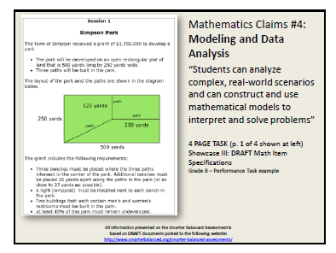
Claim #4: Modeling
DOK 4

Slide 37
Reflection:
What? So What? Now What?
What actions will you take based on what we have talked about so far in regards to tasks, DOK, and item types?
What has been clarified about the MPs? Why is the information important to teaching mathematics in your building? What action needs to be taken around “the mathematical practices must take center stage in all facets of the implementation of the CCSSM”?
  What do you/your colleagues need to know?
  What do you/your colleagues need to integrate into your practice?
  What steps will you take to share your understanding with your building leadership?

Slide 38
Implementing the Common Core
http://www.insidemathematics.org/index.php/classroom-video-visits/public-lessons-quadratic-functions/279-quadratic-functions-problem-1-part-a
Snapshots: Implementing the Common Core
Tasks + Teacher + Student = Mathematical Learning

Slide 39
Implementation Resource Websites
SMARTER Balanced Sample Items
http://sampleitems.smarterbalanced.org/itempreview/sbac/index.htm
Data Director Item Bank Referenced to CCSS
https://www98.achievedata.com/cgresd/?prev_page=News&page=Login
Mathematics Assessment Project
http://map.mathshell.org/materials/index.php
Inside Mathematics
http://www.insidemathematics.org/
The Consortium for Mathematics and Its Applications
http://www.comap.com/

Slide 40
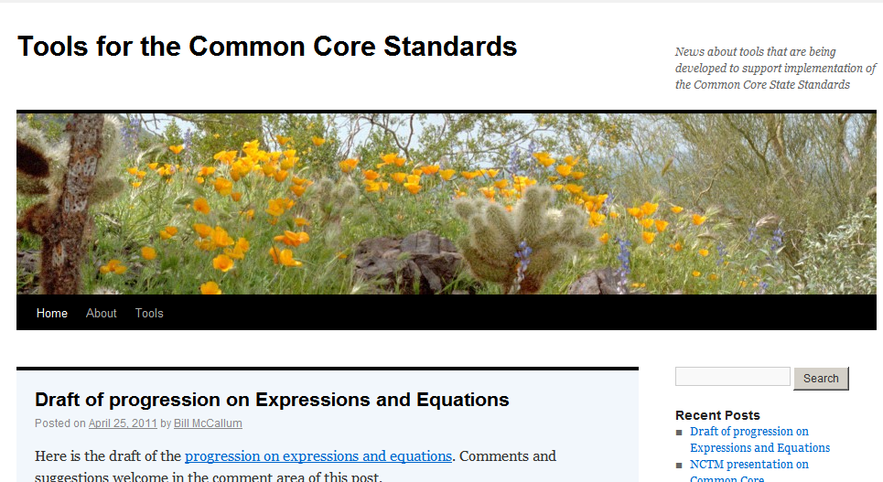
Important Websites
Bill McCallum Common Core Tools
http://commoncoretools.wordpress.com/

Slide 41

Important Websites
Bill McCallum’s Progressions
http://ime.math.arizona.edu/progressions/

Slide 42

Important Websites, cont.
Bill McCallum’s Illustrative Math
http://illustrativemathematics.org/

Slide 43
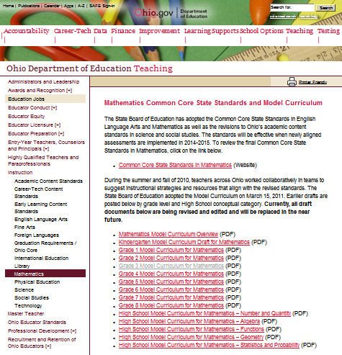
Important Websites
Ohio Progressions
http://www.ode.state.oh.us/GD/Templates/Pages/ODE/ODEDetail.aspx?page=3&TopicRelationID=1704&ContentID=83475

Slide 44

Resources from North Carolina
http://www.dpi.state.nc.us/acre/standards/support-tools/#crmath

Slide 45
Curriculum Development
We need to be here!
2014 - 2015
Curriculum
Mapping
Curriculum
Alignment
Curriculum
Pacing

Slide 46

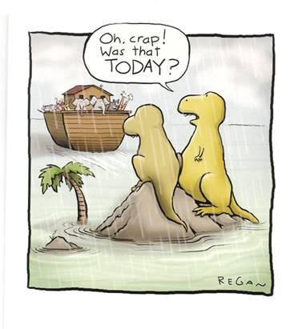
Prepare Mathematically Proficient Students

Slide 47
What is Curriculum Alignment?
Curriculum alignment refers to alignment between the
Intended Curriculum (CCSS and/or GLCEs and HSCEs),
Delivered Curriculum (content, skills, critical thinking actually delivered by each teacher), and
Achieved Curriculum (content, skills, level of thinking actually learned by students).

Slide 48
Reflection: Now What?
What actions will you take based on what we have talked about today?
  What do you/your colleagues need to know?
  What do you/your colleagues need to integrate into your practice?
  What steps will you take to share your understanding with your building leadership?

